Slide 1
Secure and Sustainable System Scaling
Abdullah Giray Yağlıkçı
UC Berkeley
August 5, 2025
Notes:
Hi, my name is Giray and today I will give a high-level overview of my PhD research and future research plans

Slide 2

Brief Self Introduction
Researcher
SAFARI Research Group since 2016
ETH Zurich (Sep 2024 - ongoing) Postdoc Researcher and Lecturer
ETH Zurich (Feb 2018 – Aug 2024) PhD Student and Teaching and Research Assist.
Intel Labs (Aug 2017 – Feb 2018) Research Assist.
Carnegie Mellon University (Aug 2016 – Aug 2017) Research Assist.
Earlier:
Univ. of Notre Dame, IN, USA (Aug 2014-Aug 2016)
TOBB Univ., Ankara, Turkey (Aug 2011-Aug 2014)
Research interests:
Computer arch., memory subsystem
Hardware security, dependability, and sustainability
Hardware/software cooperation
Testing and verification
…
Abdullah Giray Yaglikci Postdoc and Lecturer ETH Zurich
https://agyaglikci.github.io
agirayyaglikci@gmail.com
PhD: ETH Zurich, 2024
Incoming Faculty at CISPA Helmholtz Institute Center for Information Security, Privacy, and Accountability

Slide 3

System Scaling in Two Aspects
Scaling down manufacturing technology
Higher performance
Lower energy consumption
Circuit-level failure mechanisms
Mitigations incur
high hardware complexity
high energy consumption
reduced availability
Scaling out systems in a distributed manner
Lower cost of ownership
Dynamic scaling on demand
Security and privacy concerns can prevent achieving the full potential
Encryption worsens latency and energy
Isolation leads to subpar utilization
Pros
Manufacturing
Technology Node Scaling
Cons
Pros
Cons

Slide 4
Systems should scale
robustly and sustainably
as chips get denser
and many users share systems

Slide 5
Towards Robust and Sustainable Scaling
Pre-PhD Research
Understanding and reducing memory access latency
Understanding and reducing memory energy consumption
PhD Research
Understanding read disturbance failures in main memory
Mitigating read disturbance failures in main memory
Post-PhD Research
Improving the availability of data and resources while mitigating read disturbance failures in main memory
Future Research
Hardware-software co-design
Data-centric robustness
Better understanding of hardware failures
for technology node scaling AND scale-out systems

Slide 6

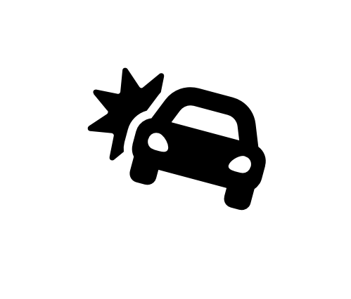


Memory Isolation
Data Loss or Corruption
access
Compromise Application Correctness
1 → 0
Leak Private Information
Memory
Take Over a Computer
Data integrity and confidentiality issues may emerge
Rule of thumb: An access to one memory address should not have unintended side effects on data stored in other addresses
Memory isolation is difficult in modern memory chips

Slide 7
Read Disturbance in Modern Memory Chips
Prevalent memory technology: Dynamic Random Access Memory (DRAM)
DRAM stores data in the form of electrical charge on a capacitor
DRAM leaks charge over time and needs periodic refresh
DRAM Read Disturbance: Accessing a DRAM cell disturbs other physically nearby cells and exacerbates their charge leakage
Wordline
Bitline
Charge
leakage
paths
Notes:
Dynamic random access memory (DRAM) is the prevalent memory technology today. [CLICK]
DRAM stores a bit of data in the form of electrical charge on a capacitor [CLICK]
To access we assert a wire called wordline [CLICK]
Which enables a transistor, conducting the capacitor to another wire called bitline [CLICK]
DRAM is a volatile memory technology as it leaks charge over time and needs to be periodically refreshed [CLICK]
Accessing a DRAM cell disturbs other physically nearby cells and exacerbates their charge leakage. This is called DRAM read disturbance [CLICK]

Slide 8
RowHammer: An Example of DRAM Read Disturbance
DRAM Subarray
Row 0
Row 1
Row 1
Victim Row
Row 2
Row 2
Row 2
Row 2
Row 2
Row 2
open
open
open
closed
closed
Aggressor Row
Aggressor Row
Row 3
Row 3
Row 2
Victim Row
closed
Row 4
Repeatedly opening (activating) and closing (precharging)
a DRAM row causes read disturbance bitflips in nearby cells
and breaks memory isolation
Notes:
A prime example of DRAM read disturbance is RowHammer, which I will show in this slide.
DRAM cells are organized in 2 dimensional arrays as rows and columns and internally accessed in a DRAM row granularity. For example, to access a data stored in Row 2, [CLICK]
We first need to open Row 2, and then perform accesses. Once we need to access another row, we need to close Row 2 and open the other row [CLICK]
[BACK& FORTH] If we keep opening and closing this row many times, called hammering a row, [CLICK]
We observe bitflips in physically nearby DRAM rows [CLICK]
This phenomenon is called RowHammer. We refer to the hammered row as the aggressor row and the rows that are affected as victim rows. [CLICK]

Slide 9
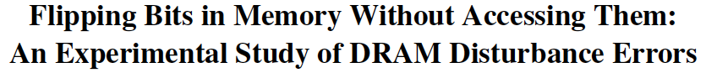
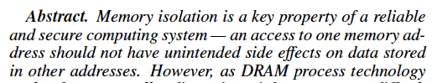
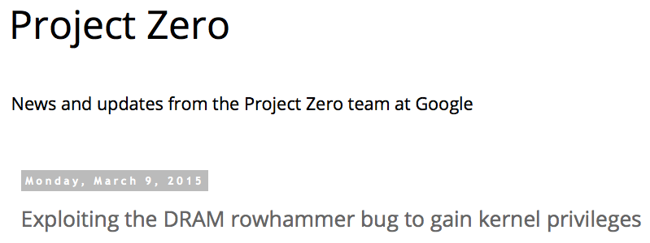
One Can Take Over an Otherwise-Secure System in 2015
Flipping Bits in Memory Without Accessing Them: An Experimental Study of DRAM Disturbance Errors (Kim et al., ISCA 2014)
Exploiting the DRAM rowhammer bug to gain kernel privileges (Seaborn, 2015)
Induce bit flips in page table entries (PTEs).
Gain write access to its own page table, and hence gain read-write access to all of physical memory.

Slide 10
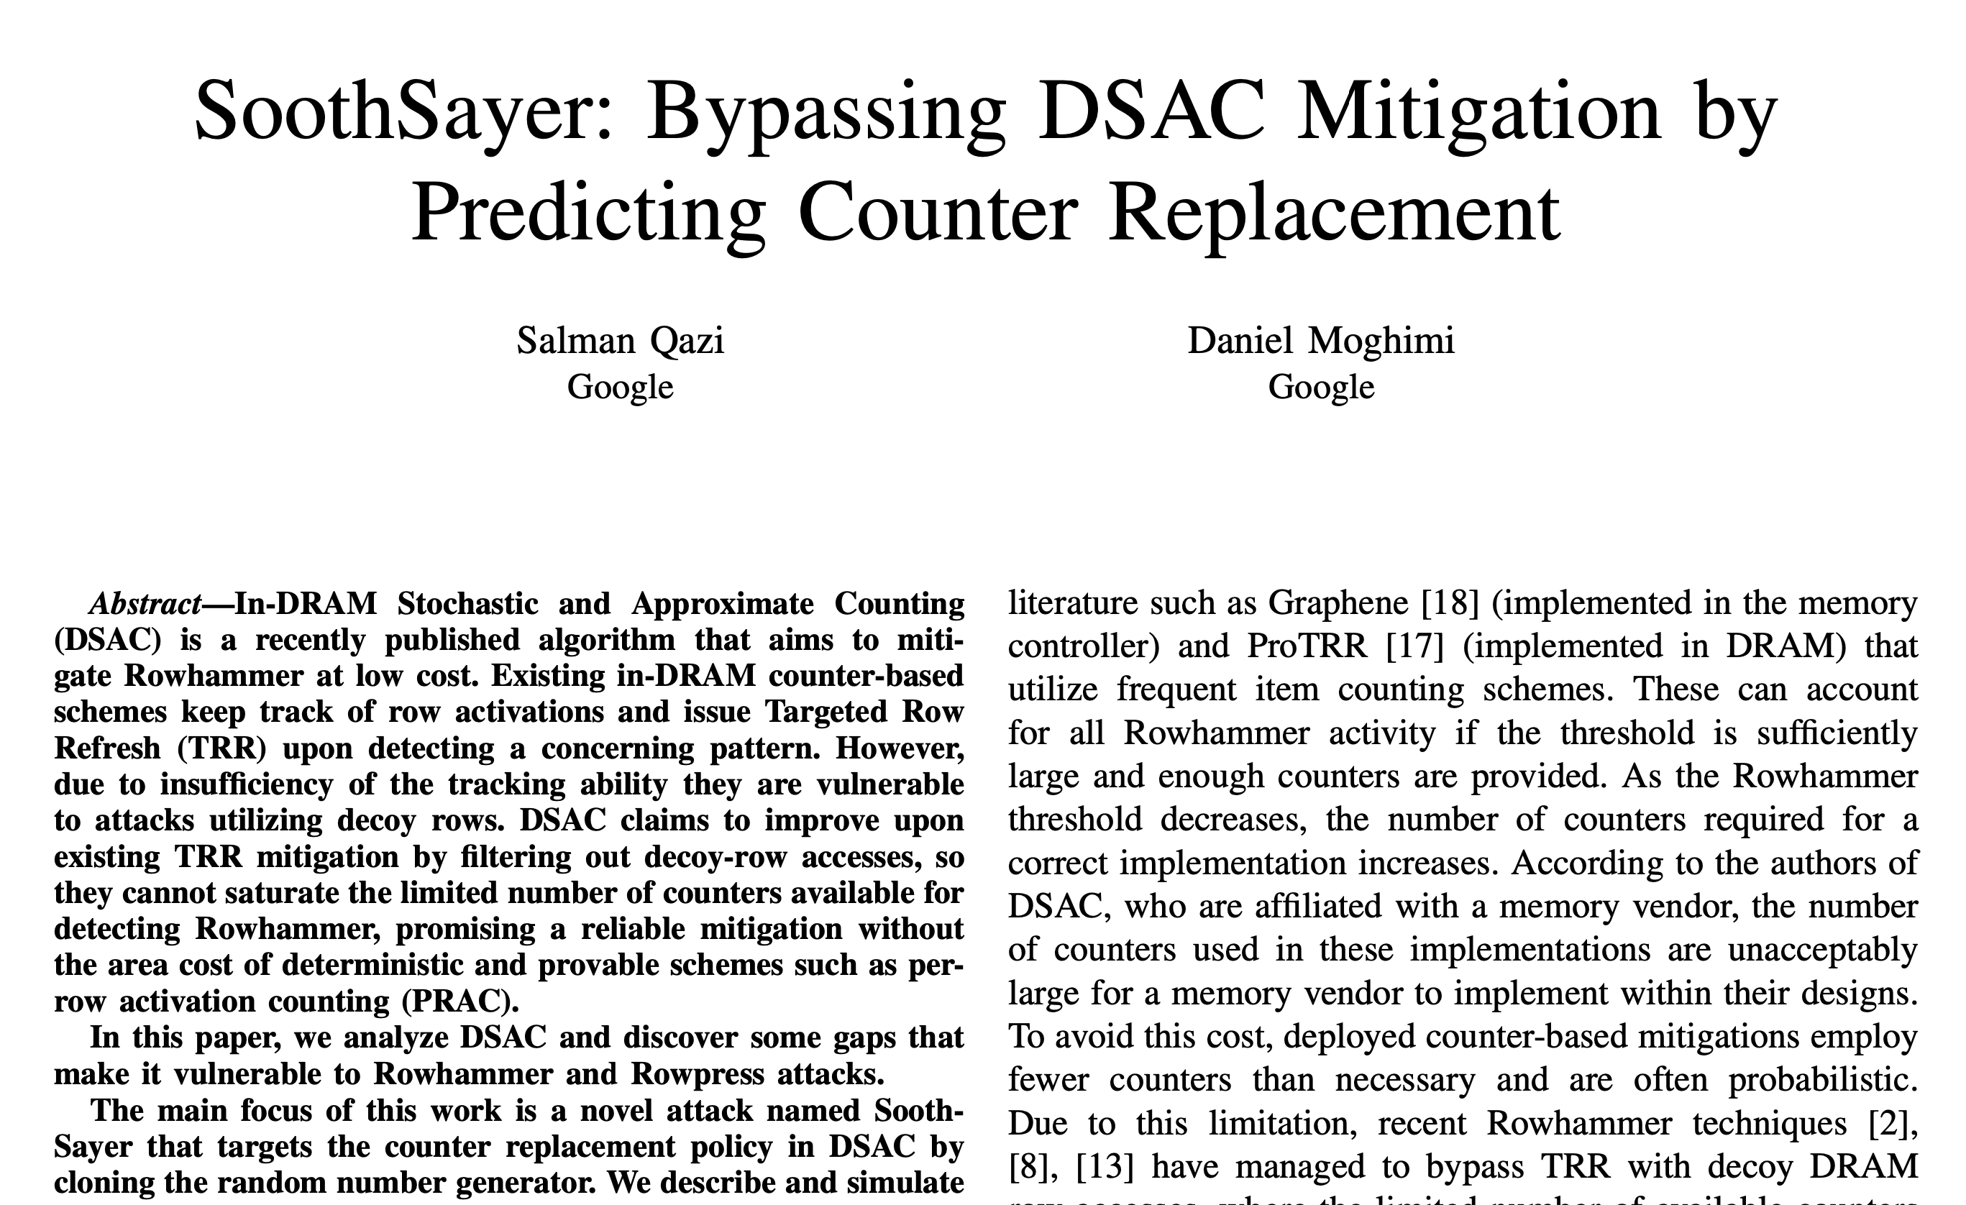
Fast Forward: Breaking Samsung’s Best Practice in 2024
Salman Qazi and Daniel Moghimi, “SoothSayer: Bypassing DSAC Mitigation by Predicting Counter Replacement,” DRAMSec, 2024

Slide 11
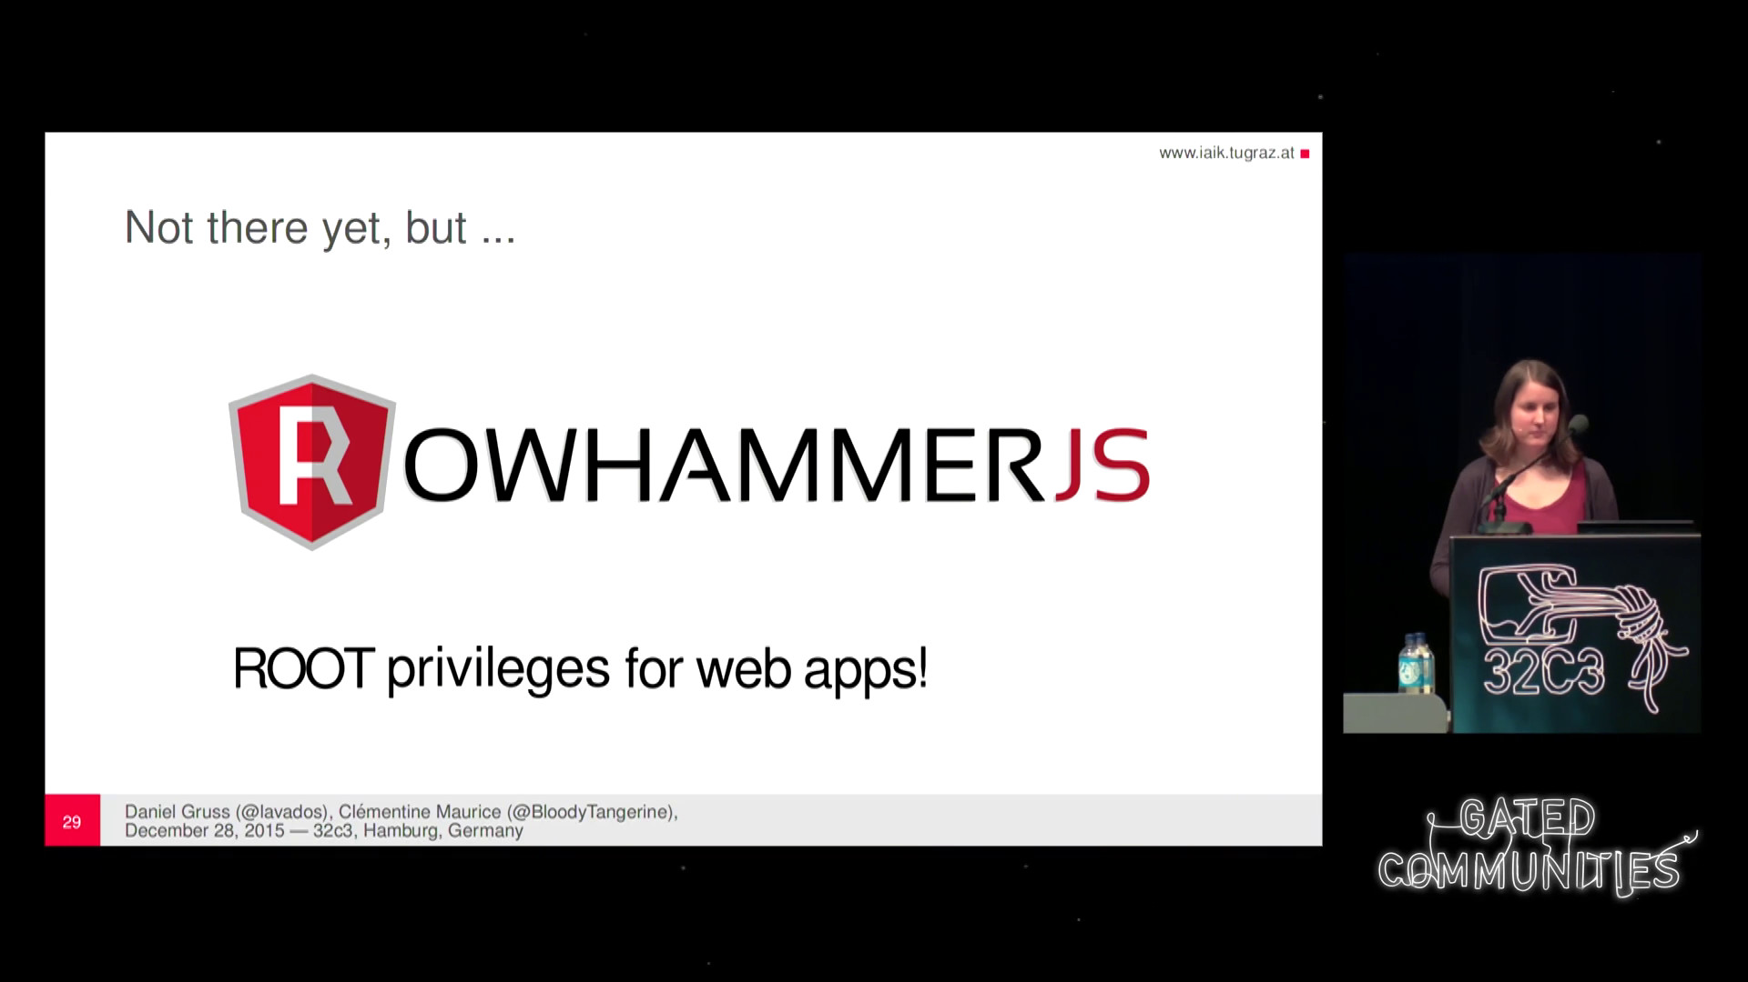
More Security Implications (I)
“We can gain unrestricted access to systems of website visitors.”
Rowhammer.js: A Remote Software-Induced Fault Attack in JavaScript (DIMVA’16)
Source: https://lab.dsst.io/32c3-slides/7197.html

Slide 12

More Security Implications (II)
“Can gain control of a smart phone deterministically”
Drammer: Deterministic Rowhammer Attacks on Mobile Platforms, CCS’16
Source: https://fossbytes.com/drammer-rowhammer-attack-android-root-devices/

Slide 13
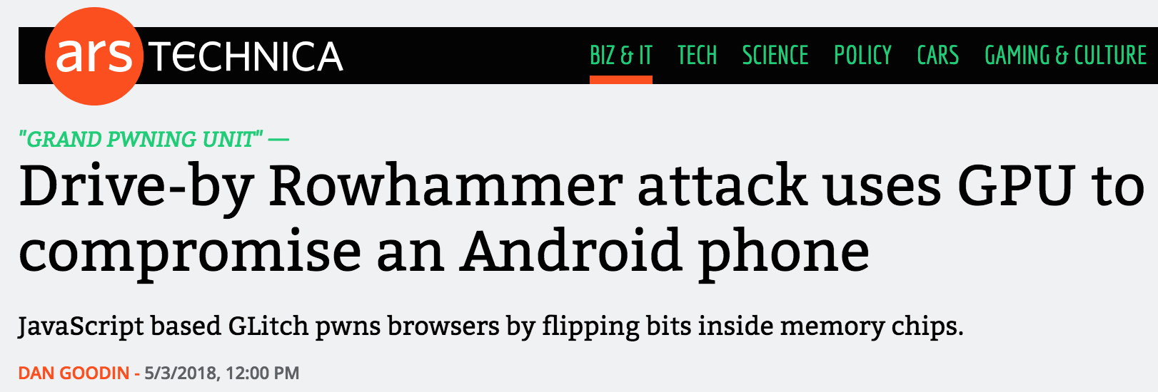

More Security Implications (III)
Using an integrated GPU in a mobile system to remotely escalate privilege via the WebGL interface. IEEE S&P 2018

Slide 14
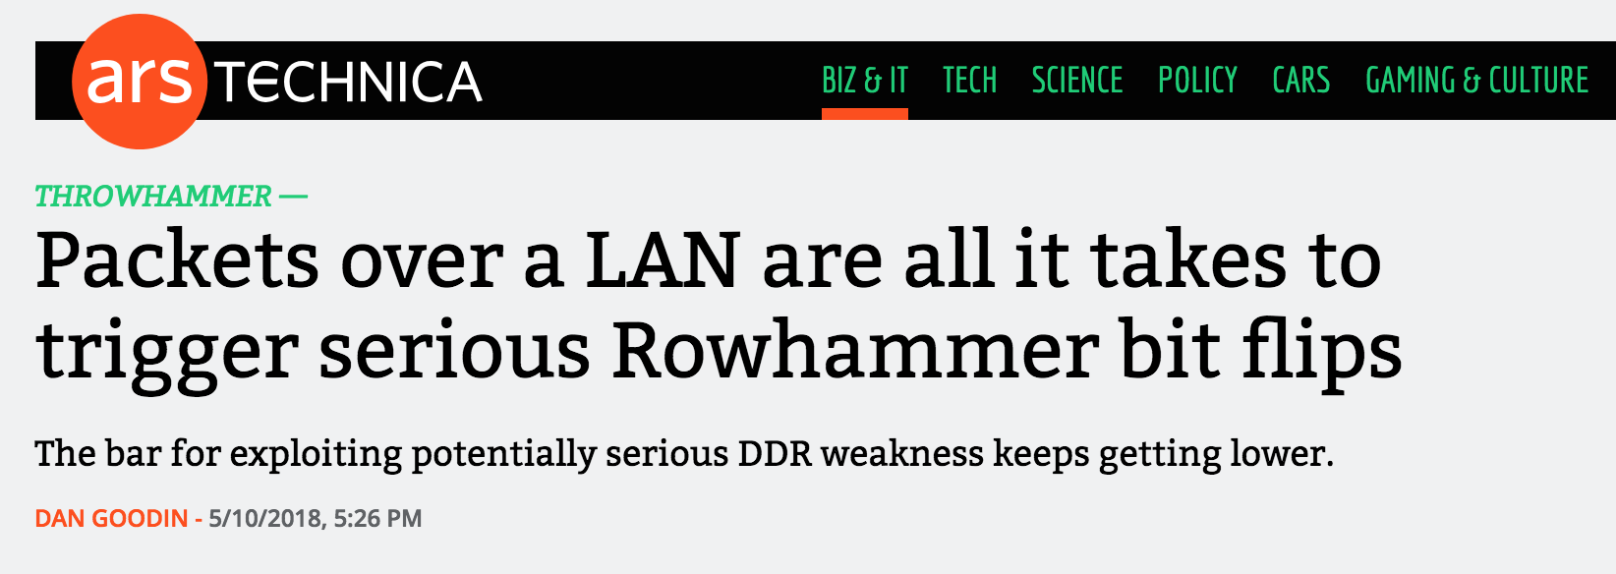
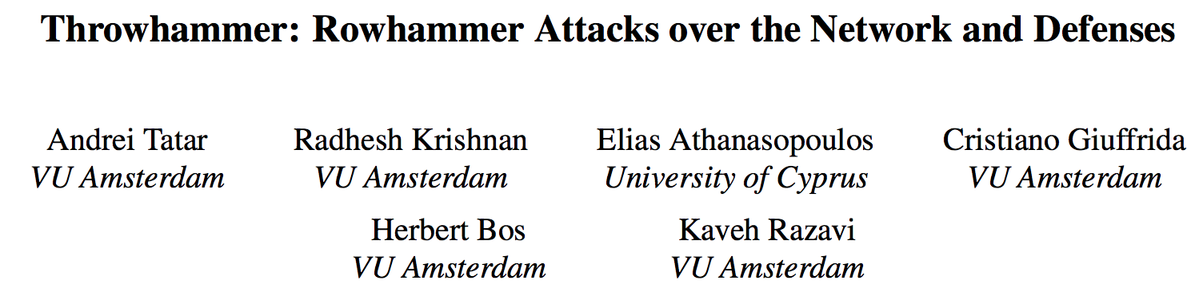
More Security Implications (IV)
Rowhammer over RDMA (I)
[Tatar+ USENIX ATC, 2018]

Slide 15



More Security Implications (V)
Rowhammer over RDMA (II)
[Lipp+ EuroS&PW, 2020]

Slide 16

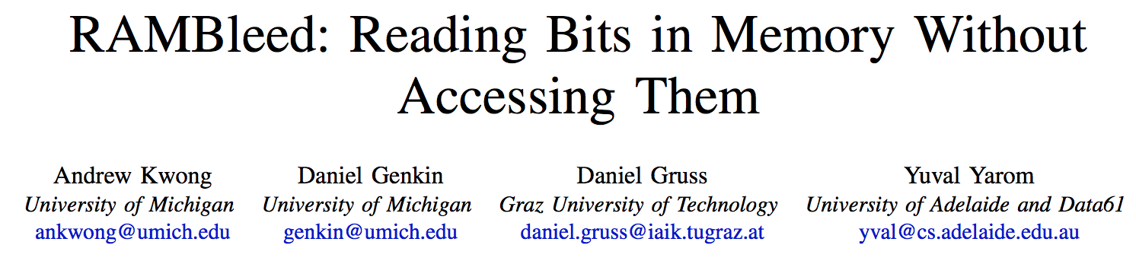
More Security Implications (VII)
[Kwong+ IEEE S&P 2020]

Slide 17
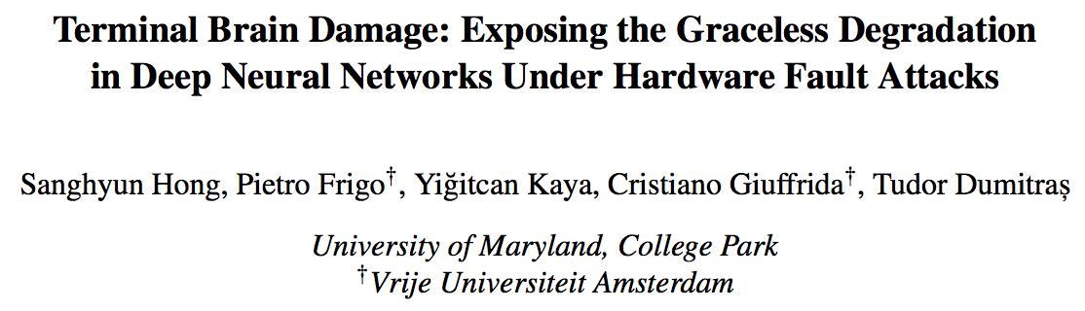
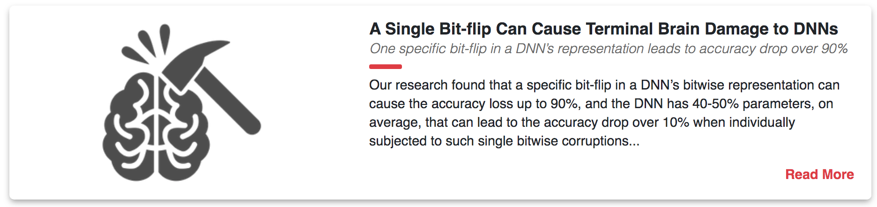
More Security Implications (VIII)
[Hong+ USENIX Security 2019]

Slide 18
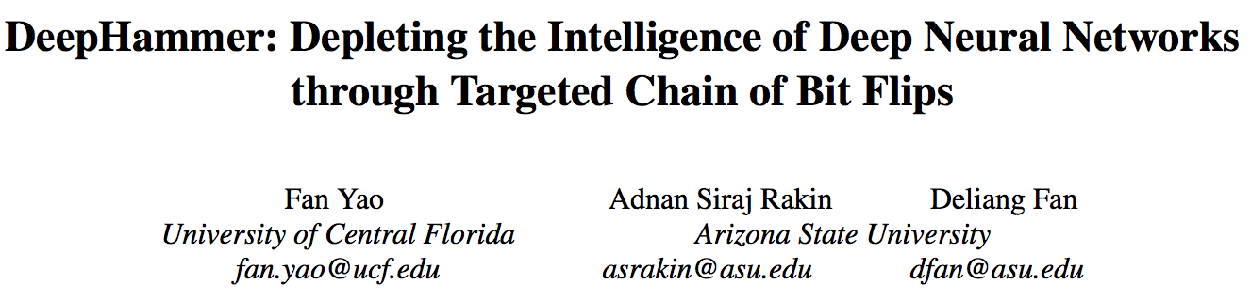
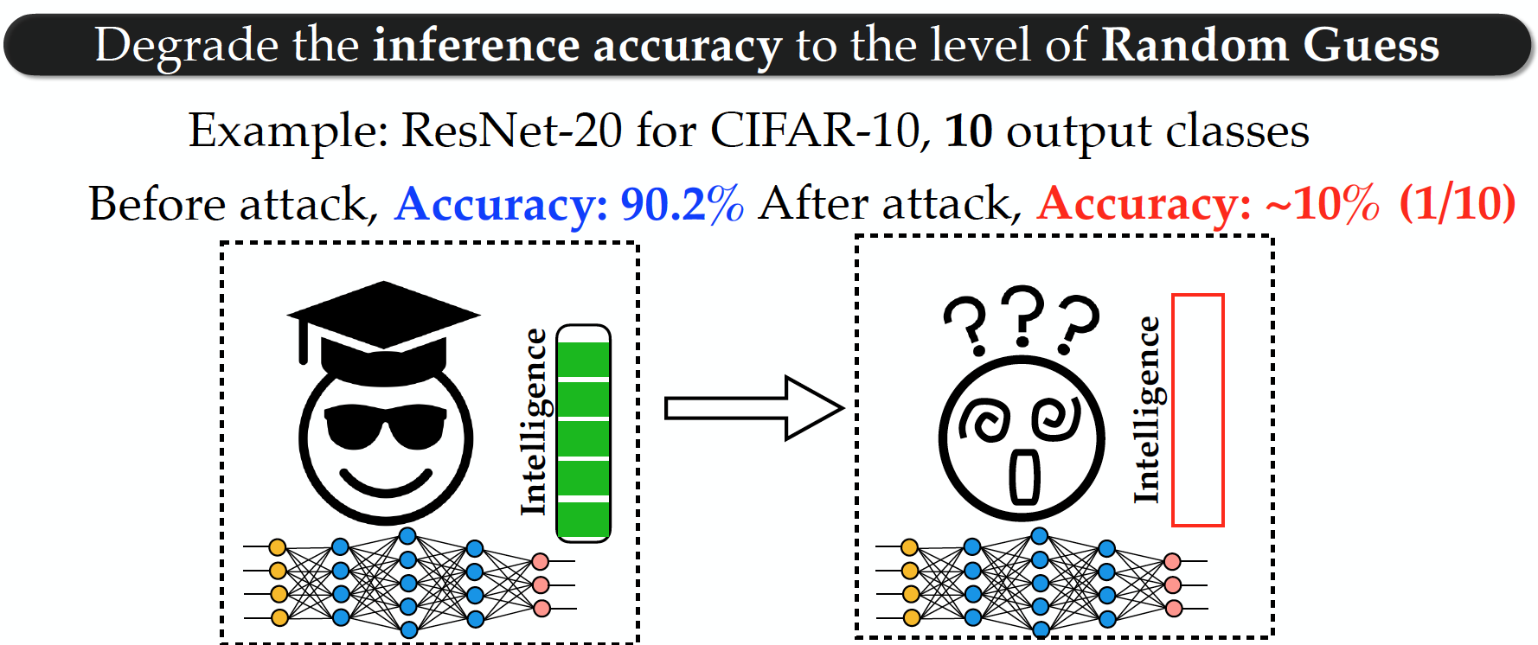
More Security Implications (IX)
[Yao+ USENIX Security 2020]

Slide 19
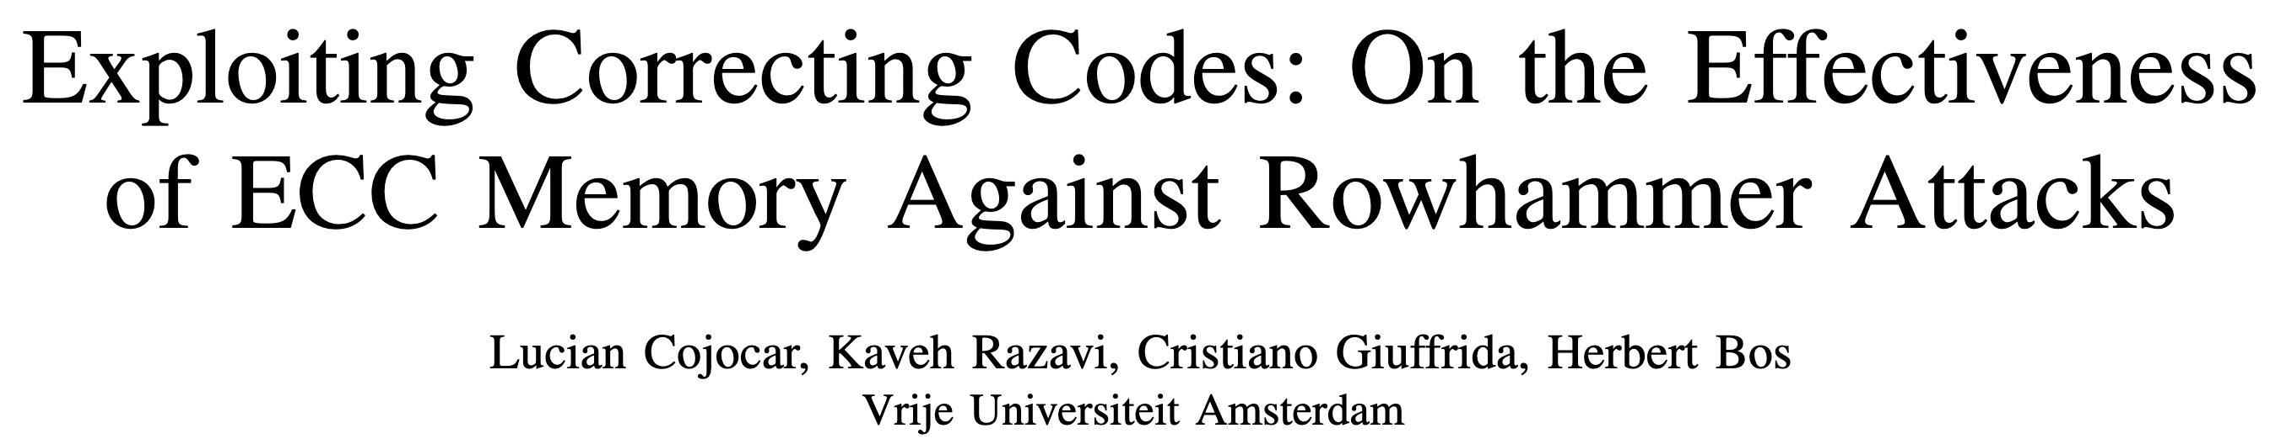
More Security Implications (XI)
Exploiting Correcting Codes: On the Effectiveness of ECC Memory Against Rowhammer Attacks. Cojocar, L. .; Razavi, K.; Giuffrida, C.; and Bos, H. In S&P, May 2019 Best Practical Paper Award, Pwnie Award Nomination for Most Innovative Research [Paper] [Slides]
Thus, many believed that Rowhammer on ECC memory, even if plausible in theory, is simply impractical. This paper shows this to be false: while harder, Rowhammer attacks are still a realistic threat even to modern ECC-equipped systems.

Slide 20
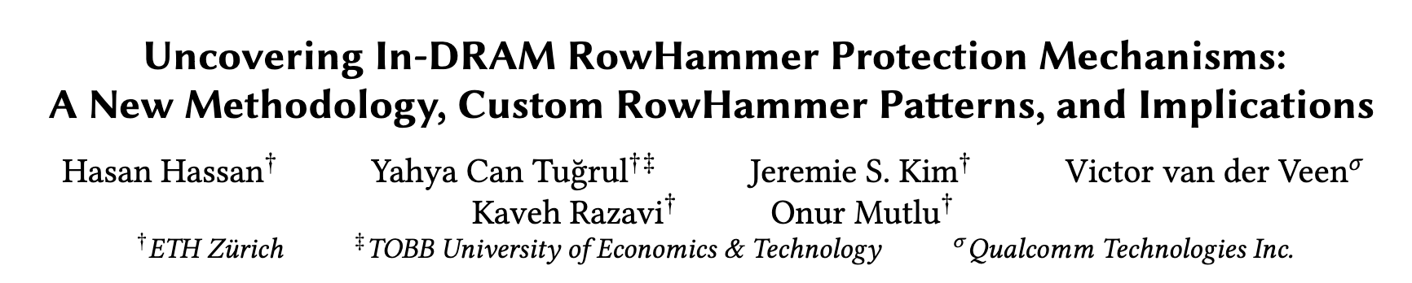





More Security Implications (XII)
Hasan Hassan, Yahya Can Tugrul, Jeremie S. Kim, Victor van der Veen, Kaveh Razavi, and Onur Mutlu, "Uncovering In-DRAM RowHammer Protection Mechanisms: A New Methodology, Custom RowHammer Patterns, and Implications,” MICRO, 2021. [Slides (pptx) (pdf)] [Short Talk Slides (pptx) (pdf)] [Lightning Talk Slides (pptx) (pdf)] [Full Talk (25 mins)] [Lightning Talk (1.5 mins)]
15x Vendor A DDR4 modules
All 45 modules we test are vulnerable
15x Vendor B DDR4 modules
99.9% of rows in a DRAM bank experience at least one RowHammer bit flip
New RowHammer access patterns
15x Vendor C DDR4 modules
U-TRR
Up to 7 RowHammer bitflips in an 8-byte dataword, making ECC ineffective
TRR does not provide security against RowHammer
U-TRR can facilitate the development of new RowHammer attacks and more secure RowHammer protection mechanisms
Notes:
[CLICK] The RowHammer vulnerability of modern DRAM is a critical reliability and security threat.
[CLICK] The security guarantees of TRR, which is the commonly used RowHammer protection mechanism, cannot be easily studied as TRR is obscure, undocumented, and proprietary.
[CLICK] In this work, our main goal is to answer the following questions. Is TRR fully secure? How can we validate the security guarantees of different TRR mechanisms?
[CLICK] To this end, we propose U-TRR, a new methodology that leverages data retention failures in DRAM to uncover the inner workings of TRR and study its security.
[CLICK] Using U-TRR, we analyze 15 DDR4 DRAM modules from each of the three major DRAM vendors.
[CLICK] Through these analyses, we make several observations regarding the TRR mechanisms implemented in these modules and craft new custom RowHammer access patterns that cause RowHammer bit flips in TRR-protected DRAM modules.
[CLICK] Our results show that: First, all 45 modules that we test across three vendors are vulnerable to our new RowHammer access patterns.
[CLICK] Second, our access pattern cause at least one bit flip in almost all DRAM rows in many modules. This makes system-level RowHammer attacks easier to mount as the attacker would have the ability to cause bit flips in almost any DRAM row [CLICK] Third, we observe that our access patterns cause up to 7 RowHammer bit flips in an 8-byte dataword, making ECC ineffective and systems equipped with ECC also susceptible to RowHammer attacks
[CLICK] We conclude that TRR does not provide security against RowHammer and can be easily circumvented using the new understanding provided by U-TRR.
[CLICK] We believe and hope that U-TRR will facilitate future research by enabling rigorous and open analysis of RowHammer mitigation mechanisms, leading to the development of both new RowHammer attacks and more secure RowHammer protection mechanisms.

Slide 21
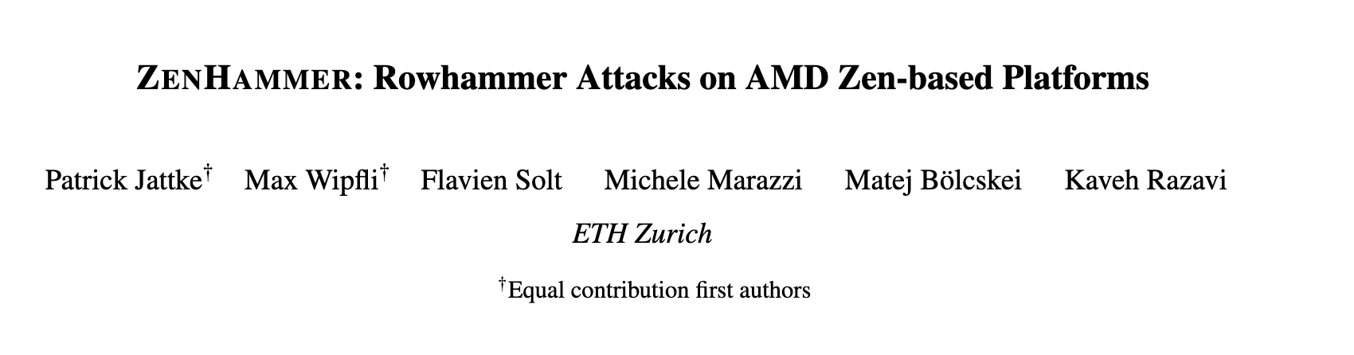
RowHammer in DDR5
Patrick Jattke; Max Wipfli; Flavien Solt; Michele Marazzi; Matej Bölcskei; and Kaveh Razavi, “ZenHammer: Rowhammer Attacks on AMD Zen-based Platforms,” in USENIX Security, 2024. [Paper] [URL]
We found bit flips on only 1 of 10 tested devices (S1), suggesting that the changes in DDR5 such as improved Rowhammer mitigations, on-die error correction code (ECC), and a higher refresh rate (32 ms) make it harder to trigger bit flips.

Slide 22
Mitigating RowHammer: Preventive Refresh
DRAM Subarray
Row 0
Row 0
Row 0
Victim Row
Row 1
Row 1
Row 1
Row 1
Victim Row
Row 2
Row 2
Row 2
Row 2
Row 2
Row 2
open
open
open
closed
Aggressor Row
Aggressor Row
Row 3
Row 3
Row 3
Row 3
Victim Row
Row 4
Row 4
Row 4
Victim Row
Refreshing potential victim rows mitigates read disturbance bitflips

Slide 23
DRAM Read Disturbance: A Critical Challenge
Technology node scaling
[Kim+, ISCA’14]
[Kim+, ISCA’20]
[Luo+, ISCA’23]
DRAM cells become increasingly more vulnerable to read disturbance
Notes:
With technology node scaling, DRAM cells get smaller in size and closer to each other[CLICK]
Such that we observe significant reductions in the minimum hammer count to induce the first bitflip in the last decade [CLICK]
Thus DRAM cells become increasingly more vulnerable to read disturbance [CLICK]

Slide 24
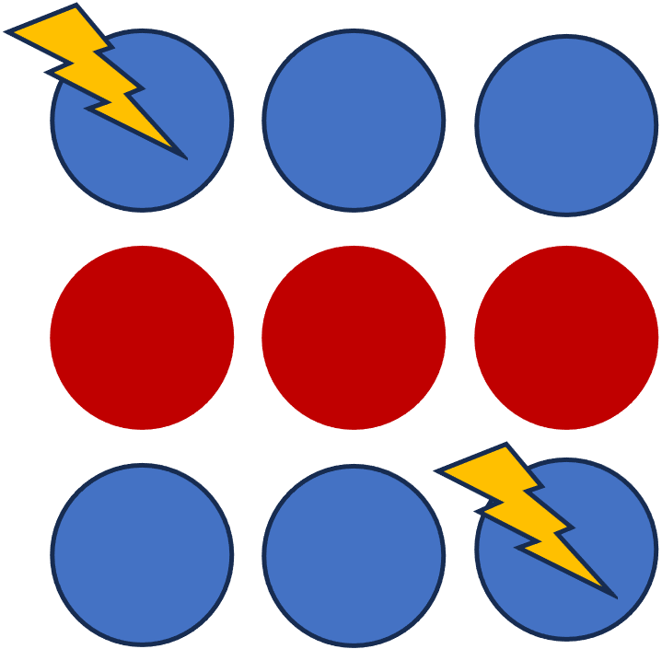
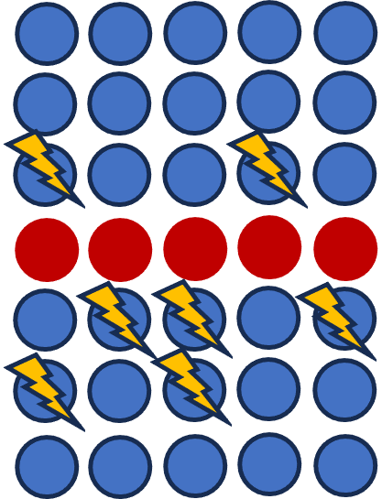
Challenge: Scalability with Worsening Vulnerability
DRAM cells become
increasingly more vulnerable
to read disturbance at device level
[Kim+, ISCA’14] [Kim+, ISCA’20] [Luo+, ISCA’23]
Existing solutions become prohibitively expensive or ineffective going forward [Kim+, ISCA’20] [Frigo+, IEEE S&P’20] [Hassan+, MICRO’21]
More efficient, scalable, and comprehensive solutions to DRAM read disturbance
Notes:
My thesis identifies two problems about solving DRAM read disturbance [CLICK]
First, As DRAM cells become more vulnerable, [CLICK]
Existing solutions become prohibitively expensive or ineffective going forward [CLICK]
Thus, we need more efficient and scalable solutions [CLICK]
And we believe that a more detailed understanding of DRAM read disturbance can help us to achieve it[CLICK]

Slide 25







Major Contributions
To efficiently and scalably mitigate DRAM read disturbance, we
build a detailed understanding of DRAM read disturbance
devise novel solutions leveraging insights into DRAM chip internals and memory controllers
MICRO’21
DSN’22
1
Memory access patterns
Temperature
Voltage
Victim cell’s physical location
2
HPCA’24
MICRO’22
HPCA’21
Svärd: Leveraging heterogeneity
BlockHammer: Selectively throttling unsafe accesses
HiRA: Parallelizing preventive actions
Notes:
To address these two problems, we conducted several studies encompassed in this thesis statement [CLICK]
We can mitigate DRAM read disturbance efficiently and scalably from three aspects [CLICK]
First, by building a detailed understanding of DRAM read disturbance [CLICK],
Which we explore for temperature [CLICK],
Memory access patterns [CLICK],
Victim cell’s physical location [CLICK],
And voltage [CLICK]
Second, by leveraging insights into modern DRAM chips and memory controllers [CLICK],
Where we leverage the heterogeneity in DRAM cells’ vulnerability levels [CLICK]
and parallelize preventive actions [CLICK]
Third, by devising novel solutions that do not require proprietary knowledge of DRAM chip internals[CLICK],
Which we achieve by selectively throttling unsafe accesses [CLICK]

Slide 26
Major Contributions
To efficiently and scalably mitigate DRAM read disturbance, we
build a detailed understanding of DRAM read disturbance
devise novel solutions leveraging insights into DRAM chip internals and memory controllers
MICRO’21
DSN’22
1
Memory access patterns
Temperature
Voltage
Victim cell’s physical location
Representative Experimental Findings
2
HPCA’24
MICRO’22
HPCA’21
Svärd: Leveraging heterogeneity
BlockHammer: Selectively throttling unsafe accesses
HiRA: Parallelizing preventive actions
Notes:
To address these two problems, we conducted several studies encompassed in this thesis statement [CLICK]
We can mitigate DRAM read disturbance efficiently and scalably from three aspects [CLICK]
First, by building a detailed understanding of DRAM read disturbance [CLICK],
Which we explore for temperature [CLICK],
Memory access patterns [CLICK],
Victim cell’s physical location [CLICK],
And voltage [CLICK]
Second, by leveraging insights into modern DRAM chips and memory controllers [CLICK],
Where we leverage the heterogeneity in DRAM cells’ vulnerability levels [CLICK]
and parallelize preventive actions [CLICK]
Third, by devising novel solutions that do not require proprietary knowledge of DRAM chip internals[CLICK],
Which we achieve by selectively throttling unsafe accesses [CLICK]

Slide 27
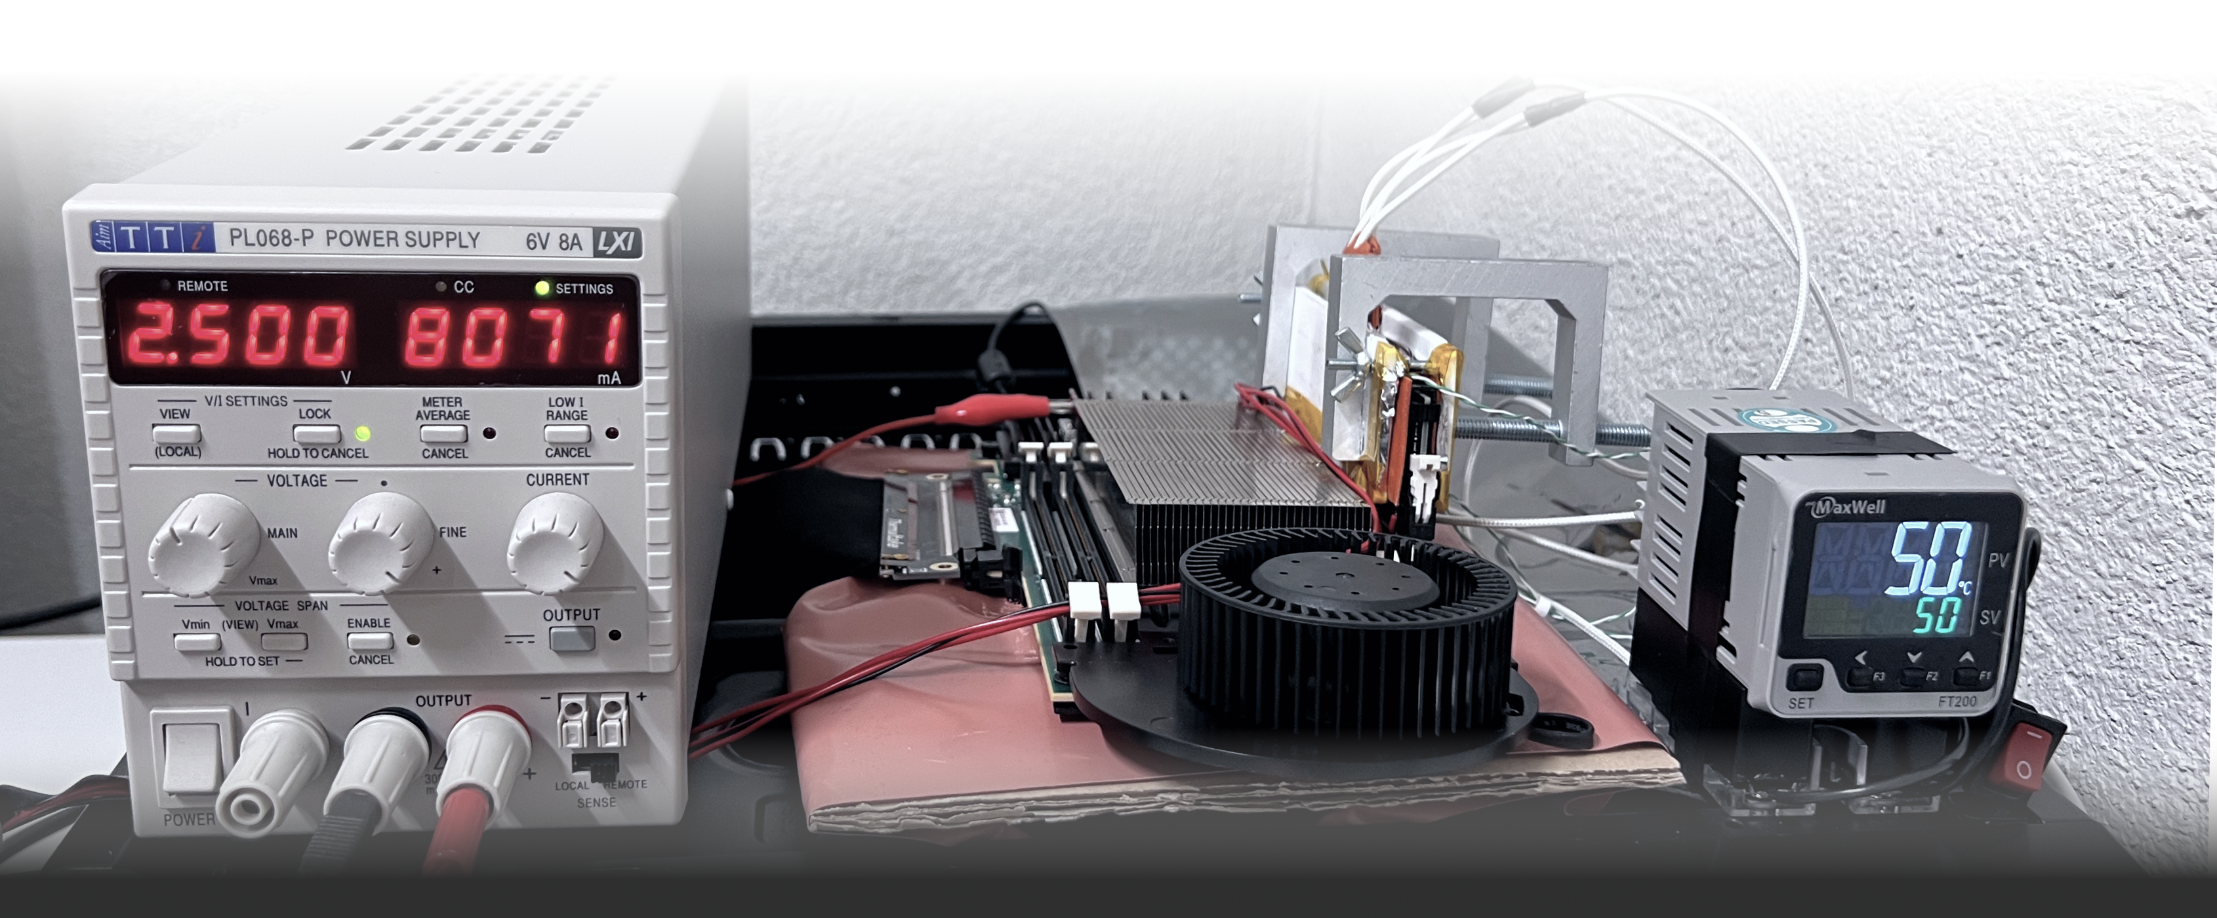
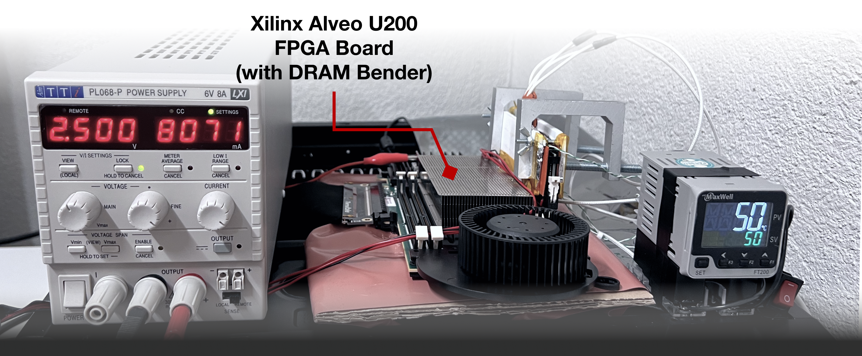
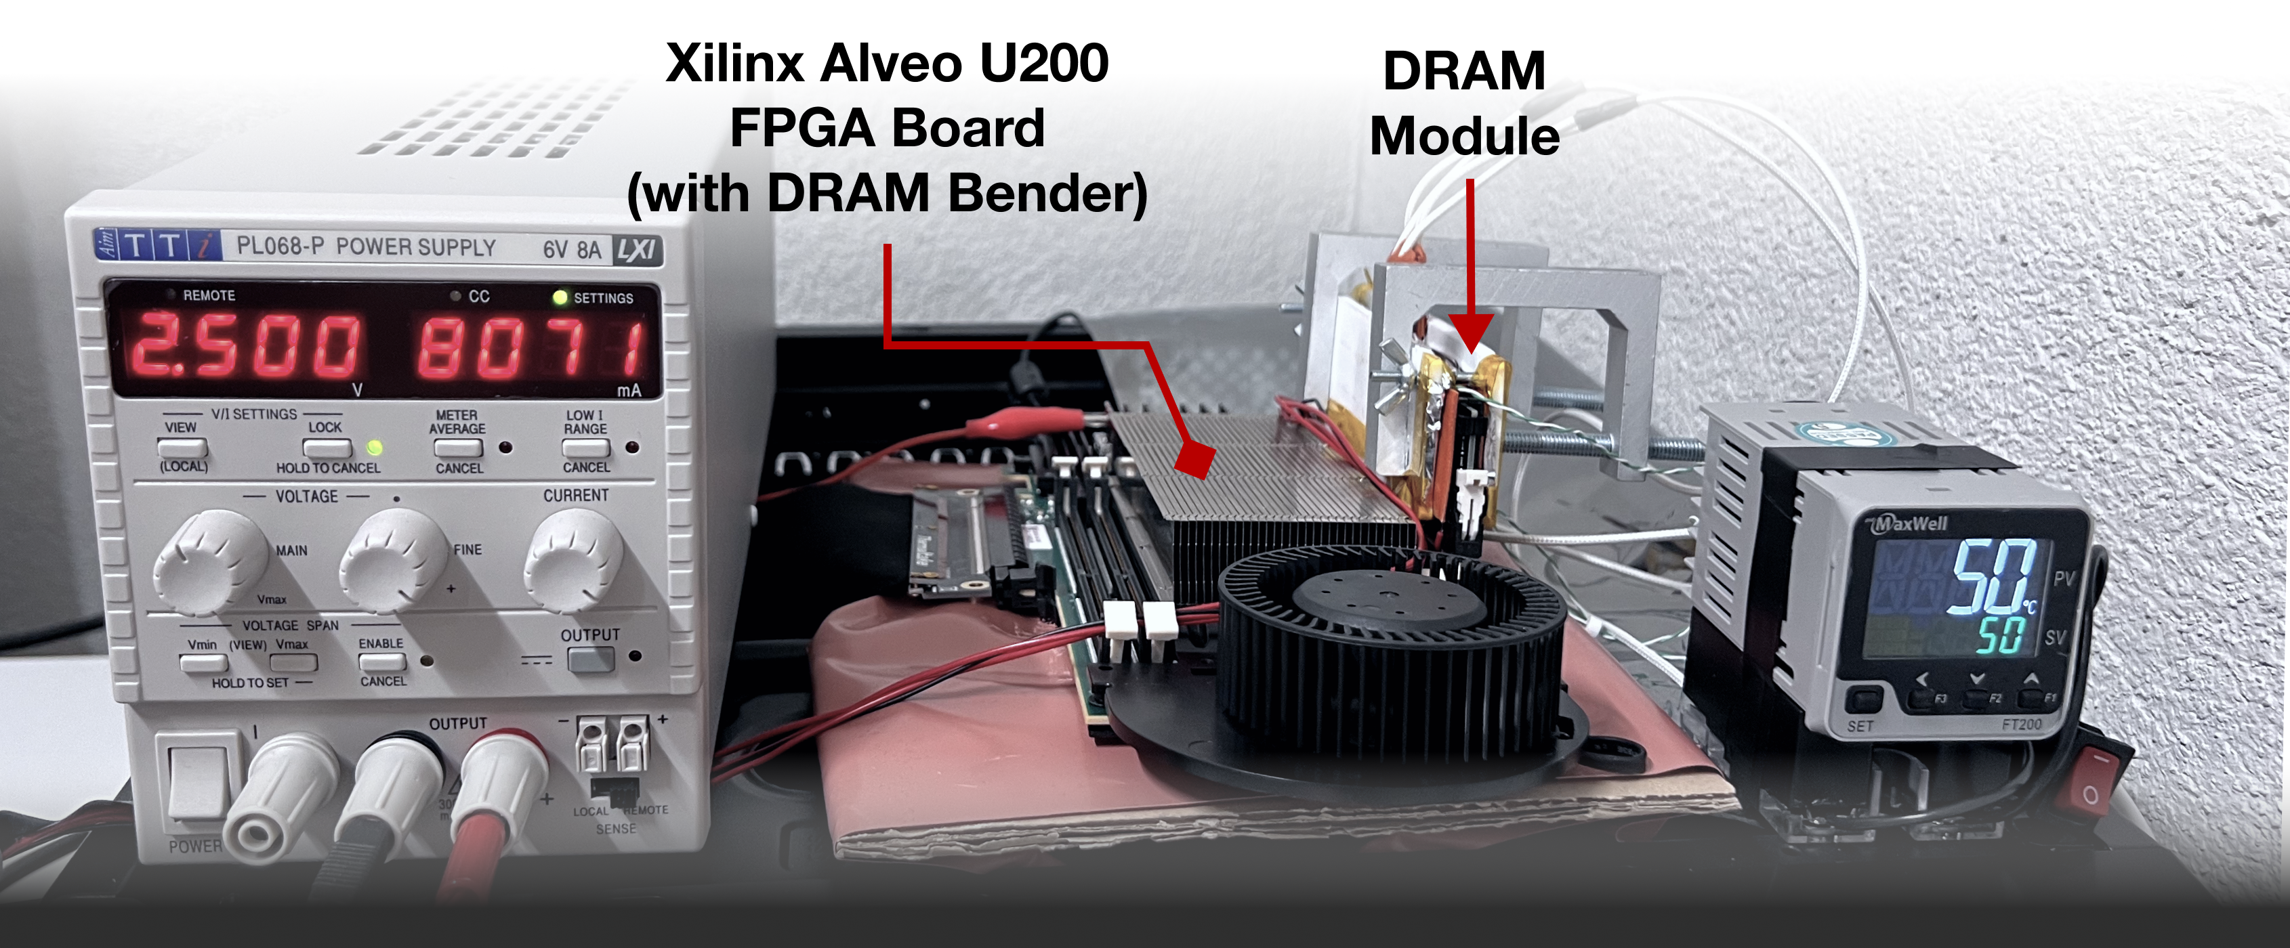
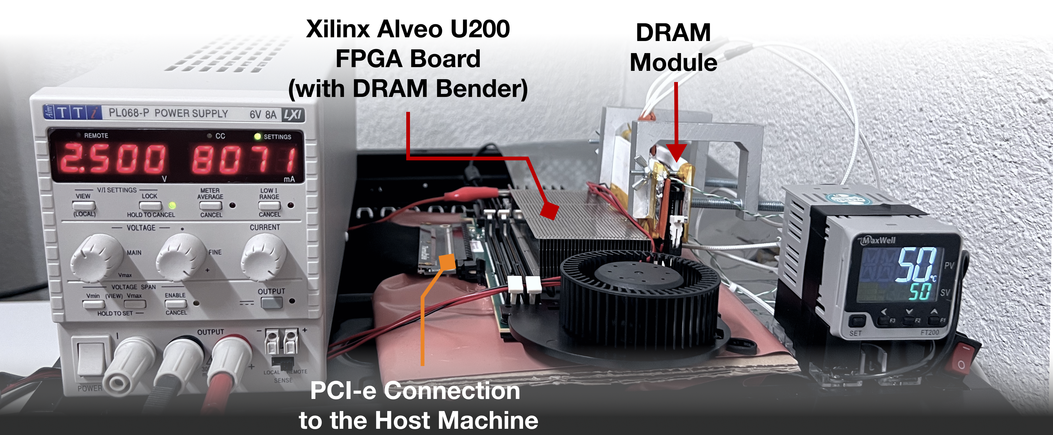
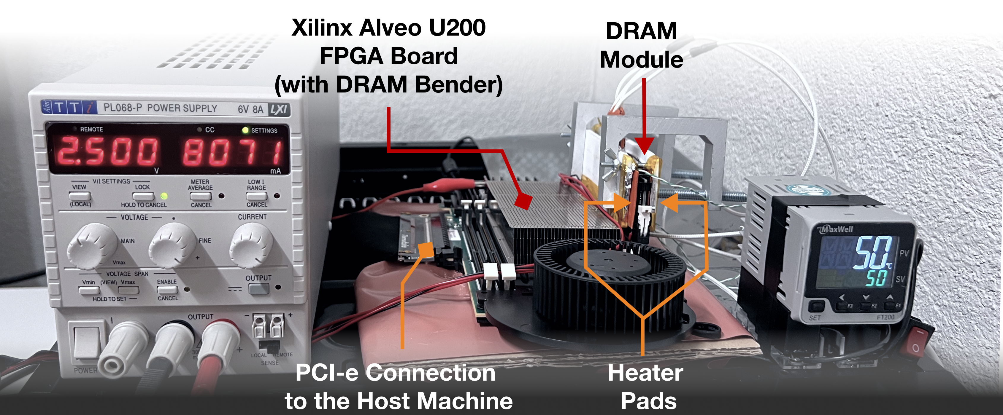
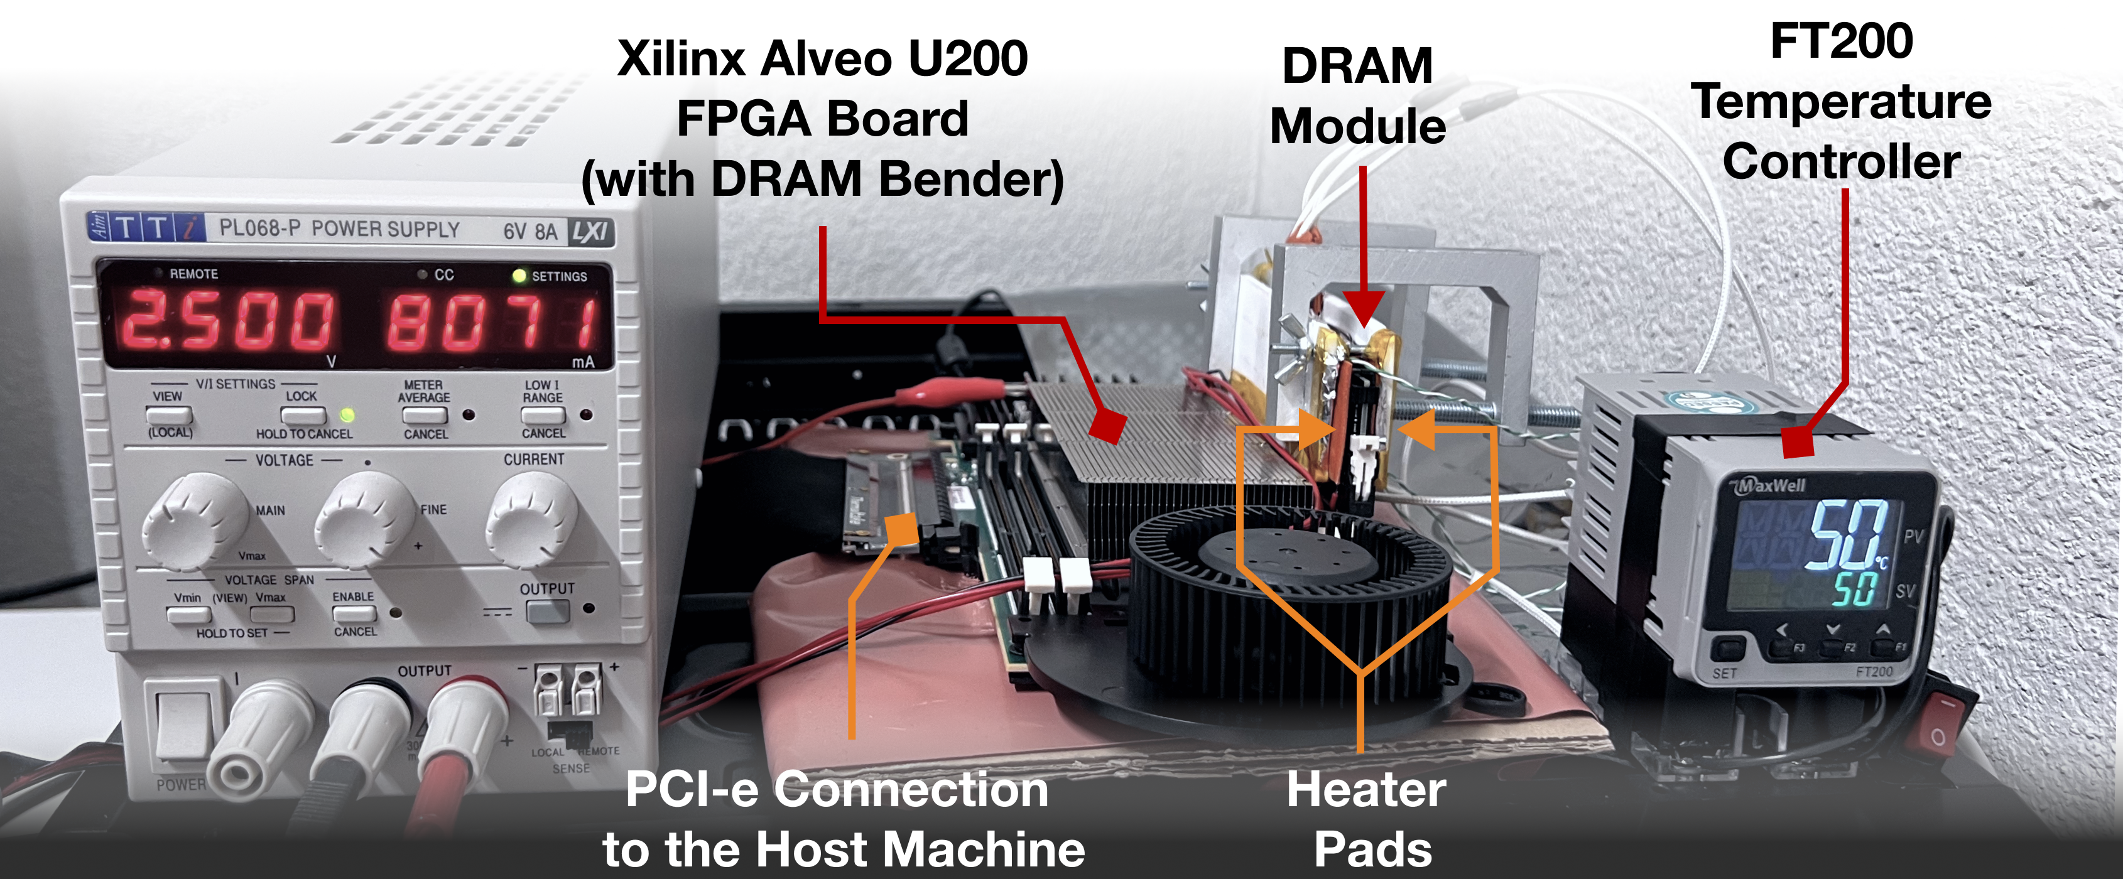
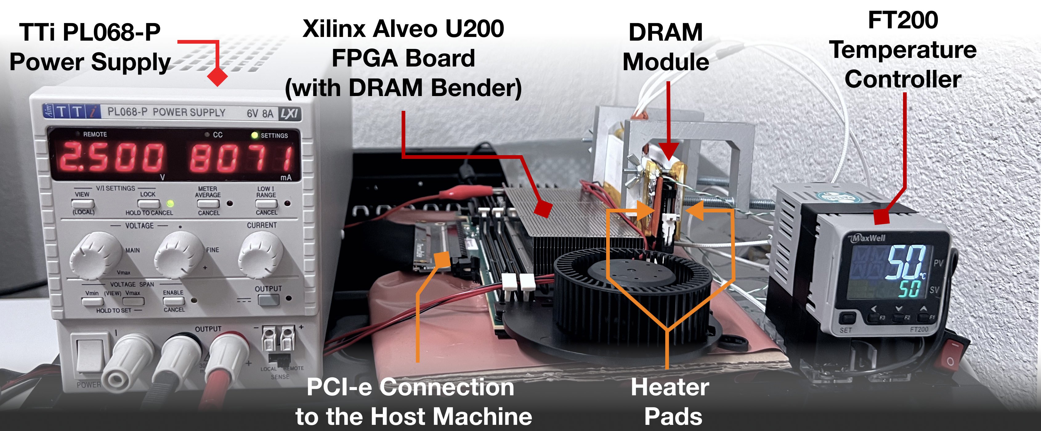
DRAM Testing Infrastructure
DRAM Bender on a Xilinx Virtex UltraScale+ XCU200
*
Fine-grained control over DRAM commands,
timing parameters (±1.5ns), temperature (±0.5°C ),
and voltage (±1mV)
*Olgun et al., “DRAM Bender: An Extensible and Versatile FPGA-based Infrastructure to Easily Test State-of-the-art DRAM Chips,” in TCAD, 2023. [GitHub: https://github.com/CMU-SAFARI/DRAM-Bender]
Notes:
We use an FPGA-based experimental setup programmed with DRAM Bender, which is an open-sourced design available on github [CLICK]
We plug in a DRAM module to test on the FPGA board [CLICK]
The board communicates with the host machine to run the test routines [CLICK]
We control the chip temperature using a pair of heaters [CLICK] connected to a temperature controller [CLICK]
We also have an external power supply that we use to sweep voltage on a power rail [CLICK]
This infrastructure provides fine-grained control over DRAM commands, timing parameters, temperature, and wordline voltage [CLICK]
=======

Slide 28
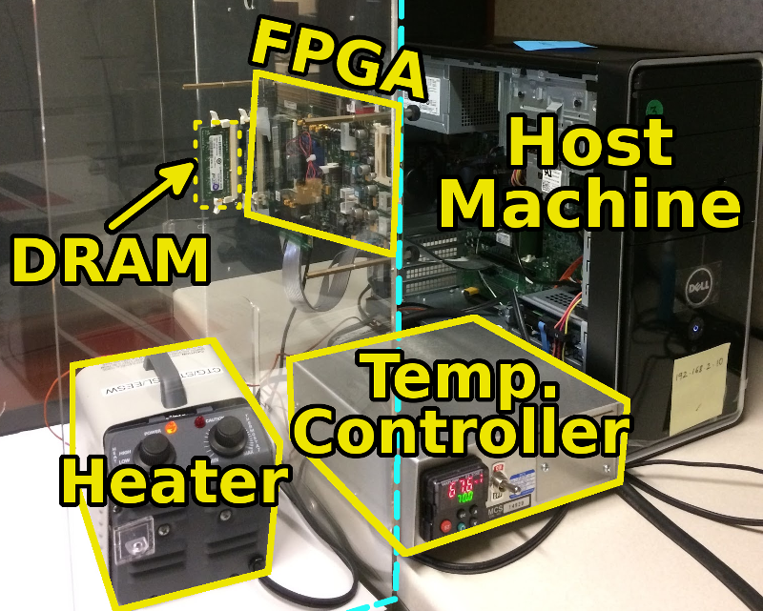
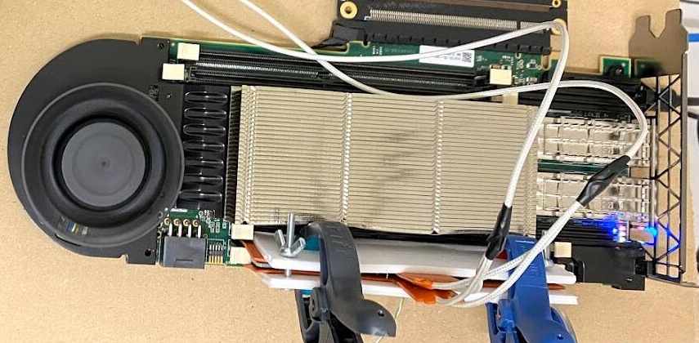
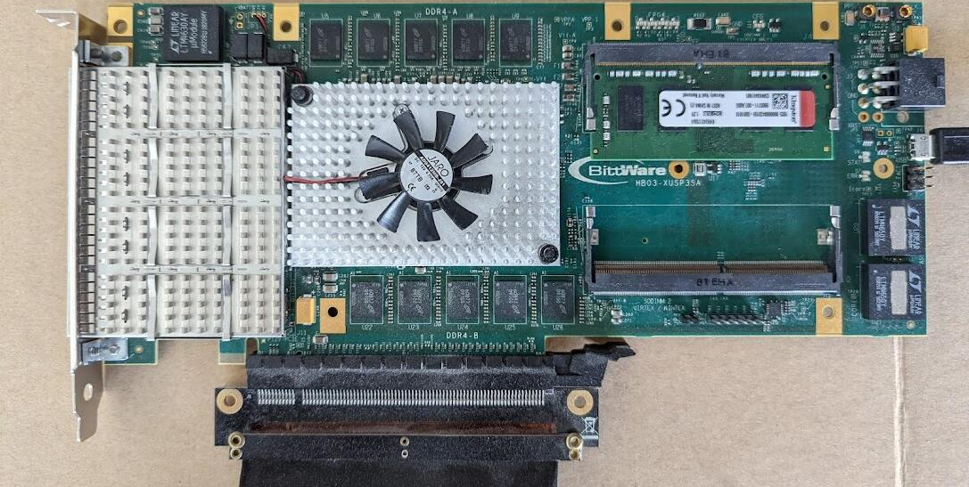
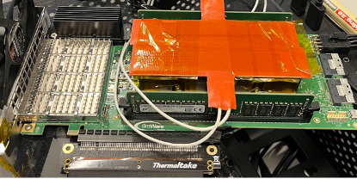
DRAM Bender for Various Memory Standards
DDR3 DRAM SODIMMs Xilinx ML605
DDR4 DRAM R/UDIMMs
Xilinx Alveo U200
DDR4 DRAM (SODIMM)
Bittware XUSP3S
HBM2 DRAM Chips
Xilinx Alveo U50
Notes:
Over time we built several versions of this infrastructure to support various memory standards, including DDR3 SODIMMs [CLICK]
DDR4 RDIMMS, UDIMMS [CLICK]
And SODIMMs [CLICK]
And HBM2 DRAM Chips [CLICK]

Slide 29
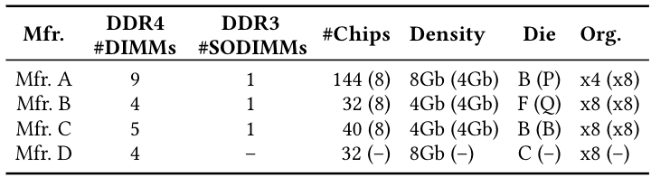
Tested DRAM Chips
272 DRAM Chips (24 DDR3 and 248 DDR4 DRAM Chips)
4 major manufacturers: Micron, Samsung, SK Hynix, and Nanya
2 DRAM standards
Mfr. | DDR4 DIMMs | DDR3 SODIMMs | # Chips | Density | Die | Org.
A (Micron) | 9 | 1 | 144 (8) | 8Gb (4Gb) | B (P) | x4 (x8)
B (Samsung) | 4 | 1 | 32 (8) | 4Gb (4Gb) | F (Q) | x8 (x8)
C (SK Hynix) | 5 | 1 | 40 (8) | 4Gb (4Gb) | B (B) | x8 (x8)
D (Nanya) | 4 | - | 32 (-) | 8Gb (-) | C (-) | x8 (-)
4 major manufacturers
272 DRAM chips
Yağlıkçı, Orosa, et al., "A Deeper Look into RowHammer’s Sensitivities: Experimental Analysis of Real DRAM Chips and Implications on Future Attacks and Defenses" in MICRO, 2021.
Notes:
In our characterization, [CLICK]
we test 272 real DRAM chips [CLICK]
from four major manufacturers, [CLICK]
that implement DDR3 and DDR4 DRAM standards [CLICK]
and with different densities, die revisions, and chip organizations[CLICK]

Slide 30
DRAM Testing Methodology
To characterize our DRAM chips at worst-case conditions:
Prevent sources of interference during core test loop
No DRAM refresh: to avoid refreshing victim row
No DRAM calibration events: to minimize variation in test timing
No RowHammer mitigation mechanisms: to observe circuit-level effects
Test for less than a refresh window (32ms) to avoid retention failures
Worst-case access sequence
We use worst-case access sequence based on prior works’ observations
For each row, repeatedly access the two physically-adjacent rows as fast as possible
Yağlıkçı, Orosa, et al., "A Deeper Look into RowHammer’s Sensitivities: Experimental Analysis of Real DRAM Chips and Implications on Future Attacks and Defenses" in MICRO, 2021.
Notes:
To characterize our DRAM chips at worst-case conditions we take two measures:
[CLICK] First, we prevent external sources of interference such that our tests can run consistently as desired and without interruptions. To achieve this we disable:
[CLICK] DRAM refresh to avoid refreshing victim rows during a RowHammer test,
[CLICK] DRAM calibration events to minimize variation in test timings
[CLICK] and RowHammer mitigation mechanisms to ensure that we can directly observe circuit-level bit flips
[CLICK] we also ensure that our tests complete in less than a refresh window to prevent retention failures from interfering with our results
[CLICK] Second, we issue the worst-case access sequence for inducing RowHammer bit flips based on observations from prior work
[CLICK] Using these observations, we test each row’s worst-case vulnerability to RowHammer by repeatedly activating the two physically-adjacent rows as fast as possible
=========

Slide 31
Impact of Temperature on DRAM Cells
The fraction of vulnerable DRAM cells, experiencing bit flips at all temperature levels within their vulnerable temperature range
no bit flips
bit flips
no bit flips
Vulnerable Temperature Range
Temperature
50ºC
90ºC
Lower
Bound
Upper
Bound
Mfr. A | Mfr. B | Mfr. C | Mfr. D
99.1% | 98.9% | 98.0% | 99.2%
Most DRAM cells are vulnerable to RowHammer throughout a bounded continuous temperature range
Yağlıkçı, Orosa, et al., "A Deeper Look into RowHammer’s Sensitivities: Experimental Analysis of Real DRAM Chips and Implications on Future Attacks and Defenses" in MICRO, 2021.
Notes:
We analyze the temperature levels a DRAM cell is vulnerable to RowHammer [CLICK]
We observe that there exists [CLICK] a lower and [CLICK] an upper bound of temperature [CLICK]
A DRAM cell experiences bit flips only within this bounded range[CLICK]
but we do not observe any bit flips out of this range [CLICK]
We call this range: vulnerable temperature range [CLICK]
This table demonstrates the fraction of DRAM cells that experience bit flips at all temperature levels within their vulnerable temperature range
We observe that more than 98% of vulnerable cells across all four manufacturers exhibit this behavior [CLICK]
Therefore, we conclude that most DRAM cells are vulnerable to RowHammer throughout a continuous temperature range [CLICK]

Slide 32
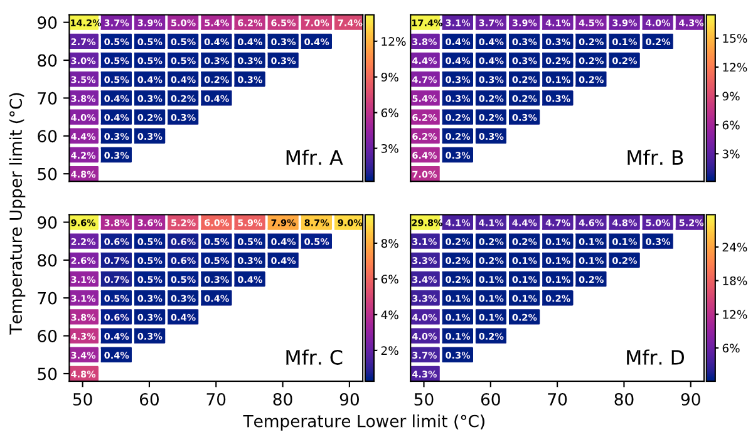
Temperature’s Impact at DRAM Cell Granularity
Hammer count: 150000 activations to each of the two aggressor rows
A population density distribution
Vulnerable from 70°C to 85°C
Fraction of Vulnerable DRAM Cells
Upper Bound (°C)
Vulnerable between
50°C and 60°C not above 60°C
Lower Bound (°C)
Different DRAM cells are vulnerable to RowHammer within specific temperature ranges
Implication on testing
A DRAM cell should be tested
at each possible operating temperature
Yağlıkçı, Orosa, et al., "A Deeper Look into RowHammer’s Sensitivities: Experimental Analysis of Real DRAM Chips and Implications on Future Attacks and Defenses" in MICRO, 2021.
Notes:
This figure shows the population density of cells, clustered based on their vulnerable temperature range. The x-axis and y-axis show the lower bound [CLICK] and the upper bound [CLICK] of a DRAM cell’s vulnerable temperature range [CLICK]
The color-scale and the percentage values show the fraction of cells for a given temperature range [CLICK]
For example, 0.4% of the cells are vulnerable to RowHammer only between 55 and 60 degrees Celsius [CLICK],
while 0.5% of the cells experience bit flips only between 70 and 85 degrees Celsius [CLICK]
We conclude that different DRAM cells are vulnerable to RowHammer within specific temperature ranges [CLICK]

Slide 33
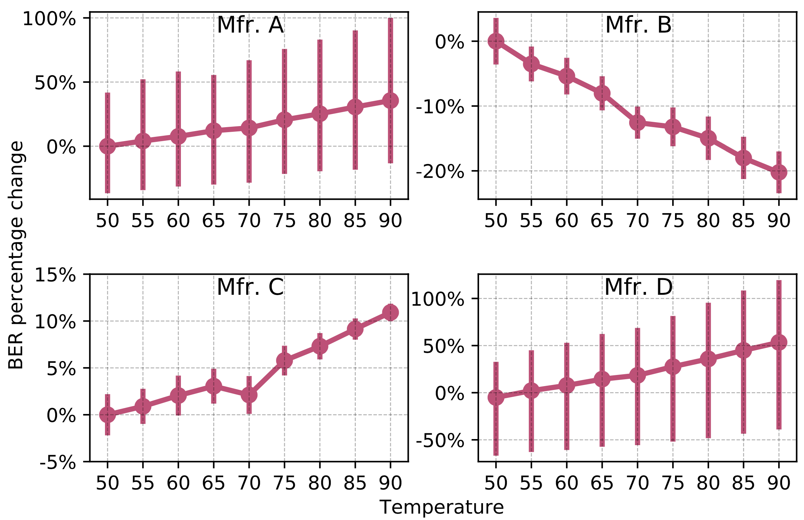
Temperature’s Impact at DRAM Row Granularity
Variation in
Bit Flip Counts
per DRAM Row
Temperature (°C)
More cells experience bit flips as temperature increases
Yağlıkçı, Orosa, et al., "A Deeper Look into RowHammer’s Sensitivities: Experimental Analysis of Real DRAM Chips and Implications on Future Attacks and Defenses" in MICRO, 2021.
Notes:
Next, we study the impact of temperature on DRAM rows. The figure shows how the number of bit flips in the victim row changes as temperature increases.[CLICK]
The x-axis shows the increasing temperature [CLICK] and y-axis reports the variation in bit flip counts normalized to the mean value at 50°C. [CLICK]
We observe that more cells experience a bit flip with increasing temperature, [CLICK]

Slide 34
Temperature’s Impact at DRAM Row Granularity
Variation in Bit Flip Counts per DRAM Row
Temperature (°C)
A DRAM row’s bit error rate can either increase or decrease with temperature depending on the DRAM manufacturer
Yağlıkçı, Orosa, et al., "A Deeper Look into RowHammer’s Sensitivities: Experimental Analysis of Real DRAM Chips and Implications on Future Attacks and Defenses" in MICRO, 2021.
Notes:
We repeat this analysis for all four manufacturers [CLICK]
We observe that the bit error rate increases with temperature in modules from three manufacturers, [CLICK]
While it exhibits an opposite trend in modules from manufacturer B. We hypothesize that this happens due to different characteristics of charge trap error mechanisms in different manufacturers. Please refer to our full paper for more details [CLICK]
Our main observation from this figure is that A DRAM row’s BER can either increase or decrease with temperature depending on the DRAM manufacturer [CLICK]

Slide 35
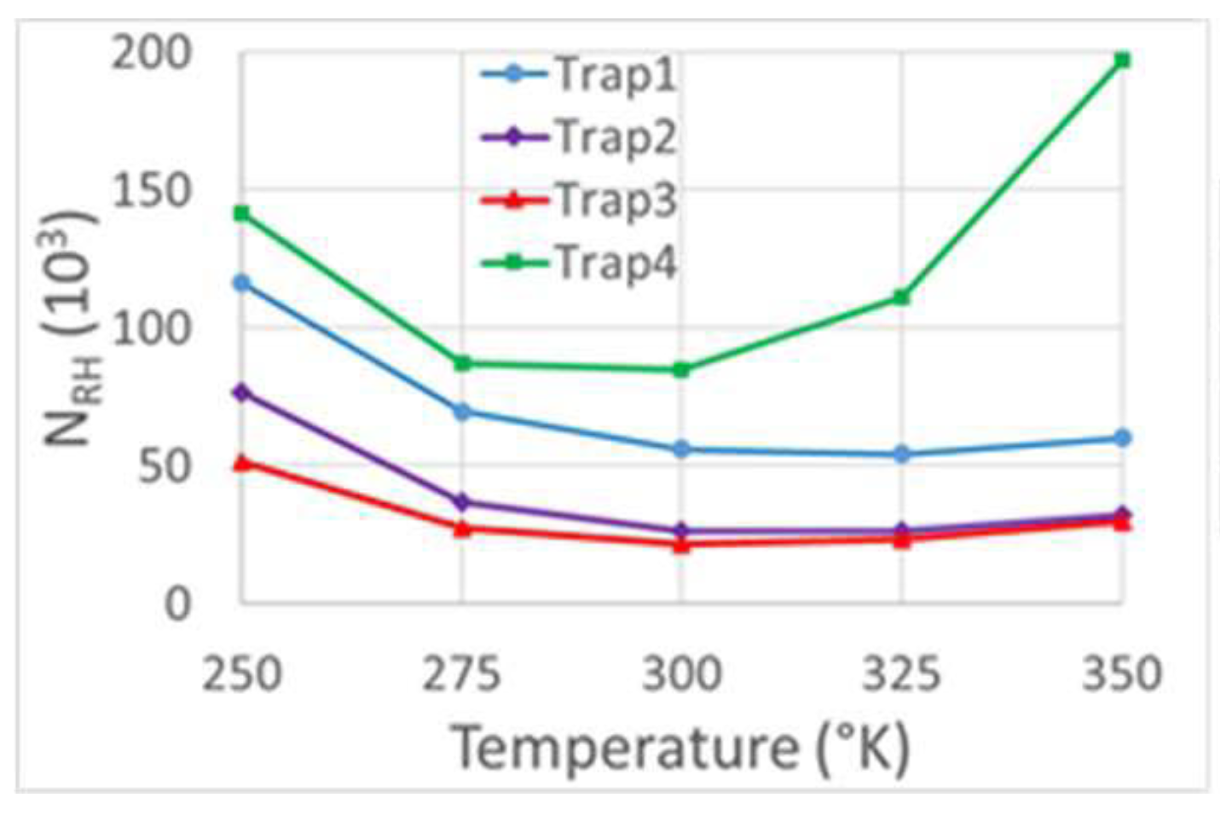
Temperature’s Impact on RowHammer
Ours are empirical observations
Similar to the behavior of Trap Assisted Charge Leakage
Increasing temperature
helps electrons move easier → higher leakage → smaller RowHammer threshold
makes traps lose charge → lower trap-assisted leakage → larger RowHammer threshold
Device characteristics determine the dominant effect
Varies across
Cells
Chips
Manufacturers
Lower is more vulnerable
RowHammer Threshold (x1000)
Temperature (K)
3D TCAD model [Yang+, EDL'19]
Yağlıkçı, Orosa, et al., "A Deeper Look into RowHammer’s Sensitivities: Experimental Analysis of Real DRAM Chips and Implications on Future Attacks and Defenses" in MICRO, 2021.

Slide 36
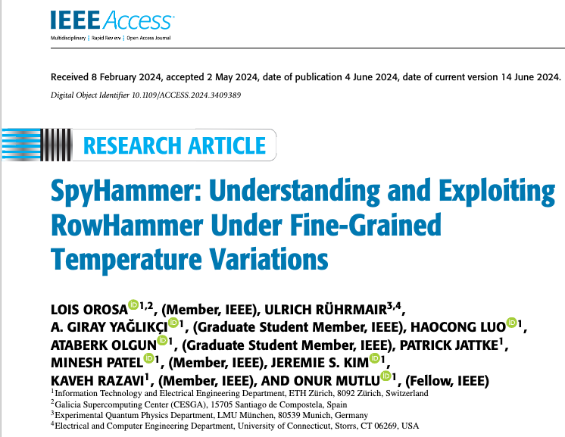
Temperature Study’s Impact: Spying on a Machine’s Temperature via RowHammer
Observe RowHammer BER to measure change in temperature
Find canary cells that exhibit erroneous behavior at particular temperature points
Reverse-engineer the DRAM module’s model
Characterize an identical model in lab
Build a regression model of BER vs temperature
Identify canary cells
Monitor canary cells to identify temperature

Slide 37
Major Contributions
To efficiently and scalably mitigate DRAM read disturbance, we
build a detailed understanding of DRAM read disturbance
devise novel solutions leveraging insights into DRAM chip internals and memory controllers
MICRO’21
DSN’22
1
Memory access patterns
Temperature
Voltage
Victim cell’s physical location
Representative Experimental Findings
2
HPCA’24
MICRO’22
HPCA’21
Svärd: Leveraging heterogeneity
BlockHammer: Selectively throttling unsafe accesses
HiRA: Parallelizing preventive actions
Notes:
To address these two problems, we conducted several studies encompassed in this thesis statement [CLICK]
We can mitigate DRAM read disturbance efficiently and scalably from three aspects [CLICK]
First, by building a detailed understanding of DRAM read disturbance [CLICK],
Which we explore for temperature [CLICK],
Memory access patterns [CLICK],
Victim cell’s physical location [CLICK],
And voltage [CLICK]
Second, by leveraging insights into modern DRAM chips and memory controllers [CLICK],
Where we leverage the heterogeneity in DRAM cells’ vulnerability levels [CLICK]
and parallelize preventive actions [CLICK]
Third, by devising novel solutions that do not require proprietary knowledge of DRAM chip internals[CLICK],
Which we achieve by selectively throttling unsafe accesses [CLICK]

Slide 38

Impact of Memory Access Pattern
on time
Open
Open
Close
Close
A smaller hammer count is sufficient to induce bitflips
with increased aggressor row on time
State-of-the-Art
Our Finding w/ 15 column accesses
36% reduction
Minimum hammer count to induce the first bitflip
Implication on defenses
Existing mitigations are ineffective without this insight
Follow-up
This finding paved the way to the discovery of RowPress [Luo+, ISCA’23]
Yağlıkçı, Orosa, et al., "A Deeper Look into RowHammer’s Sensitivities: Experimental Analysis of Real DRAM Chips and Implications on Future Attacks and Defenses" in MICRO, 2021.
Notes:
The second example is about the memory access patterns. [CLICK]
Previously known worst-case access pattern opens and closes an aggressor row as fast as possible [CLICK]
In contrast, in this study, we wait for some time after opening the aggressor row [CLICK]
We observe that doing this significantly reduces the necessary hammer count to induce the first bitflip [CLICK]
An implication is that an existing mitigation can be ineffective if it is not designed accounting for this effect [CLICK]
A follow-up of our work investigates this effect more rigorously and shows that this effect is an artifact of a new read disturbance phenomenon called RowPress [CLICK]

Slide 39
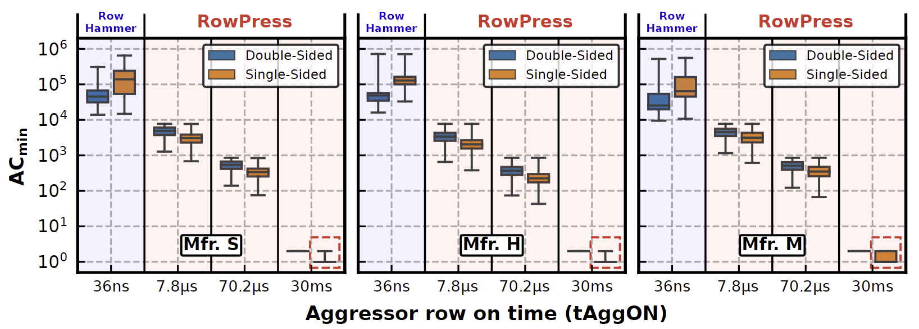
Our Work Led to the Discovery of RowPress
Reduces the minimum number of row activations needed to induce a bitflip (ACmin) by 1-2 orders of magnitude
In extreme cases, activating a row only once induces bitflips
Lower is more vulnerable
[Luo+, ISCA’23]
RowPress on HBM2-20nm for row on time of 3.9 us Read Disturbance Threshold: 335 activations [Olgun+, DSN’24]
Benign becomes attacker: Even SPEC workloads reach to this activation count
Mentored paper
Notes:
RowPress amplifies read disturbance because
First, it reduces the minimum number of row activations needed to induce a bitflip by 1-2 orders of magnitude
Second, in extreme cases, activating a row only once induces bitflips

Slide 40
More Background: Row Buffer Locality
Bitline
DRAM Cell
Row Hit: Row buffer has the desired content
Service RD/WR from the row buffer (~10ns)
Row Miss: Row buffer has no content
Open the row (~13ns)
Service RD/WR from the row buffer (~10ns)
Row Conflict: Row buffer has different content
Close the active row (~13ns)
Open the desired row (~13ns)
Serve RD/WR from the row buffer (~10ns)
Wordline
…
DRAM Subarray
…
…
…
…
…
Row Buffer
I/O Circuitry
Row buffer hit is significantly faster than miss and conflict
Key Insight: Memory controller keeps a row open if the row is likely to be accessed again
Key Idea: Keep accessing the aggressor row to incentivize the memory controller to keep the row open
Notes:
This is a simplified diagram of a DRAM cell, where the data is stored as capacitor voltage and accessed through the access transistor [CLICK]
A DRAM cell inherently exhibits several charge leakage paths [CLICK]
And requires to perform refresh operations to restore the capacitor voltage with a time period called refresh window.
[PAUSE]
To access a DRAM cell, [CLICK]
the memory controller must first open or activate the row to fetch the row’s data into the row buffer [CLICK]
The READ and WRITE requests targeting the row are serviced from the row buffer [CLICK]
After all requests are serviced from the row, the memory controller must close or precharge the row in order to begin accessing data from another row. [CLICK]

Slide 41
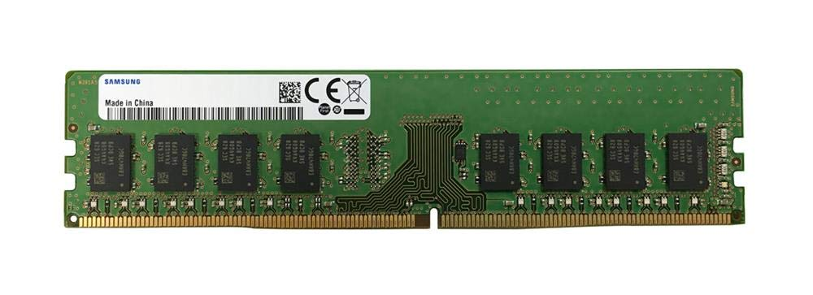
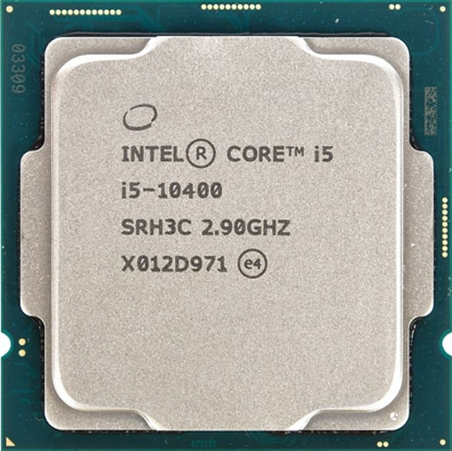
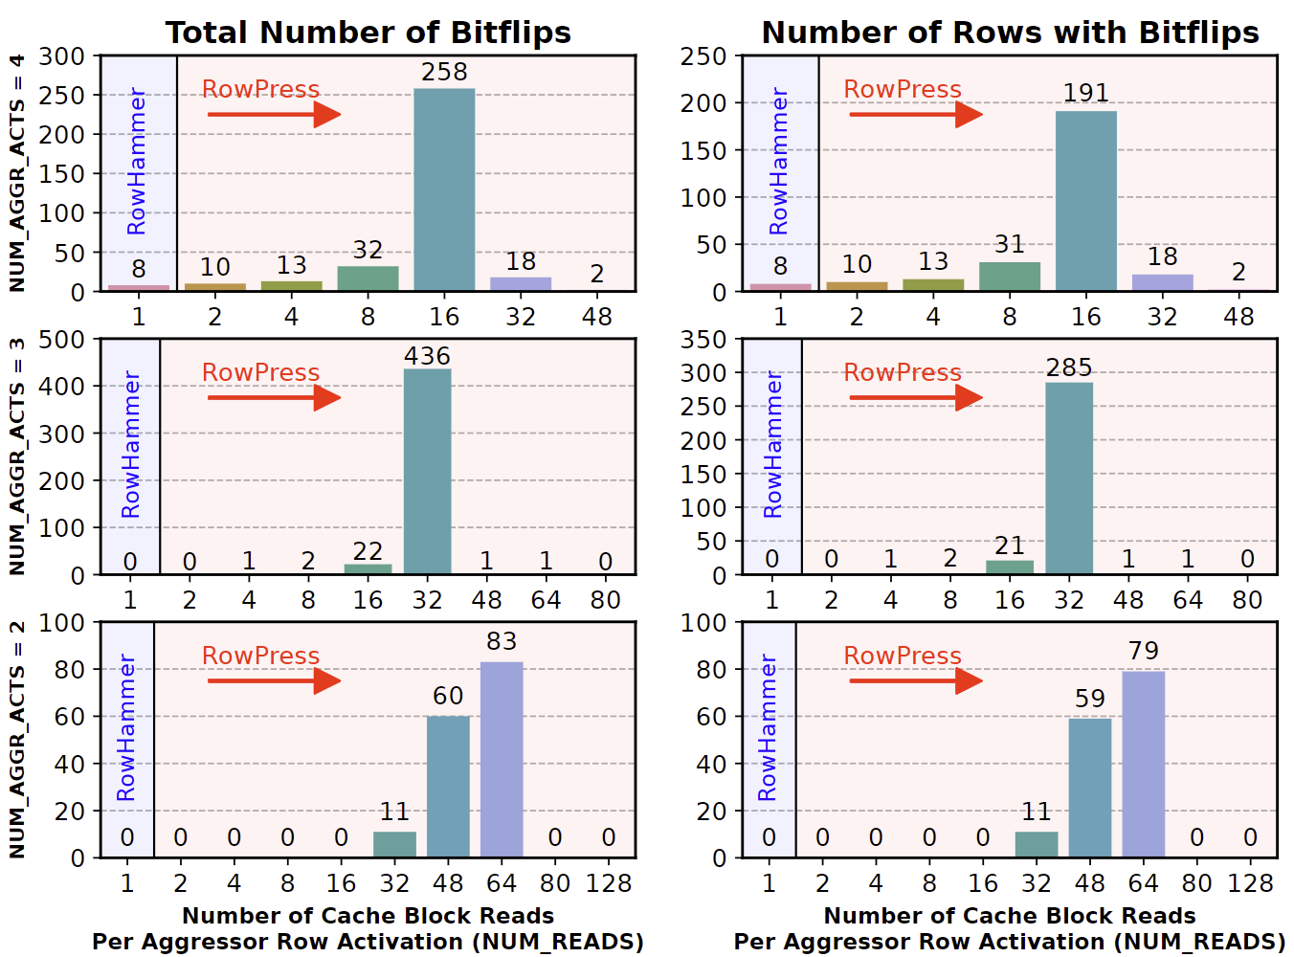
RowPress Demonstration on a Real-System
Samsung DDR4 Module M378A2K43CB1-CTD
(Date Code: 20-10)
w/ TRR RowHammer Mitigation
Intel Core i5-10400 (Comet Lake)
// Sync with Refresh and Loop Below
for (k = 0; k < NUM_AGGR_ACTS; k++)
for (j = 0; j < NUM_READS; j++) ∗AGGRESSOR1[j];
for (j = 0; j < NUM_READS; j++) ∗AGGRESSOR2[j];
for (j = 0; j < NUM_READS; j++)
clflushopt(AGGRESSOR1[j]);
clflushopt(AGGRESSOR2[j]);
mfence();
activate_dummy_rows();
Number of Cache Blocks Accessed
Per Aggressor Row ACT
(NUM_READS=1 is Rowhammer)
Read Disturbance
Bitflip Count
Erroneous Row Count
Notes:
We demonstrate RowPress on a real system with a recent Intel processor and a Samsung DDR4 module with TRR rowhammer mitigation. The key idea of our RowPress program is to keep a DRAM row open for a longer period by keeping accessing different cache blocks in the row.
Here is the key part of our program, where we can change the number of cache blocks read per aggressor row activation. If we only read 1 cache block, then the program does the same as RowHammer

Slide 42
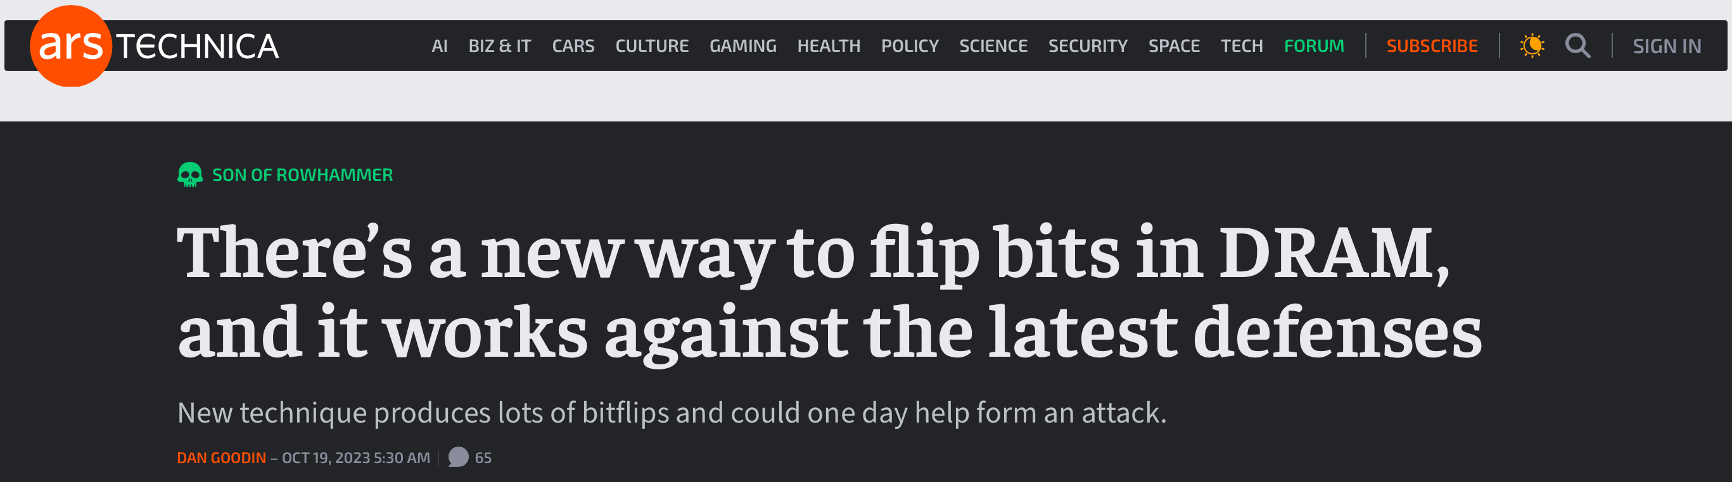
RowPress on Media
“
Samsung is aware of industry concerns around the latest DDR4 DRAM RowPress attack scenario and has been implementing measures in tandem with industry partners to counter such schemes.
”
Notes:
RowPress attracted a huge attention in the industry and DRAM manufacturers are working on RowPress solutions today [CLICK]

Slide 43
Major Contributions
To efficiently and scalably mitigate DRAM read disturbance, we
build a detailed understanding of DRAM read disturbance
devise novel solutions leveraging insights into DRAM chip internals and memory controllers
MICRO’21
DSN’22
1
Memory access patterns
Temperature
Voltage
Victim cell’s physical location
Representative Experimental Findings
2
HPCA’24
MICRO’22
HPCA’21
Svärd: Leveraging heterogeneity
BlockHammer: Selectively throttling unsafe accesses
HiRA: Parallelizing preventive actions
Notes:
To address these two problems, we conducted several studies encompassed in this thesis statement [CLICK]
We can mitigate DRAM read disturbance efficiently and scalably from three aspects [CLICK]
First, by building a detailed understanding of DRAM read disturbance [CLICK],
Which we explore for temperature [CLICK],
Memory access patterns [CLICK],
Victim cell’s physical location [CLICK],
And voltage [CLICK]
Second, by leveraging insights into modern DRAM chips and memory controllers [CLICK],
Where we leverage the heterogeneity in DRAM cells’ vulnerability levels [CLICK]
and parallelize preventive actions [CLICK]
Third, by devising novel solutions that do not require proprietary knowledge of DRAM chip internals[CLICK],
Which we achieve by selectively throttling unsafe accesses [CLICK]

Slide 44

A Closer Look into RowHammer
Bitline
Low Voltage
Victim Row
Aggressor Row
Wordline Voltage
Low Voltage
Victim Row
time
Aggressor Row
Low Voltage
Aggressor Row
Disturbance
Repeatedly toggling
wordline voltage
leads to RowHammer bitflips
High Voltage
Low Voltage
Victim Row
Low Voltage
Victim Row
Yağlıkçı et al., ”Understanding RowHammer Under Reduced Wordline Voltage: An Experimental Study Using Real DRAM Devices," in DSN, 2022.
Notes:
This cartoon provides a closer look into RowHammer. [CLICK]
Asserting high voltage to a row’s wordline for row activation disturbs nearby rows [CLICK]
Repeating this operation [CLICK] many times [CLICK] exacerbates the leakage in victim rows and leads to bit flips [CLICK]
So, repeatedly toggling wordline voltage leads to RowHammer bitflips [CLICK]

Slide 45
Effect of Reducing Wordline Voltage
Reducing wordline voltage
can reduce RowHammer vulnerability
at the cost of weaker cells
Wordline
Voltage
Wordline
Voltage
time
time
Aggressor row
Aggressor row
Victim row
Reduction in disturbance
Victim row
Bitline
Bitline
Wordline
Wordline
Smaller charge
and
weaker channel
Yağlıkçı et al., ”Understanding RowHammer Under Reduced Wordline Voltage: An Experimental Study Using Real DRAM Devices," in DSN, 2022.
Notes:
When we reduce wordline voltage, [CLICK]
we can reduce RowHammer vulnerability [CLICK]
At the potential cost of weakening DRAM cells by reducing their charge and weakening channels in their access transistors [END]

Slide 46
Key Results of Voltage Scaling Study
Reducing wordline voltage can reduce RowHammer vulnerability
15.2% (66.9% max) fewer bitflips occur
7.4% (85.8% max) more activations needed to induce a bitflip
Row activation latency increases with reduced wordline voltage
208 / 272 DRAM chips have no bitflips at nominal latency
Changing timing constraint from 13.5ns to 24ns avoids bitflips
More DRAM cells tend to experience data retention bitflips when wordline voltage is reduced
216 / 272 DRAM chips have no bitflips at nominal refresh rate
SECDED ECC at nominal refresh rate avoids bitflips
16% increase in refresh rate avoids bitflips
Yağlıkçı et al., ”Understanding RowHammer Under Reduced Wordline Voltage: An Experimental Study Using Real DRAM Devices," in DSN, 2022.
Notes:
We begin with investigating wordline voltage's effect on row activation latency [CLICK]
This figure shows how [CLICK]
reducing wordline voltage [CLICK]
affects the row activation latency[CLICK]
We observe that the row activation latency increases with reduced wordline voltage [CLICK]
However, the nominal activation latency already has a significant guardband, [CLICK]
allowing most DRAM chips to complete row activation before the nominal activation latency [END]

Slide 47
Major Contributions
To efficiently and scalably mitigate DRAM read disturbance, we
build a detailed understanding of DRAM read disturbance
devise novel solutions leveraging insights into DRAM chip internals and memory controllers
MICRO’21
DSN’22
1
Memory access patterns
Temperature
Voltage
Victim cell’s physical location
Representative Experimental Findings
2
HPCA’24
MICRO’22
HPCA’21
Svärd: Leveraging heterogeneity
BlockHammer: Selectively throttling unsafe accesses
HiRA: Parallelizing preventive actions
Notes:
To address these two problems, we conducted several studies encompassed in this thesis statement [CLICK]
We can mitigate DRAM read disturbance efficiently and scalably from three aspects [CLICK]
First, by building a detailed understanding of DRAM read disturbance [CLICK],
Which we explore for temperature [CLICK],
Memory access patterns [CLICK],
Victim cell’s physical location [CLICK],
And voltage [CLICK]
Second, by leveraging insights into modern DRAM chips and memory controllers [CLICK],
Where we leverage the heterogeneity in DRAM cells’ vulnerability levels [CLICK]
and parallelize preventive actions [CLICK]
Third, by devising novel solutions that do not require proprietary knowledge of DRAM chip internals[CLICK],
Which we achieve by selectively throttling unsafe accesses [CLICK]

Slide 48

Another Key Finding: Variation across Rows
All DRAM Rows in a DRAM Bank
90% of rows
Weakest
10% of rows
Say, bitflips occur at
N hammers in these rows
We need at least 2N hammers
to induce bitflips in these rows
RowHammer vulnerability
significantly varies across DRAM rows
Implication on defenses
Configuring a solution for the worst-case overprotects many rows and makes it expensive
Follow-up
This finding paved the way to the design of Svärd [Yaglikci+, HPCA’24] (will be covered)
Yağlıkçı, Orosa, et al., "A Deeper Look into RowHammer’s Sensitivities: Experimental Analysis of Real DRAM Chips and Implications on Future Attacks and Defenses" in MICRO, 2021.
Notes:
The third key finding is about the variation of read disturbance across DRAM rows. Assume that this box represents all rows in a bank [CLICK]
If the weakest 10% of the rows experience bitflips after being hammered for N times, [CLICK]
We need at least 2N hammers to induce a bitflip in the remaining 90% [CLICK]
This shows that RowHammer vulnerability significantly varies across DRAM rows [CLICK]
And mitigation mechanisms that are configured for the worst row, overprotect many rows, leading to performance / energy / area overheads [CLICK]

Slide 49
Major Contributions
To efficiently and scalably mitigate DRAM read disturbance, we
build a detailed understanding of DRAM read disturbance
devise novel solutions leveraging insights into DRAM chip internals and memory controllers
MICRO’21
DSN’22
1
Memory access patterns
Temperature
Voltage
Victim cell’s physical location
Representative Novel Solutions
2
HPCA’24
MICRO’22
HPCA’21
Svärd: Leveraging heterogeneity
BlockHammer: Selectively throttling unsafe accesses
HiRA: Parallelizing preventive actions
Notes:
To address these two problems, we conducted several studies encompassed in this thesis statement [CLICK]
We can mitigate DRAM read disturbance efficiently and scalably from three aspects [CLICK]
First, by building a detailed understanding of DRAM read disturbance [CLICK],
Which we explore for temperature [CLICK],
Memory access patterns [CLICK],
Victim cell’s physical location [CLICK],
And voltage [CLICK]
Second, by leveraging insights into modern DRAM chips and memory controllers [CLICK],
Where we leverage the heterogeneity in DRAM cells’ vulnerability levels [CLICK]
and parallelize preventive actions [CLICK]
Third, by devising novel solutions that do not require proprietary knowledge of DRAM chip internals[CLICK],
Which we achieve by selectively throttling unsafe accesses [CLICK]

Slide 50
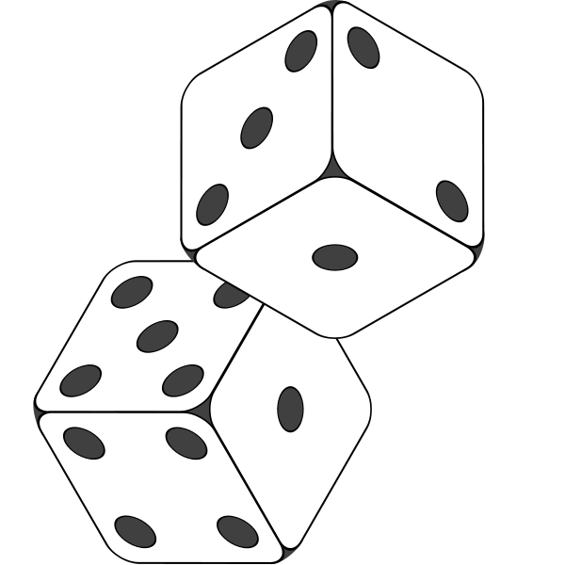
Spatial Variation-Aware RowHammer Defenses
Key insight: Significant variation across DRAM rows
Key Idea: Dynamically tune the aggressiveness of existing solutions to the victim row’s read disturbance vulnerability
Svärd: Spatial Variation-Aware Read Disturbance Defenses Fewer preventive actions (e.g., refresh) for stronger rows
PARA: Probabilistic Row Activation [Kim+, ISCA’14]
Random
Number
Yes
Preventively
refresh the victim row
Row
Activation
>
Threshold
>
Threshold
victim row
Less vulnerable
Svärd
Higher threshold
→ Fewer refresh
More vulnerable
Lower threshold
→ More aggressive refresh
Svärd works with many other read disturbance solutions, including:
AQUA [Saxena+, MICRO’22]
BlockHammer [Yaglikci+, HPCA’21]
Hydra [Qureshi+, ISCA’22]
RRS [Saileshwar+, ASPLOS’22]
Yağlıkçı et al., "Spatial Variation-Aware Read Disturbance Defenses:
Experimental Analysis of Real DRAM Chips and Implications on Future Solutions,” in HPCA, 2024.

Slide 51
Performance Evaluation
Cycle-level simulations using Ramulator 2.0 [Luo+, CAL 2023]
System Configuration:
Workloads: 120 different 8-core multiprogrammed workloads from SPEC CPU2006, SPEC CPU2017, TPC, MediaBench, and YCSB benchmark suites
Integrated with AQUA, BlockHammer, PARA, Hydra, and RRS
HC_{first}: {4K, 2K, 1K, 512, 256, 128, 64} hammers The minimum hammer count needed to induce the first bitflip
Processor | 3.2 GHz, 8 core, 4-wide issue, 128-entry instr. window
Last-Level Cache | 64-byte cache line, 8-way set-associative, 8 MB
Memory Scheduler | FR-FCFS
Address Mapping | Minimalistic Open Pages
Main Memory | DDR4, 4 bank group, 4 banks per bank group (16 banks per rank)
Yağlıkçı et al., "Spatial Variation-Aware Read Disturbance Defenses:
Experimental Analysis of Real DRAM Chips and Implications on Future Solutions,” in HPCA, 2024.
Notes:
We use Ramulator for cycle-level simulations in our performance evaluation [CLICK]
We simulate a realistic system with the shown parameters that I will not explain in detail [CLICK]
We simulate 125 different 8-core multiprogrammed workloads [CLICK]
We sweep DRAM chip capacity from 2Gb to 128Gb [CLICK]
And RowHammer threshold: the minimum number of activations needed to induce the first RowHammer bit flip from 1K to 64 [CLICK]

Slide 52
Key Results
Svärd reduces the performance overhead of existing solutions and significantly improves system throughput
Svärd’s hardware complexity:
AQUA [Saxena+, MICRO’22]
1.6x
BlockHammer [Yaglikci+, HPCA’21]
4.9x
Hydra [Qureshi+, ISCA’22]
1.1x
PARA [Kim+, ISCA’14]
2.0x
RRS [Saileshwar+, ASPLOS’22]
4.8x
No
Additional
Latency
In-DRAM
Implementation
0.006%
In-Processor
Implementation
0.027%
Svärd improves system’s availability at low cost without compromising data integrity
Yağlıkçı et al., "Spatial Variation-Aware Read Disturbance Defenses:
Experimental Analysis of Real DRAM Chips and Implications on Future Solutions,” in HPCA, 2024.

Slide 53
Major Contributions
To efficiently and scalably mitigate DRAM read disturbance, we
build a detailed understanding of DRAM read disturbance
devise novel solutions leveraging insights into DRAM chip internals and memory controllers
MICRO’21
DSN’22
1
Memory access patterns
Temperature
Voltage
Victim cell’s physical location
Representative Novel Solutions
2
HPCA’24
MICRO’22
HPCA’21
Svärd: Leveraging heterogeneity
BlockHammer: Selectively throttling unsafe accesses
HiRA: Parallelizing preventive actions
Notes:
To address these two problems, we conducted several studies encompassed in this thesis statement [CLICK]
We can mitigate DRAM read disturbance efficiently and scalably from three aspects [CLICK]
First, by building a detailed understanding of DRAM read disturbance [CLICK],
Which we explore for temperature [CLICK],
Memory access patterns [CLICK],
Victim cell’s physical location [CLICK],
And voltage [CLICK]
Second, by leveraging insights into modern DRAM chips and memory controllers [CLICK],
Where we leverage the heterogeneity in DRAM cells’ vulnerability levels [CLICK]
and parallelize preventive actions [CLICK]
Third, by devising novel solutions that do not require proprietary knowledge of DRAM chip internals[CLICK],
Which we achieve by selectively throttling unsafe accesses [CLICK]

Slide 54
Challenge (2/2): Compatibility
Application
Level
In-DRAM Mapping
Virtual Memory Address
Proprietary
Processor-visible
Row Addresses
System
Level
Physical Memory Address
Memory
Controller
DRAM Bus Addresses
(Channel, Rank, Bank, Row…)
Physical Row Addresses
Visible within the processor
DRAM chip
A RowHammer attack hammers Row A
Processor-based defenses can detect the attack
Refresh rows A+1 and A-1
Bitflips still may occur due to unknown DRAM-internal row mapping
Victim
Rows
Row A
Row A-1
Row A+1
Physical Row Layout
Many existing solutions rely on this proprietary information
Notes:
The second problem is about compatibility with DRAM communication protocols [CLICK]
Let’s recap how we manage memory addresses. We use virtual addresses in the application level [CLICK]
The system software translates them to physical addresses [CLICK]
Which then parsed in the memory controller to identify DRAM bus addresses, such as banks and rows [CLICK]
All these translations are visible within the processor [CLICK]
However, yet another translation is performed within the DRAM chips from processor-visible addresses to physical row addresses [CLICK]
This translation is proprietary information of the DRAM vendors and obfuscated from the processor [CLICK]
When a RowHammer attack hammers a Row A [CLICK]
A defense implemented in the processor can detect this attack [CLICK]
And preventively refresh row addresses A+1 and A-1, which may not correspond to actual victim rows [CLICK]
As a result, bitflips still may occur [CLICK]
Unfortunately, many existing solutions rely on this proprietary information [CLICK]

Slide 55


BlockHammer
Application
Level
Virtual Memory Address
In-DRAM Mapping
Proprietary
Processor-visible
Row Addresses
System
Level
Physical Memory Address
Memory
Controller
DRAM Bus Addresses
(Channel, Rank, Bank, Row…)
Physical Row Addresses
Visible within the processor
DRAM chip
A RowHammer attack hammers Row A
BlockHammer detects hammered rows using area-efficient Bloom filters
Selectively throttles accesses targeting hammered rows
Victim
Rows
???
Row A
Row A-1
Row A+1
Physical Row Layout
BlockHammer prevents read disturbance bitflips without the knowledge of or modifications to DRAM chip internals
Yağlıkçı, et al., ”BlockHammer: Preventing RowHammer at Low Cost by Blacklisting Rapidly-Accessed DRAM Rows" in HPCA, 2021.
Notes:
The second problem is about compatibility with DRAM communication protocols [CLICK]
Let’s recap how we manage memory addresses. We use virtual addresses in the application level [CLICK]
The system software translates them to physical addresses [CLICK]
Which then parsed in the memory controller to identify DRAM bus addresses, such as banks and rows [CLICK]
All these translations are visible within the processor [CLICK]
However, yet another translation is performed within the DRAM chips from processor-visible addresses to physical row addresses [CLICK]
This translation is proprietary information of the DRAM vendors and obfuscated from the processor [CLICK]
When a RowHammer attack hammers a Row A [CLICK]
A defense implemented in the processor can detect this attack [CLICK]
And preventively refresh row addresses A+1 and A-1, which may not correspond to actual victim rows [CLICK]
As a result, bitflips still may occur [CLICK]
Unfortunately, many existing solutions rely on this proprietary information [CLICK]

Slide 56
BlockHammer: Evaluation
Cycle-level simulations using Ramulator and DRAMPower
System Configuration:
Single-Core Benign Workloads:
22 SPEC CPU 2006
4 YCSB Disk I/O
2 Network Accelerator Traces
2 Bulk Data Copy with Non-Temporal Hint (movnti)
Randomly Chosen Multiprogrammed Workloads:
125 workloads containing 8 benign applications
125 workloads containing 7 benign applications and 1 RowHammer attack
Processor | 3.2 GHz, {1,8} core, 4-wide issue, 128-entry instr. window
LLC | 64-byte cache line, 8-way set-associative, {2,16} MB
Memory scheduler | FR-FCFS
Address mapping | Minimalistic Open Pages
DRAM | DDR4 1 channel, 1 rank, 4 bank group, 4 banks per bank group
RowHammer Threshold | 32K → 1K
Yağlıkçı, et al., ”BlockHammer: Preventing RowHammer at Low Cost by Blacklisting Rapidly-Accessed DRAM Rows" in HPCA, 2021.
Notes:
We conduct cycle-level simulations using RAMULATOR and DRAMPOWER to evaluate the performance and DRAM energy consumption.
[CLICK] We simulate a realistic system with a DDR4 DRAM module.
[CLICK] We use single-core workloads from four benchmarks in our simulations.
22 SPEC benchmarks, 4 disk I/O memory access traces from YCSB benchmark suite, 2 memory access traces collected from a network accelerator chip, and 2 synthetic traces that mimic bulk data copy with non-temporal hint.
[CLICK] We randomly combine these workloads to create two types of eight-core multiprogrammed workloads:
[CLICK] workloads that contain eight benign applications
[CLICK] and workloads that contain seven benign applications along with one thread performing RowHammer attack.

Slide 57
BlockHammer: Evaluation
Cycle-level simulations using Ramulator and DRAMPower
System Configuration:
Single-Core Benign Workloads:
22 SPEC CPU 2006
4 YCSB Disk I/O
2 Network Accelerator Traces
2 Bulk Data Copy with Non-Temporal Hint (movnti)
Randomly Chosen Multiprogrammed Workloads:
125 workloads containing 8 benign applications
125 workloads containing 7 benign applications and 1 RowHammer attack
No RowHammer attack: Negligible (<0.6%) performance and energy overheads
Processor | 3.2 GHz, {1,8} core, 4-wide issue, 128-entry instr. window
LLC | 64-byte cacheline, 8-way set-associative, {2,16} MB
Memory scheduler | FR-FCFS
Address mapping | Minimalistic Open Pages
DRAM | DDR4 1 channel, 1 rank, 4 bank group, 4 banks per bank group
RowHammer Threshold | 32K
RowHammer attack present: Significant improvement on system performance (71%) and energy consumption (32%)
Yağlıkçı, et al., ”BlockHammer: Preventing RowHammer at Low Cost by Blacklisting Rapidly-Accessed DRAM Rows" in HPCA, 2021.
Notes:
We conduct cycle-level simulations using RAMULATOR and DRAMPOWER to evaluate the performance and DRAM energy consumption.
[CLICK] We simulate a realistic system with a DDR4 DRAM module.
[CLICK] We use single-core workloads from four benchmarks in our simulations.
22 SPEC benchmarks, 4 disk I/O memory access traces from YCSB benchmark suite, 2 memory access traces collected from a network accelerator chip, and 2 synthetic traces that mimic bulk data copy with non-temporal hint.
[CLICK] We randomly combine these workloads to create two types of eight-core multiprogrammed workloads:
[CLICK] workloads that contain eight benign applications
[CLICK] and workloads that contain seven benign applications along with one thread performing RowHammer attack.

Slide 58
Publications in PhD Dissertation
Dissertation: "Enabling Efficient and Scalable DRAM Read Disturbance Mitigation via New Experimental Insights into Modern DRAM Chips," ETH Zürich, 2024.
A. Giray Yağlıkçı, Yahya Can Tuğrul, Geraldo F. Oliveira, İsmail Emir Yüksel, Ataberk Olgun, Haocong Luo, Onur Mutlu "Spatial Variation-Aware Read Disturbance Defenses: Experimental Analysis of Real DRAM Chips and Implications on Future Solutions," in HPCA, 2024.
A. Giray Yağlıkçı, Ataberk Olgun, Minesh Patel, Haocong Luo, Hasan Hassan, Lois Orosa, Oguz Ergin, and Onur Mutlu, "HiRA: Hidden Row Activation for Reducing Refresh Latency of Off-the-Shelf DRAM Chips," in MICRO, 2022.
A. Giray Yağlıkçı, Haocong Luo, Geraldo F. de Oliveira, Ataberk Olgun, Minesh Patel, Jisung Park, Hasan Hassan, Jeremie S. Kim, Lois Orosa, and Onur Mutlu, "Understanding RowHammer Under Reduced Wordline Voltage: An Experimental Study Using Real DRAM Devices," in DSN, 2022.
A. Giray Yağlıkçı, Lois Orosa, Haocong Luo, Ataberk Olgun, Jisung Park, Hasan Hassan, Minesh Patel, Jeremie S. Kim, and Onur Mutlu, "A Deeper Look into RowHammer’s Sensitivities: Experimental Analysis of Real DRAM Chips and Implications on Future Attacks and Defenses," in MICRO, 2021.
A. Giray Yağlıkçı, Minesh Patel, Jeremie S. Kim, Roknoddin Azizi, Ataberk Olgun, Lois Orosa, Hasan Hassan, Jisung Park, Konstantinos Kanellopoulos, Taha Shahroodi, Saugata Ghose, and Onur Mutlu, "BlockHammer: Preventing RowHammer at Low Cost by Blacklisting Rapidly-Accessed DRAM Rows," in HPCA, 2021.

Slide 59


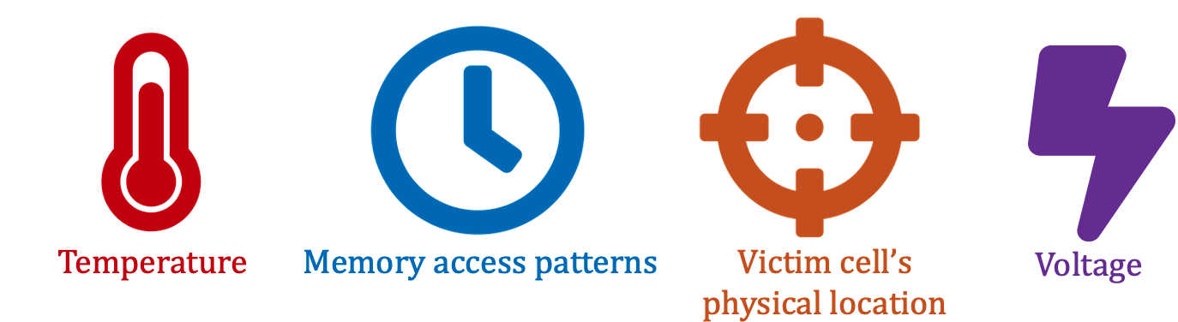



More Details and Discussion on YouTube
https://www.youtube.com/live/CRtm1es4n3o?si=8N5zB6e_RUc5Ejl8
https://www.youtube.com/live/YQwRYWpCsk0?si=jXPueMHb5wgs69-q

Slide 60
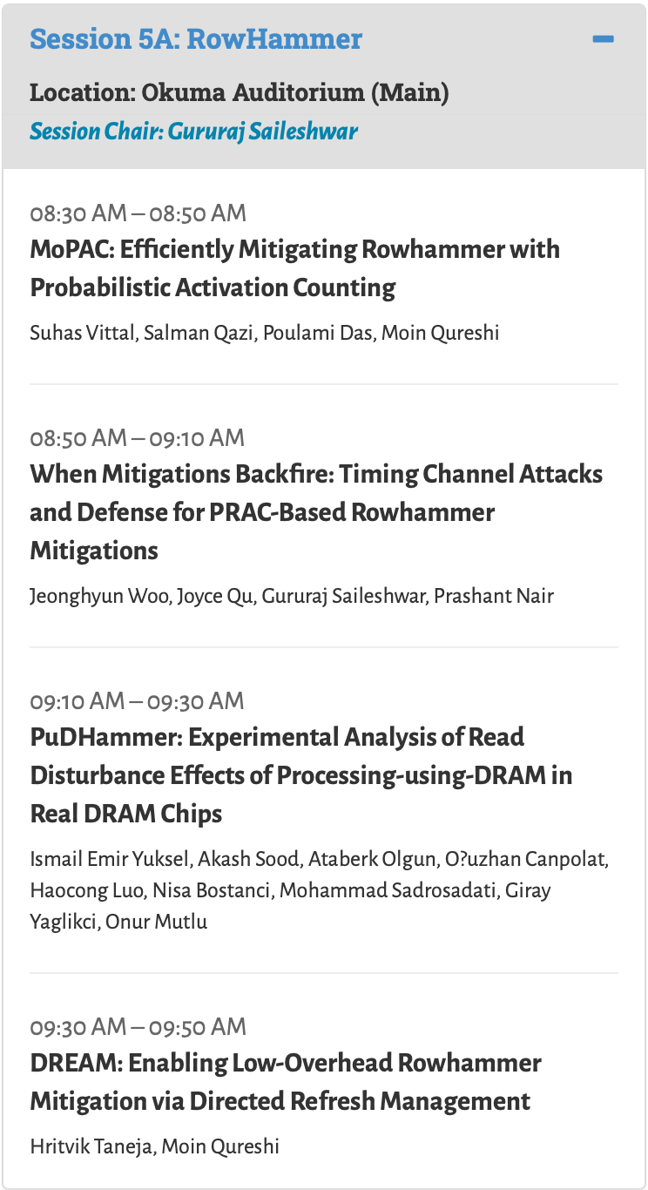
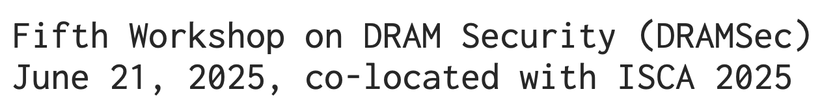
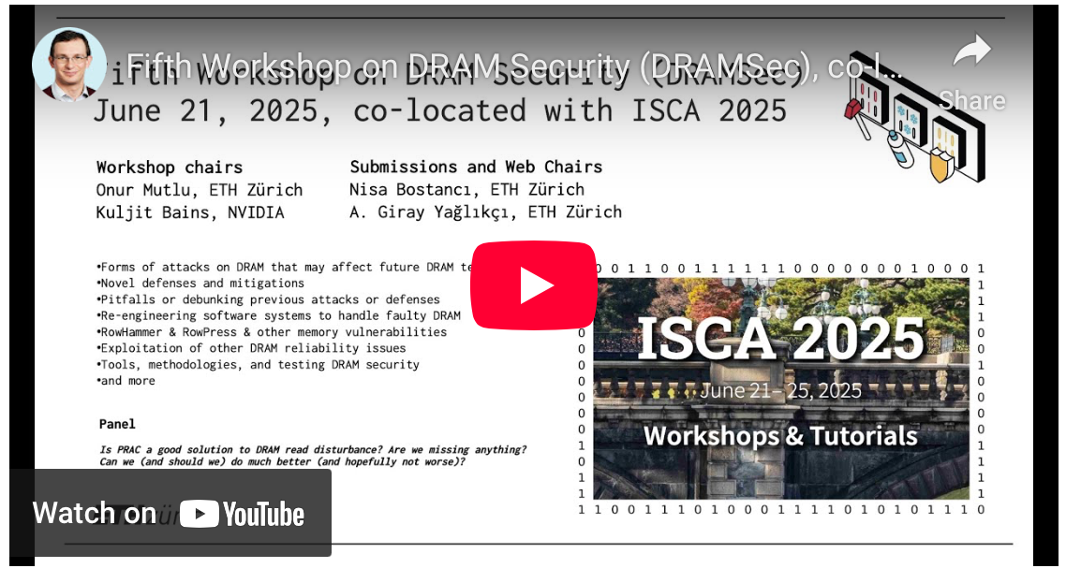




RowHammer in ISCA 2025
https://dramsec.ethz.ch
In participation of experts from

Slide 61
Towards Robust and Sustainable Scaling
Pre-PhD Research
Understanding and reducing memory access latency
Understanding and reducing memory energy consumption
PhD Research
Understanding read disturbance failures in main memory
Mitigating read disturbance failures in main memory
Post-PhD Research
Improving the availability of data and resources while mitigating read disturbance failures in main memory
Future Research
Hardware-software co-design
Data-centric robustness
Better understanding of hardware failures
technology node scaling AND scale-out systems

Slide 62
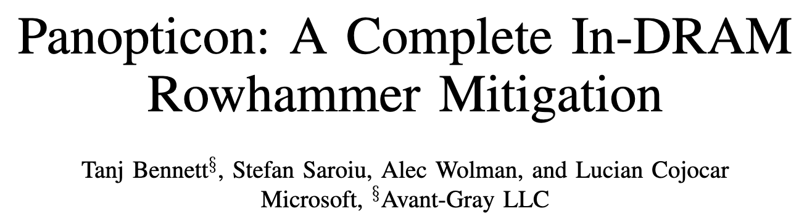
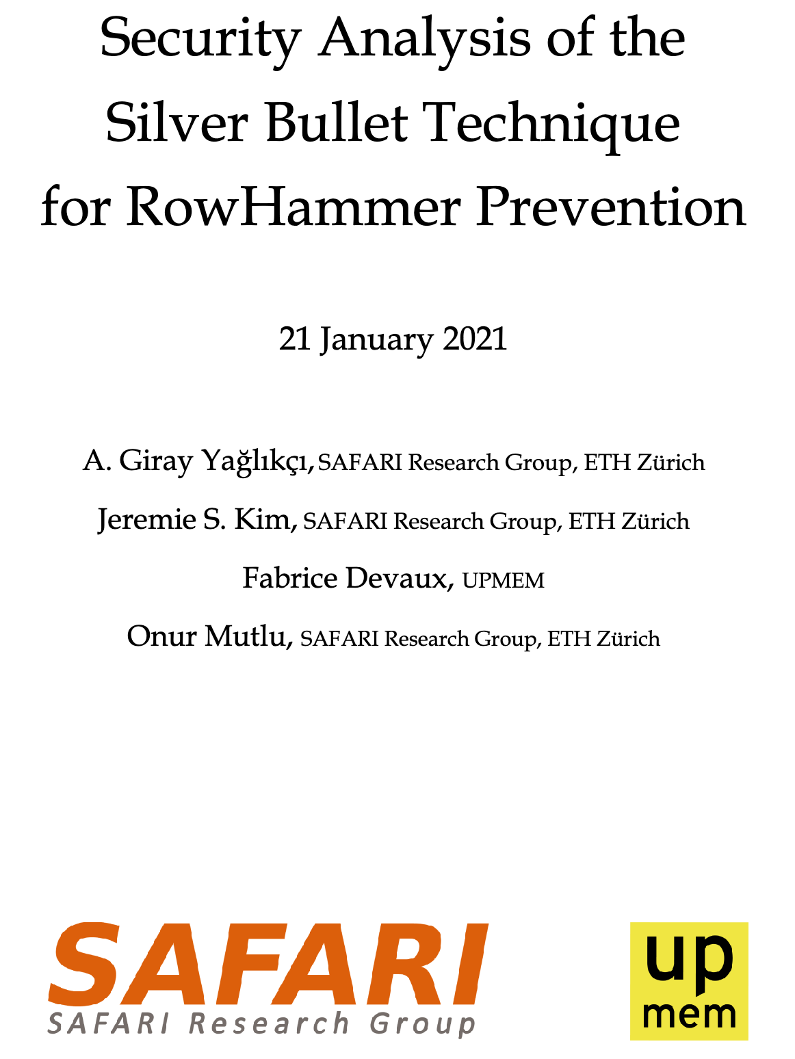
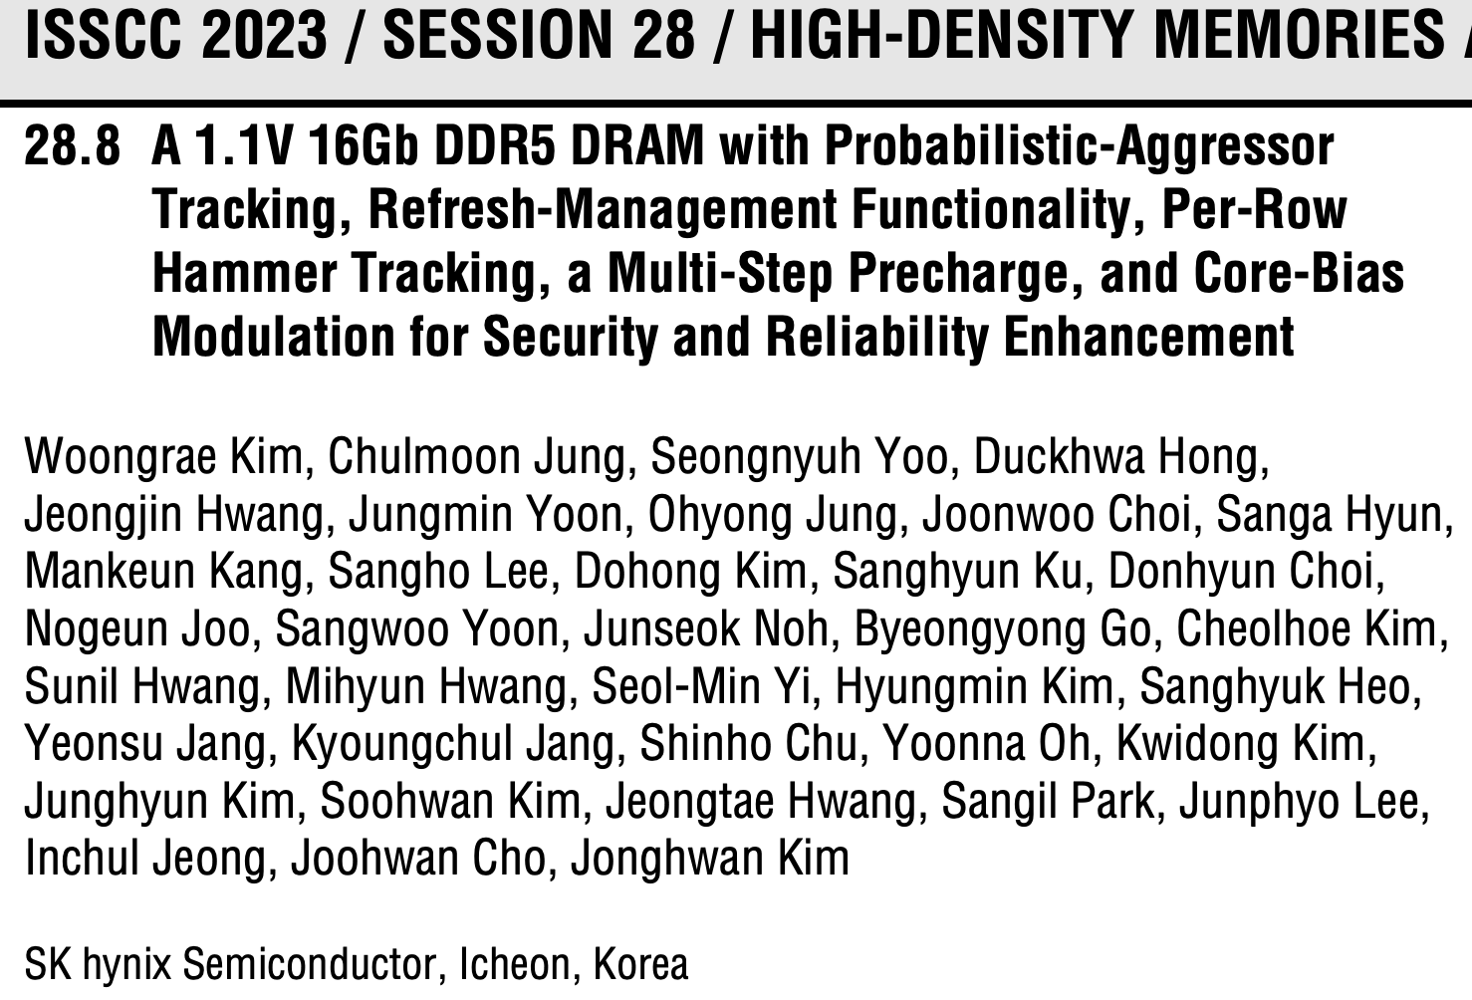
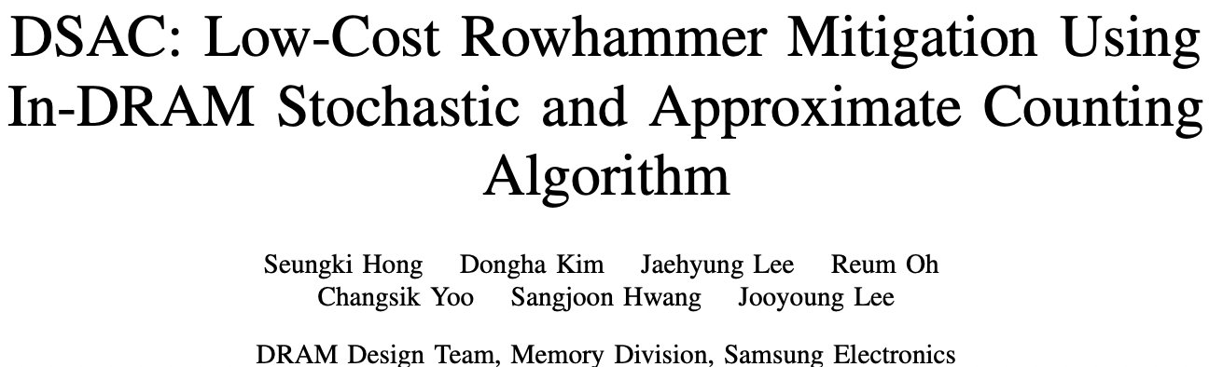

Meanwhile: RowHammer in Industry Research
JEDEC* formed a RowHammer task force
Manufacturers’ attitude changed: Denial → Solution
An early secure solution emerged from UPMEM
Then Microsoft, SK Hynix, Samsung, NVIDIA
Google hacked Samsung’s solution
2023
2021
2023
2024
2021
2024
*JEDEC: Joint Electron Device Engineering Council

Slide 63
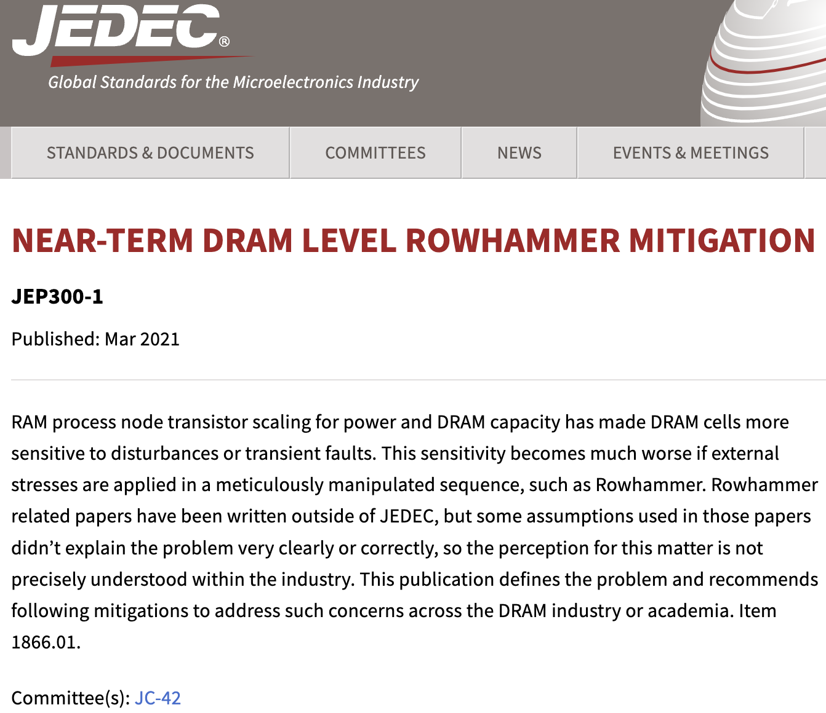

Meanwhile: RowHammer in Industry Research
https://www.jedec.org/standards-documents/docs/jep300-1
https://www.jedec.org/standards-documents/docs/jep301-1

Slide 64


Meanwhile: RowHammer in Industry Research
The first promising update
a decade after the discovery of RowHammer
PRAC: Per Row Activation Counting in DRAM

Slide 65


Understanding Industry’s Solution
presented in DRAMSec 2024 (co-located with ISCA)
https://github.com/CMU-SAFARI/ramulator2
PRAC is secure against RowHammer
PRAC increases the latency of closing a DRAM row, causing ~10% performance degradation for benign workloads
PRAC can be exploited by memory performance attacks (up to 94% reduction in DRAM chip’s availability)
Co-supervised paper

Slide 66



PRAC: Industry’s Best Solution to RowHammer
Per Row Activation Counting (PRAC) [JEDEC, 2024]
Tracking RowHammer: DRAM chip
Maintains an activation counter for each DRAM row
Updates the counter of a row while the row is closed
Mitigating RowHammer: DRAM chip
Internally performs preventive refreshes
Needs time to perform preventive refreshes
Sends a back-off signal to the memory controller to ask for time
Memory controller provides DRAM chip with time for RowHammer-preventive refreshes
The devil is in this detail
High Activation
Count Detected
Counter 0
back-off
Counter 1
RFM
...
Counter 3
Per Row
Activation Counters
Notes:
With PRAC
[CLICK] DRAM maintains an activation counter for each DRAM row
[CLICK] Whenever one of these counters reaches a critical value
For example close to RowHammer threshold
[CLICK] The DRAM module triggers whats called a back-off
[CLICK] After a back-off is received by the memory controller
It stops performing accesses to DRAM
And starts sending special commands that allow time for preventive refreshes
=====
Make the arrow shorter for high activation count
Refreshes should be refresh with subscript ps

Slide 67
Chronus: Making Industry’s Best Solution Better
Problem: PRAC incurs 10% slowdown (common case)
Key Insight: Closing a row has the added latency of updating the row’s counter because the counter is stored within the row
Key Idea: Update row activation counters in parallel to column accesses by leveraging subarray-level parallelism
Key Result: Chronus significantly reduces PRAC’s performance overhead to 0.04%
Counters
DRAM Rows
PRAC increases the latency of closing a DRAM row by 140%
0
101010101010101010101010
0
101010101010101010101010
…
…
Co-supervised paper

Slide 68
Chronus’s Key Idea: Concurrent Counter Update
Chronus concurrently updates counters while serving accesses
DRAM Bank
Row Decoder
Counter 0
Counter N-1
Counter
Subarray
Counter N+1
Counter 2N-1
Counter
Updates
Increment
Row Buffer
Row Decoder
Row 0
Subarray
Level
Parallelism
Regular
Subarray
Row N-1
Row Buffer
Regular
Accesses
Row Decoder
Row N
Regular
Subarray
Row 2N-1
Row Buffer
We leverage inherently-available subarray-level parallelism to alleviate PRAC’s performance overhead
Co-supervised paper
Notes:
Chronus concurrently updates counters with a small change to the bank
Alongside the regular DRAM subarrays that store data, Chronus adds an additional Counter subarray to store counters
DRAM -> access, Counter -> updates
SALP

Slide 69





Making Industry’s Best Solution Better
Oğuzhan Canpolat^{1,2} A. Giray Yağlıkçı¹ Geraldo F. Oliveira¹ Ataberk Olgun¹
Nisa Bostancı¹ İsmail Emir Yüksel¹ Haocong Luo¹
Oğuz Ergin^{2,3} Onur Mutlu¹
¹ETH Zürich ²TOBB University of Economics and Technology ³University of Sharjah
published in HPCA 2025
https://github.com/CMU-SAFARI/Chronus
Co-supervised paper

Slide 70







BreakHammer: Throttling Suspect Threads in Hardware
Suspect Thread
Trace back who triggered
Attacker
Core
RowHammer-preventive actions
Memory
Controller
User
Core
Detect and slow down the memory accesses of threads
that trigger many RowHammer-preventive actions
Key Results:
Under attack:
Significantly improves system performance (by 90% on average)
Significantly reduces energy consumption (by 55% on average)
No attack:
Slightly (<1%) improves performance and energy consumption
https://github.com/CMU-SAFARI/BreakHammer
Co-supervised paper
Notes:
BreakHammer’s key idea is to detect and slow down the memory accesses of threads that trigger many RowHammer-preventive actions
[CLICK] We refer to these threads as suspect threads

Slide 71

published in MICRO 2024
https://github.com/CMU-SAFARI/BreakHammer
Co-supervised paper

Slide 72
Towards Robust and Sustainable Scaling
Pre-PhD Research
Understanding and reducing memory access latency
Understanding and reducing memory energy consumption
PhD Research
Understanding read disturbance failures in main memory
Mitigating read disturbance failures in main memory
Post-PhD Research
Improving the availability of data and resources while mitigating read disturbance failures in main memory
Future Research
Hardware-software co-design
Data-centric robustness
Better understanding of hardware failures
technology node scaling AND scale-out systems

Slide 73
Hardware-Software Co-Design for Sustainable Robustness
Memory virtualization
CPU scheduling
Address space
Insights into data structures
Software semantics
User / Process / Thread / Address Space
User behaviors
Data confidentiality requirements
Parent processes
Data sparsity
Software
Error resilience
Co-design can make security low cost
Hardware
Thermal management
Accelerators
Hyperthreading
Accurate measurements
Prompt responses
Voltage scaling
Prompt response
Sensors
Counters
Prefetchers
Many opportunities for ensuring security at low cost

Slide 74
Hardware-Assisted Malware Detection An Example HW-SW Co-Design Direction
Hardware-level sensors and counters can quickly and accurately collect data on application behavior and react in nanoseconds
RowHammer attacks (e.g., BlockHammer [Yaglikci+, HPCA’21])
Performance attacks (e.g., BreakHammer [Canpolat+, MICRO’24])
Timing side channel attacks (e.g., Cyclone [Harris, MICRO’19])
…
Software-level malware detection has a better big picture
Program(s) that spawn those malicious threads
User(s) that run those programs
More constructive reactions (e.g., flag functions and inform programmers)
Key Insight: System-level attacks often try the attack many times
Key Idea: Provide software-level malware detection with hardware-level observations and statistics

Slide 75
Towards Robust and Sustainable Scaling
Pre-PhD Research
Understanding and reducing memory access latency
Understanding and reducing memory energy consumption
PhD Research
Understanding read disturbance failures in main memory
Mitigating read disturbance failures in main memory
Post-PhD Research
Improving the availability of data and resources while mitigating read disturbance failures in main memory
Future Research
Hardware-software co-design
Data-centric robustness
Better understanding of hardware failures
technology node scaling AND scale-out systems

Slide 76

Data-Centric Security and Privacy (1/5) Motivation for Sustainable Scaling
William Dally,
HiPEAC 2015
A memory access (off-chip data movement) consumes ~100x-1000x the energy of an arithmetic operation

Slide 77
Data-Centric Security and Privacy (2/5) High-Level Motivation for Data-Centric S&P
Data-centric computation
for better performance (-per-Joule and –per-area)
Processing in Memory and Storage
are two promising computation paradigms
More to do for Security in Memory and Storage

Slide 78
Data-Centric Security and Privacy Problem Definition
Common security practices are processor-centric e.g., Intel SGX and ARM TrustZone
Moving encrypted data across chips consumes time and energy, increases bus usage, and reduces processor’s and memory’s availability
Supporting accelerators near memory and storage becomes complicated
Processing in memory and storage can perform
Encryption
Isolation
Access control
Error correction
Timing obfuscation
…
Processing in memory and storage have a lot to offer

Slide 79



Data-Centric Security and Privacy
Specialized circuitry near data
Hardware complexity
Added latency
Computation using homomorphic encryption
High capacity overhead → Against density scaling
Increased execution time
HPCA’25
MICRO’21
ASPLOS’25
State-of-the-art is far from a definitive solution

Slide 80

Security of Data-Centric Computation
Timing side- and covert-channel attacks are easier near/in memory
Less noise
No (or simpler) caches
Finer-grained control
Larger channel bandwidth
No low-cost and effective solution yet
DSN 2025
https://arxiv.org/pdf/2404.11284

Slide 81
Data-Centric Security and Privacy Workloads of Special Interest
Critical health applications
Agent-based simulations
Genomics
Common characteristics
Excessively large amount of data
Computation in distributed and shared environments
Data integrity is important for correctness
Confidentiality and privacy are first-order concerns
Performance challenges are barely solved so far
Bad news: We are far from ideal
Good news: Lots of research to conduct

Slide 82
Towards Robust and Sustainable Scaling
Pre-PhD Research
Understanding and reducing memory access latency
Understanding and reducing memory energy consumption
PhD Research
Understanding read disturbance failures in main memory
Mitigating read disturbance failures in main memory
Post-PhD Research
Improving the availability of data and resources while mitigating read disturbance failures in main memory
Future Research
Hardware-software co-design
Data-centric robustness
Better understanding of hardware failures
technology node scaling AND scale-out systems

Slide 83
Better Understanding of Failure Mechanisms
A generic question: what is the worst-case for a given system?
Failure mechanisms depend on many conditions and can be observed somewhat probabilistically
Post-manufacturing testing cannot cover all conditions practically
Better methodologies and infrastructures are needed
Testing is costly
the chip cannot be used while testing
you need to buy chips to test
We need to revolutionize testing and data collection with
Online testing methodologies: test a chip in runtime when it is idle
Automated reverse-engineering tools
Crowdsource data collection for scaling up sample sets

Slide 84




Some Good Examples of Testing Infrastructures
Examples of good offline testing tools
DRAM Bender
Revizor
We need plug-and-play online (runtime) testing tools

Slide 85
Systems should scale
robustly and sustainably
as chips get denser
and many users share systems

Slide 86
Secure and Sustainable System Scaling
Abdullah Giray Yağlıkçı
UC Berkeley
August 5, 2025
Notes:
Hi, my name is Giray and today I will give a high-level overview of my PhD research and future research plans

Slide 87
Secure and Sustainable System Scaling
Backup Slides
Abdullah Giray Yağlıkçı
UC Berkeley
August 5, 2025
Notes:
Hi, my name is Giray and today I will give a high-level overview of my PhD research and future research plans

Slide 88
Brief Self Introduction
Researcher
SAFARI Research Group
ETH Zurich (Feb 2018 – ongoing)
Intel Labs (Aug 2017 – Feb 2018)
Carnegie Mellon University (Aug 2016 – Aug 2017)
Earlier:
Univ. of Notre Dame, IN, USA (Aug 2014-Aug 2016)
TOBB Univ., Ankara, Turkey (Aug 2011-Aug 2014)
Research interests:
Computer architecture
Memory and storage systems
Hardware security, safety, reliability, performance, availability, fairness, energy efficiency
Hardware/software cooperation
Memory-centric security
Testing and verification
…
Abdullah Giray Yaglikci Postdoc. Researcher and Lecturer
ETH Zurich
https://agyaglikci.github.io
agirayyaglikci@gmail.com
PhD: ETH Zurich, 2024

Slide 89

Memory Organization
Prevalent memory technology: Dynamic Random Access Memory (DRAM)
DRAM
Module
Subarray
Bitline
DRAM Cell
Bank
Wordline
…
Chip I/O
. . .
DRAM Row
…
…
…
…
…
Row Buffer
DRAM Chip
DRAM Bank
DRAM Subarray
Notes:
This is a DRAM module, used as the main memory on many systems. [CLICK]
A DRAM module consists of multiple chips each of which contains multiple banks [CLICK]
Each bank is composed of multiple subarrays [CLICK]
And within each subarray, there is a two dimensional array of DRAM cells. [CLICK]
These cells are organized into rows that are selected using wordlines [CLICK]
And the cells are connected to a row buffer via bitlines [CLICK]

Slide 90
DRAM Operation
Prevalent memory technology: Dynamic Random Access Memory (DRAM)
Bitline
DRAM Cell
Wordline
Wordline
Access transistor
…
DRAM Subarray
…
DRAM Cell
charge
leakage
paths
Capacitor
Bitline
…
…
…
…
Row Buffer
Refresh: Restores the capacitor voltage with a time period called refresh window
I/O Circuitry
Row Activation: Fetch the row’s content into the row buffer
Column Access: Read/Write a column in the row buffer
Precharge: Disconnect the row from the row buffer
Notes:
This is a simplified diagram of a DRAM cell, where the data is stored as capacitor voltage and accessed through the access transistor [CLICK]
A DRAM cell inherently exhibits several charge leakage paths [CLICK]
And requires to perform refresh operations to restore the capacitor voltage with a time period called refresh window.
[PAUSE]
To access a DRAM cell, [CLICK]
the memory controller must first open or activate the row to fetch the row’s data into the row buffer [CLICK]
The READ and WRITE requests targeting the row are serviced from the row buffer [CLICK]
After all requests are serviced from the row, the memory controller must close or precharge the row in order to begin accessing data from another row. [CLICK]

Slide 91

RowHammer under Reduced Refresh Latency
Experimental data out of 388 DDR4 DRAM chips from 3 major vendors
RowHammer-preventive refresh latency can be significantly reduced without jeopardizing the DRAM chip’s data integrity
PaCRAM: Partial Charge Restoration for Aggressive Mitigation
Reduces the latency of RowHammer-preventive refreshes
Performs preventive refreshes slightly more frequently
Improves system performance and energy efficiency
Near-zero hardware complexity
published in HPCA 2025
https://github.com/CMU-SAFARI/PaCRAM
Co-supervised paper
Notes:
In summary,
[CLICK] The three major DRAM maintenance operations are refresh, RowHammer protection, and memory scrubbing.
[CLICK] We observe that implementing new and efficient maintenance mechanisms often requires difficult-to-realize changes in various system components, including the DRAM interface and the memory controller.
[CLICK] In this work, our goal is to first, ease the process of enabling new DRAM maintenance operations in DRAM and
[CLICK] enable more efficient in-DRAM maintenance operations
[CLICK] To this end, we propose Self-Managing DRAM (or SMD for short), which enables implementing new in-DRAM maintenance mechanisms with no further changes in the DRAM interface and the memory controller
[CLICK] According to our evaluations, SMD-based maintenance mechanisms achieve significant performance and energy efficiency benefits across many system configurations and workloads.
[CLICK] We release the source code of SMD on github.

Slide 92
Major Contributions
To efficiently and scalably mitigate DRAM read disturbance, we
build a detailed understanding of DRAM read disturbance
leverage insights into modern DRAM chips and memory controllers
devise a novel solution that do not require proprietary knowledge of DRAM chip internals
MICRO’21
DSN’22
1
Memory access patterns
Temperature
Voltage
Victim cell’s physical location
2
HPCA’24
MICRO’22
HiRA: Parallelizing preventive actions
Svärd: Leveraging heterogeneity
3
HPCA’21
BlockHammer: Selectively throttling unsafe accesses
Notes:
To address these two problems, we conducted several studies encompassed in this thesis statement [CLICK]
We can mitigate DRAM read disturbance efficiently and scalably from three aspects [CLICK]
First, by building a detailed understanding of DRAM read disturbance [CLICK],
Which we explore for temperature [CLICK],
Memory access patterns [CLICK],
Victim cell’s physical location [CLICK],
And voltage [CLICK]
Second, by leveraging insights into modern DRAM chips and memory controllers [CLICK],
Where we leverage the heterogeneity in DRAM cells’ vulnerability levels [CLICK]
and parallelize preventive actions [CLICK]
Third, by devising novel solutions that do not require proprietary knowledge of DRAM chip internals[CLICK],
Which we achieve by selectively throttling unsafe accesses [CLICK]

Slide 93


Other Works (Not Covered due to Time Limitation)
DSN 2022
First work to investigate wordline voltage’s effect on RowHammer vulnerability
Reducing wordline voltage reduces RowHammer vulnerability
Worsens data retention time and row activation latency
MICRO 2022
Leverages inherently-available but not exposed subarray-level parallelism in DRAM
Reduces time spent for refresh by half and improves system performance

Slide 94


A Deeper Look into RowHammer’s Sensitivities Experimental Analysis of Real DRAM Chips and Implications on Future Attacks and Defenses
Lois Orosa Abdullah Giray Yağlıkçı
Haocong Luo Ataberk Olgun Jisung Park
Hasan Hassan Minesh Patel Jeremie S. Kim Onur Mutlu
Notes:
Hello, I am Giray,
and I will be presenting our work
A Deeper Look into RowHammer’s Sensitivities: Experimental Analysis of Real DRAM Chips and Implications on Future Attacks and Defenses

Slide 95
Impact of Temperature on DRAM Cells
Vulnerable from 70°C to 85 ° C
Fraction of Vulnerable DRAM Cells
Upper Bound (°C)
Vulnerable
from 55°C to 60°C
Lower Bound (°C)
Different DRAM cells are vulnerable to RowHammer within specific temperature ranges
Notes:
This figure shows the population density of cells, clustered based on their vulnerable temperature range. The x-axis and y-axis show the lower bound [CLICK] and the upper bound [CLICK] of a DRAM cell’s vulnerable temperature range [CLICK]
The color-scale and the percentage values show the fraction of cells for a given temperature range [CLICK]
For example, 0.4% of the cells are vulnerable to RowHammer only between 55 and 60 degrees Celsius [CLICK],
while 0.5% of the cells experience bit flips only between 70 and 85 degrees Celsius [CLICK]
We conclude that different DRAM cells are vulnerable to RowHammer within specific temperature ranges [CLICK]

Slide 96
Impact of Temperature on DRAM Cells
Upper Bound (°C)
29.8% of the cells experience bit flips at all tested temperatures
Lower Bound (°C)
OBSERVATION 2
A significant fraction of vulnerable DRAM cells exhibit bit flips at all tested temperatures
Notes:
Here are the results for all four manufacturers.
We make two observations from this figure. [CLICK]
First, we observe that a significant fraction of vulnerable DRAM cells exhibit bit flips at all tested temperatures For example, almost 30% of cells from manufacturer D experience bit flips at all temperatures we tested, [CLICK]

Slide 97
Impact of Temperature on DRAM Cells
Upper Bound (°C)
0.2% of the cells experience bit flips only at 70°C
Lower Bound (°C)
OBSERVATION 3
A small fraction of all vulnerable DRAM cells are vulnerable to RowHammer only in a very narrow temperature range
Notes:
Second, we observe that [CLICK]
a small fraction of the cells from all four manufacturers are vulnerable to RowHammer only in a very narrow temperature range. [CLICK]
For example, 0.2% of the cells from manufacturer D experience bit flips only at 70C. [CLICK]

Slide 98
Impact of Temperature on DRAM Rows
Variation in
Bit Flip Counts
per DRAM Row
Temperature (°C)
More cells experience bit flips as temperature increases
Notes:
Next, we study the impact of temperature on DRAM rows. The figure shows how the number of bit flips in the victim row changes as temperature increases.[CLICK]
The x-axis shows the increasing temperature [CLICK] and y-axis reports the variation in bit flip counts normalized to the mean value at 50°C. [CLICK]
We observe that more cells experience a bit flip with increasing temperature, [CLICK]

Slide 99
Impact of Temperature on DRAM Rows
Variation in Bit Flip Counts per DRAM Row
Temperature (°C)
OBSERVATION 4
A DRAM row’s bit error rate can either increase or decrease with temperature depending on the DRAM manufacturer
Notes:
We repeat this analysis for all four manufacturers [CLICK]
We observe that the bit error rate increases with temperature in modules from three manufacturers, [CLICK]
While it exhibits an opposite trend in modules from manufacturer B. We hypothesize that this happens due to different characteristics of charge trap error mechanisms in different manufacturers. Please refer to our full paper for more details [CLICK]
Our main observation from this figure is that A DRAM row’s BER can either increase or decrease with temperature depending on the DRAM manufacturer [CLICK]

Slide 100
Memory Access Patterns in Aggressor Row Active Time Analysis
Baseline access pattern:
Increasing aggressor row active time:
Increasing bank precharged time:
Row A is active
Row B is active
Row A is active
Row B is active
Time
Row A is active
Row B is active
Row A is active
Time
Aggressor row active time
Aggressor row active time
Aggressor row active time
Row A is active
Row B is active
Row A is active
Time
Bank precharged time
Bank precharged time
Bank precharged time
Notes:
To perform this analysis, we conduct two sets of experiments [CLICK]
In the baseline, we hammer rows A and B as frequently as possible [CLICK]
In the first set of tests, we increase the time that an aggressor row is active [CLICK],
And in the second set of experiments we increase the time that the bank is precharged [CLICK]

Slide 101

Increasing Aggressor Row Active Time
Number of Bit Flips
per DRAM Row
Aggressor Row Active Time (ns)
As the aggressor row stays active longer, more DRAM cells experience RowHammer bit flips
Notes:
This plot demonstrates how [CLICK]
bit error rate varies [CLICK]
when aggressor row active time increases [CLICK]
We observe that: As the aggressor row stays active longer, more DRAM cells experience RowHammer bit flips [CLICK]

Slide 102

Increasing Aggressor Row Active Time
Number of Bit Flips
per DRAM Row
Aggressor Row Active Time (ns)
As the aggressor row stays active longer, more DRAM cells experience RowHammer bit flips
Notes:
We observe the same trend on modules from all four manufacturers [CLICK]

Slide 103

Increasing Aggressor Row Active Time
Minimum Activation Count
to Observe a Bit Flip (HC_{first})
Aggressor Row Active Time (ns)
Fewer activations are required to cause RowHammer bit flips when aggressor rows stay active for longer time
Notes:
In this plot, we investigate the variation in Hcfirst, [CLICK]
the minimum activation count to observe a bit flip [CLICK]
With increasing aggressor row active time [CLICK]
We observe that DRAM cells experience bit flips at smaller activation counts when aggressor rows stay active longer [CLICK]

Slide 104
Increasing Aggressor Row Active Time
Minimum Activation Count
to Observe a Bit Flip (HC_{first})
Aggressor Row Active Time (ns)
OBSERVATION 8
As the aggressor row stays active longer, more DRAM cells experience RowHammer bit flips and they experience RowHammer bit flips at lower activation counts
Notes:
We observe the same trend on modules from all four manufacturers [CLICK]
Based on our observations on the bit error rate and Hcfirst, we conclude that: as the aggressor row stays active longer, more DRAM cells experience RowHammer bit flips AND they experience RowHammer bit flips at lower activation counts [CLICK]

Slide 105
RowPress vs. RowHammer
Instead of using a high activation count,
☞ increase the time that the aggressor row stays open
RowHammer
Aggressor Row
Open
Close
36ns, 47K activations to induce bitflips
RowPress
Aggressor Row
Open
Close
7.8µs, only 5K activations to induce bitflips
We observe bitflips even with ONLY ONE activation in extreme cases where the row stays open for 30ms
Notes:
Instead of a high activation count, RowPress increases the time the that aggressor stays open.
Doing disturbs adjacent rows enough to cause bitflips without a very high activation count.
We observe bitflips even with only one activation in extreme cases.

Slide 106

Spatial Variation across Rows
The minimum activation count to observe bit flips (HC_{first}) across DRAM rows:
Minimum Activation Count
to Observe a Bit Flip (HC_{first})
DRAM Rows (sorted by reducing HC_{first})
The RowHammer vulnerability
significantly varies across DRAM rows
Notes:
To do this analysis, we first investigate how Hcfirst, [CLICK]
the minimum activation count to observe bit flips, varies [CLICK]
across different DRAM rows sorted by reducing Hcfirst value on the x-axis.
Each curve in this plot represents a different DRAM module [CLICK]
We observe that Hcfirst values and thus the RowHammer vulnerability significantly varies across DRAM rows, as we highlight [CLICK]

Slide 107
Spatial Variation across Rows
Min. Activation Count
to Observe a Bit Flip (HC_{first})
DRAM Rows (sorted by reducing HC_{first})
The RowHammer vulnerability
significantly varies across DRAM rows
Notes:
This significant variation can be observed on modules from all four manufacturers

Slide 108

Spatial Variation across Rows
Minimum Activation Count
to Observe a Bit Flip (HC_{first})
DRAM Rows (sorted by reducing HC_{first})
OBSERVATION 12
A small fraction of DRAM rows are significantly more vulnerable to RowHammer than the vast majority of the rows
Notes:
Zooming into the most vulnerable DRAM rows, [CLICK]
We observe that the most vulnerable 10% of the rows experience bit flips at activation counts about half the Hcfirst of the other rows [CLICK]
Therefore, we conclude that a small fraction of DRAM rows are significantly more vulnerable to RowHammer than the vast majority of the rows [CLICK]

Slide 109

Spatial Variation across Columns
Number of Bit Flips in a Column
Chip ID
Column Index
OBSERVATION 13
Certain columns are significantly more vulnerable
to RowHammer than other columns
Notes:
To investigate how the RowHammer vulnerability varies across columns, we generate a heatmap plot of [CLICK]
bit error rates [CLICK]
across columns [CLICK]
and chips [CLICK]
We observe that bit errors concentrate on certain DRAM columns more than others, implying that certain columns are significantly more vulnerable to RowHammer than other columns [CLICK]

Slide 110

Spatial Variation across Columns
High RowHammer vulnerability across all chips
→design-induced variation
16.7%
1.0
0.5
0.0
Worse RowHammer Vulnerability
30.6%
0.0 0.2 0.4 0.6 0.8 1.0
Larger Variation across DRAM Chips
High variation in vulnerability across chips
→ manufacturing-process-induced variation
Notes:
To further investigate the variation across columns and chips, we cluster each DRAM column based on [CLICK]
its RowHammer vulnerability on average across DRAM chips [CLICK]
and the variation in its vulnerability across DRAM chips
This plot shows the population density of DRAM columns exhibiting a level of RowHammer vulnerability and variation across chips
For example, [CLICK] 16.7% of DRAM columns exhibit a high RowHammer vulnerability across all chips, indicating design-induced variation across columns [CLICK]
In contrast, 30.6% of DRAM columns exhibit a high variation in their RowHammer vulnerability across chips, indicating manufacturing-process-induced variation [CLICK]

Slide 111
Spatial Variation across Columns
50.8%
16.7%
Worse RowHammer Vulnerability
59.8%
30.6%
29.1%
Larger Variation across DRAM Chips
OBSERVATION 14
Both manufacturing process and design
affect a DRAM column’s RowHammer vulnerability
Notes:
Here we see the same analysis for four manufacturers [CLICK]
We observe that there exist columns with very low or very high variation across chips from all four manufacturers [CLICK]
Based on this analysis, we conclude that both manufacturing process and design affect a DRAM column’s RowHammer vulnerability [CLICK]

Slide 112

Attack Improvement 1: Making DRAM Cells More Vulnerable
An attacker can manipulate temperature to make the cells that store sensitive data more vulnerable
DRAM cells are vulnerable in a bounded temperature range
no bit flips
Vulnerable Temperature Range
no bit flips
Temperature
50°C
70°C
75°C
65°C
55°C
45°C
Heating up chip temperature
Cooling down chip temperature
Notes:
In the first example for an attack improvement, the attacker manipulates the DRAM module’s temperature to increase the RowHammer vulnerability of the cells that store sensitive data [CLICK]
We observe that DRAM cells are vulnerable to RowHammer in a bounded temperature range [CLICK]
that we call vulnerable temperature range [CLICK]
For example, let this range be from 50 to 70 degrees celsius for the victim cells
To attack the cells within their vulnerable temperature range, an attacker can [CLICK]
heat up the chip if its current temperature is below 50 [CLICK]
Or cool down the chip if its current temperature is above 70 degrees celsius [CLICK]

Slide 113
Attack Improvement 2: Temperature-Dependent Trigger
Identify abnormal increase in temperature to attack a data center during its peak hours
Precisely measure the temperature to trigger an attack exactly at the desired temperature
76.6%
of the cells*
1.
70 °C
Temperature
0.4%
of the cells*
2.
0.4%
of the cells*
70 °C
70 °C
Temperature
Temperature
*Example fraction values from Mfr. C
Notes:
In the second attack example, the attacker uses RowHammer to understand the DRAM chip’s current temperature [CLICK]
As an example, more than 76% of the vulnerable cells experience bit flips above 70 degrees Celsius for Mfr C. Focusing on these cells, an attacker can identify abnormal operating conditions that might occur in a data center during its peak hours. This information can be used to trigger an attack when the data center is under pressure[CLICK]
If it is important to measure temperature precisely, the attacker can focus on a smaller set of vulnerable cells that experience bit flips only in a narrow temperature range. For example, 0.4% of vulnerable cells experience bit flips only at 70 degrees Celsius in Mfr C. Using these cells, the attacker can precisely detect the temperature and trigger an attack accordingly [CLICK]

Slide 114
Attack Improvement 3: Bypassing Defenses with Aggressor Row Active Time
Activating aggressor rows as frequently as possible:
Row A is active
Row B is active
Row A is active
Time
Keeping the aggressor rows active for a longer time:
Row A is active
Row B is active
36% reduction in HC_{first}
Time
Reduces the minimum activation count to induce a bit flip by 36%
Bypasses defenses that do not account for this reduction
Notes:
In the third example, an attacker can leverage the effect of aggressor row active time [CLICK]
In this scenario, instead of activating aggressor rows as frequently as possible, [CLICK]
the attacker can keep the aggressor rows active for longer time [CLICK]
Based on our analyses, HCfirst reduces by 36% on average with the proposed access pattern
With this reduction, an attacker can bypass RowHammer defenses that do not account for this reduction [CLICK]

Slide 115
Defense Improvements
Example 1: Leveraging the variation across DRAM rows
Example 2: Leveraging the variation with temperature
A DRAM cell experiences bit flips within a bounded temperature range
A row can be disabled within the row’s vulnerable temperature range
90%
HC_{first}
10%
Aggressiveness can be reduced:
33% area reduction for BlockHammer [Yağlıkçı+, HPCA'21]
$2×$HC_{first}
80% area reduction for Graphene [Park+, MICRO'20]
Breakdown of DRAM Rows
no bit flips
Vulnerable Temperature Range
no bit flips
Temperature
Disable RowA
Disable RowB
Temperature
Notes:
I will also explain two improvements for defense mechanisms in this slide, but you can find more in the paper [CLICK]
The first improvement leverages the variation across rows [CLICK]
We observe that 90% of the rows do not experience bit flips until the activation count reaches the double Hcfirst of the 10% of the rows.[CLICK]
Therefore, we can reduce the aggressiveness of defense mechanisms for 90% of the rows, which can reduce the area overheads of state-of-the-art defense mechanisms: [CLICK] BlockHammer and [CLICK] Graphene, by 33 and 80%, respectively [CLICK]
The second example leverages the variation in RowHammer vulnerability with temperature [CLICK]
We show that DRAM cells experience bit flips in bounded temperature ranges [CLICK]
To avoid bit flips, A DRAM row can be disabled when its cells are vulnerable to RowHammer at the current operating temperature [CLICK]

Slide 116
More Defense Implications in the Paper
Leveraging the similarity across subarrays in a DRAM module can reduce the module’s profiling time for RowHammer errors
Monitoring and limiting the aggressor row active time from the memory controller can reduce the RowHammer vulnerability and make defenses more efficient
ECC schemes can target the non-uniform bit error distribution caused by design-induced variation across DRAM columns
Cooling DRAM chips can reduce overall bit error rate
Notes:
We propose more defense improvements in the paper that I will briefly mention in this slide [CLICK]
First, Leveraging the similarity across subarrays in a DRAM module can reduce the module’s profiling time for RowHammer errors
Second, Monitoring and limiting the aggressor row active time from the memory controller can reduce the RowHammer vulnerability and make defenses more efficient
Third, ECC schemes can target the non-uniform bit error distribution caused by design-induced variation across DRAM columns
Fourth, Cooling DRAM chips can reduce overall bit error rate

Slide 117


Distribution of the Change in HC_{first}
Percentage Change in
Minimum Activation Count
to Observe a Bit Flip (HC_{first})
Less Vulnerable
More Vulnerable
Rows Ordered by HC_{First} change
Notes:
This figure shows the distribution of the change in HCfirst, which is the minimum activation count to observe a bit flip. The purple line indicates how HCfirst changes when changing the temperature from 50 to 55 celsius degrees, and the orange line indicates how HCfirst changes when the temperature increases from 50 to 90 Celsius degrees [CLICK]
The y-axis shows the percentage change in in HCfirst. Positive percentage changes indicate that the cell is less vulnerable to RowHammer when the temperature increases, and a negative percentage change indicates that the cell is more vulnerable when the temperature increases [CLICK]
The x-axis shows the vulnerable cells ordered from most positive to most negative temperature change [CLICK]
For each curve, we mark the x- axis point at which the curve crosses the y = 0% line. This represents the percentile of rows whose vulnerability decreases [CLICK]

Slide 118

Distribution of the Change in HC_{first}
OBSERVATION 5
DRAM rows can show either higher or lower HC_{first}
when temperature increases
Notes:
Here are the results for all four manufacturers.
We make three observations from this figure. [CLICK]
First, we observe that a DRAM rows can show either higher or lower HCfirst when temperature increases [CLICK]
For example, in manufacturer C, some DRAM cells show higher HCfirst, and other show lower HCfirst [CLICK]

Slide 119
Distribution of the Change in HC_{first}
OBSERVATION 6
HC_{first} tends to generally decrease
as temperature change (ΔT) increases
Notes:
Second, [CLICK]
We observe that HCfirst tends to generally decrease as temperature change (ΔT) increases [CLICK]
The figure shows that, for all manufacturer, the percentage of cells that are more vulnerable to RowHammer increases, when comparing the temperature change from 50 to 55C to the temperature change from 50 to 90C [CLICK]

Slide 120
Distribution of the Change in HC_{first}
OBSERVATION 7
The HC_{first} change (ΔHC_{first}) tends to be larger
as temperature change (ΔT) increases
Notes:
And third, [CLICK]
We observe thatThe HCfirst change tends to be larger as temperature change increases [CLICK]
The figure shows that, for all manufacturer, when increase the temperature change from 50-55C to 50-90C, the absolute changes values increase [CLICK]

Slide 121

Circuit-Level Justification Temperature Analysis
We hypothesize that our observations are caused by the non-monotonic behavior of charge trapping characteristics of DRAM cells
3D TCAD model [Yang+, EDL'19]
HC_{first} decreases as temperature increases, until a temperature inflection point where HC_{first} starts to increase as temperature increases
A cell is more vulnerable to RowHammer at temperatures close to its temperature inflection point
Notes:
And third, [CLICK]
We observe thatThe HCfirst change tends to be larger as temperature change increases [CLICK]
The figure shows that, for all manufacturer, when increase the temperature change from 50-55C to 50-90C, the absolute changes values increase [CLICK]

Slide 122
Increasing Aggressor Row Active Time (t_{AggOn})
Bit Error Rate
HC_{first}
OBSERVATION 8
As the aggressor row stays active longer,
more DRAM cells experience RowHammer bit flips and
they experience RowHammer bit flips at lower hammer counts
We analyze how the coefficient of variation* values for BER and HC_{first} change across rows when the aggressor row stays active longer
OBSERVATION 9
RowHammer vulnerability consistently worsens
as t_{AggOn} increases across all tested DRAM rows**
*$Coefficient of Variation \left(CV\right)={Standard Deviation}/{Average}$
** Please refer to the full paper for coefficient of variation-based (CV) analysis
Notes:
These plots demonstrate how bit error rate [CLICK]
And Hcfirst changes with increasing aggressor row active time for all four manufacturers [CLICK]
We observe a significant increase in bit error rates [CLICK]
And a significant decrease in Hcfirst with the increasing aggressor row active time [CLICK]
Therefore, we conclude that: As the aggressor row stays active longer, more DRAM cells experience RowHammer bit flips AND they experience RowHammer bit flips at lower hammer counts [CLICK]
We also analyze the relative standard deviation (or coefficient of variation) of both metrics with increasing active time in the paper [CLICK] and conclude that RowHammer vulnerability consistently worsens as the aggressor row active time increases across all DRAM rows we tested [CLICK]
Jeremie's method of explaining on one figure and showing all in the next slide
one observation per slide
write hcfirst openly
just flash hcfirst

Slide 123


Increasing Bank Precharged Time (t_{AggOff})
Bit Error Rate
HC_{first}
OBSERVATION 10
As the bank stays precharged longer, fewer DRAM cells
experience RowHammer bit flips and they experience RowHammer
bit flips at higher hammer counts
We repeat the coefficient of variation* analysis for BER and HC_{first} change across rows when the bank stays precharged longer
OBSERVATION 11
RowHammer vulnerability consistently reduces
as t_{AggOff} increases across all tested DRAM rows**
*$Coefficient of Variation \left(CV\right)= {Standard Deviation}/{Average}$
** Please refer to the full paper for coefficient of variation-based (CV) analysis
Notes:
Similarly, these plots demonstrate how bit error rate [CLICK]
And Hcfirst changes with increasing the bank’s precharged time [CLICK]
We observe that bit error rates significantly decrease [CLICK]
And Hcfirst values increase as the bank’s precharged time increases [CLICK]
Therefore, as the bank stays precharged longer, fewer DRAM cells experience RowHammer bit flips and they experience RowHammer bit flips at higher hammer counts [CLICK]
We also analyze the relative standard deviation (or coefficient of variation) of both metrics with increasing the bank's precharged time in the paper [CLICK] and conclude that RowHammer vulnerability consistently reduces as the bank’s precharged time increases [CLICK]
can be more inthe paper slide

Slide 124
Circuit-Level Justification Aggressor Row Active Time Analysis
Two possible circuit level justifications for RowHammer bit flips:
Electron injection in the victim cell [Walker+, TED'21][Yang+, TDMR'16]
Wordline-to-wordline cross-talk noise between aggressor and victim rows that occurs when the aggressor row is being activated [Ryu+, IEDM'17][Walker+, TED'21]
We hypothesize that increasing the aggressor row’s active time (𝑡_{𝐴𝑔𝑔𝑂𝑛}) has a larger impact on exacerbating electron injection to the victim cell, compared to the reduction in cross-talk noise due to lower activation frequency. Thus, RowHammer vulnerability worsens when 𝑡_{𝐴𝑔𝑔𝑂𝑛} increases
Increasing a bank’s precharged time (𝑡_{𝐴𝑔𝑔𝑂ff}) decreases RowHammer vulnerability because longer 𝑡_{𝐴𝑔𝑔𝑂ff} reduces the effect of cross-talk noise without affecting electron injection (since 𝑡_{𝐴𝑔𝑔𝑂n} is unchanged).
Notes:
And third, [CLICK]
We observe thatThe HCfirst change tends to be larger as temperature change increases [CLICK]
The figure shows that, for all manufacturer, when increase the temperature change from 50-55C to 50-90C, the absolute changes values increase [CLICK]

Slide 125
Spatial Variation across Rows
HC_{first} worst-to-best ratio in this range: P100/P90
Minimum Activation Count
to Observe a Bit Flip (HC_{first})
Hc_{first} Worst-to-Best Ratio
DRAM Rows (sorted by reducing HC_{first})
Manufacturers
OBSERVATION 12
A small fraction of DRAM rows
are significantly more vulnerable to RowHammer
than the vast majority of the rows
Notes:
Zooming into the most vulnerable DRAM rows, We compare the HCfirst of the most vulnerable row [CLICK]
to the minimum HCfirst in 90th percentile of rows [CLICK]
This boxplot shows [CLICK] the distribution of this ratio [CLICK] across DRAM modules for each manufacturer
We observe that the most vulnerable 10% of the rows experience bit flips at activation counts about half the Hcfirst of the other rows [CLICK]
Therefore, we conclude that a small fraction of DRAM rows are significantly more vulnerable to RowHammer than the vast majority of rows [CLICK]

Slide 126
Spatial Variation across Columns
We analyze BER variation across DRAM columns
OBSERVATION 13
Certain columns are significantly more vulnerable
to RowHammer than other columns
Notes:
To investigate how the RowHammer vulnerability varies across columns, we generate a heatmap plot of bit error rates across columns [CLICK] and chips [CLICK]
We observe that bit errors concentrate on certain DRAM columns more than others, implying that certain columns are significantly more vulnerable to RowHammer than other columns [CLICK]
define color scale
remove the first sentence

Slide 127

Spatial Variation across Subarrays
OBSERVATION 15
The most vulnerable DRAM row in a subarray
is significantly more vulnerable
than the other rows in the subarray
Notes:
Next we investigate how the RowHammer vulnerability varies across DRAM subarrays in a DRAM module
Subarrays are marked in terms of the average [CLICK] and the minimum [CLICK] HCfirst values they exhibit across DRAM rows that they contain [CLICK]
We observe that the minimum Hcfirst in a subarray is about the half of the average Hcfirst in a subarray [CLICK]
Therefore, we conclude that The most vulnerable DRAM row in a subarray is significantly more vulnerable than the other rows in the subarray [CLICK]
avoid highlighting the linear regression
slope of the curve is approx .5

Slide 128
Spatial Variation across Subarrays
OBSERVATION 16
HC_{first} distributions of subarrays within a DRAM module
are significantly more similar to each other
than those of subarrays from different modules
* We analyze the similarity between Hcfirst distributions of different subarrays based on Bhattacharyya distance in the paper
Notes:
In this plot, each marker style represents subarrays in a different DRAM module [CLICK]
We observe that subarrays within a DRAM module exhibit more similar Hcfirst values to each other, compared to subarrays in different DRAM modules [CLICK]
and we verify this observation based on Bhattacharyya distance analysis in the paper [CLICK]

Slide 129

Spatial Variation across Subarrays Bhattacharyya Distance Analysis
Different
Identical
Different
HC_{first} distributions of subarrays within a DRAM module exhibit significantly more similarity to each other
than HC_{first} distributions of subarrays from different modules
Notes:
To investigate these similarities more, we compare the similarity of HCfirst distributions between subarrays from the same module [CLICK]
And from different modules [CLICK]
This plot shows the cumulative distribution of this similarity in terms of normalized Bhattacharyya distance (BD)
A normalized BD of 1.0 [CLICK]
indicates that two distributions are identical, while [CLICK]
two distributions exhibit more difference as the normalized BD takes larger or smaller values than 1.0 [CLICK]
Especially in manufacturers B and C, we observe a significant difference between normaized BD values of subarray within the same module and subarrays in different modules [CLICK]
Therefore, we conclude that HC_{first} distributions of subarrays within a DRAM module exhibit significantly more similarity to each other than HC_{first} distributions of subarrays from different modules

Slide 130
Circuit-Level Justification Spatial Variation Analysis
Variation across rows, columns, and chips:
Manufacturing process variation causes differences in cell size and bitline/wordline impedance values, which introduces variation in cell reliability characteristics within and across DRAM chips
Design-induced variation causes cell access latency characteristics to vary deterministically based on a cell’s physical location in the memory chip (e.g., its proximity to I/O circuitry)
Similarity across subarrays:
Cell’s access latency is dominated by its physical distance from the peripheral structures (e.g., local senseamplifiers and wordline drivers) within the subarray, causing corresponding cells in different subarrays to exhibit similar access latency characteristics
Notes:
And third, [CLICK]
We observe thatThe HCfirst change tends to be larger as temperature change increases [CLICK]
The figure shows that, for all manufacturer, when increase the temperature change from 50-55C to 50-90C, the absolute changes values increase [CLICK]

Slide 131
Example Attack Improvements
Aggressor Row Active Time
The attacker can reduce HC_{first} (by 36%) by performing (10-15) additional READ commands targeting the aggressor row to bypass RowHammer defenses that do not account for this reduction
These observations can be leveraged
to craft more effective RowHammer attacks
Notes:
As another improvement, an attacker can leverage the observation that increasing aggressor row's active time reduces HCfirst [CLICK]
The attacker can exploit this observation to reduce Hcfirst by 36% on average, by performing [CLICK]
10 to 15 additional column accesses to an aggressor row, [CLICK]
This way, an attacker can bypass RowHammer defenses that do not account for this reduction in Hcfirst [CLICK]
We believe that these observations can be leveraged to craft more effective RowHammer attacks [CLICK]
HCfirst is cut
what do arrows mean?
avoid using hcfirst
draw the attack pattern and emphasize bypassing

Slide 132
Example Attack Improvements
76.6% of DRAM cells exhibit bit flips above 70°C
Upper Bound (°C)
0.4% of DRAM cells exhibit bit flips only at 70°C
Lower Bound (°C)
Example 1: Temperature-dependent trigger
An attacker can measure DRAM chip’s current temperature
To identify when the DRAM chip is at a certain temperature
To precisely measure temperature for covert channels
To identify abnormal operating conditions (e.g., warmer than usual)
To attack a data center during its peak hours
To spy on an end-user’s behavioral patterns
Example 2: Manipulating temperature to make chips more vulnerable
An attacker can heat up or cool down a DRAM chip to a temperature level where the victim cells are vulnerable
Notes:
Using our observations, [CLICK] an attacker can measure a DRAM chip’s current temperature [CLICK]
As an example, 0.4% of DRAM cells are vulnerable to RowHammer only at 70 degree Celsius. Focusing on these cells, an attacker can trigger another attack when the DRAM chip is at this temperature level [CLICK]
As another example, more than 76% of the cells are vulnerable above 70 degrees Celsius. Focusing on these cells, an attacker can identify abnormal operating conditions that might be caused by a data center’s peak hours or an end-user’s behavioral changes. [CLICK]
Alternatively, if physical access is possible, the attacker can heat up or cool down a DRAM chip to increase the success probability of the attack [CLICK]

Slide 133

Understanding RowHammer Under Reduced Wordline Voltage An Experimental Study Using Real DRAM Devices
Abdullah Giray Yağlıkçı
Haocong Luo Geraldo F. de Oliviera Ataberk Olgun
Minesh Patel Jisung Park Hasan Hassan Jeremie S. Kim
Lois Orosa Onur Mutlu
Notes:
Hello, I am Giray, and I will present our new paper Understanding RowHammer Under Reduced Wordline Voltage

Slide 134
A Closer Look into RowHammer
Low Voltage
Victim Row
Agressor Row
Wordline Voltage
Low Voltage
Victim Row
time
Repeatedly toggling
wordline voltage
is the key to inducing RowHammer bit flips
Aggressor Row
Low Voltage
Aggressor Row
Disturbance
High Voltage
Low Voltage
Victim Row
Low Voltage
Victim Row
Bitline
Notes:
This cartoon provides a closer look into RowHammer. [CLICK]
Asserting high voltage to a row’s wordline for row activation disturbs nearby rows [CLICK]
Repeating this operation [CLICK] many times [CLICK] exacerbates the leakage in victim rows and leads to bit flips [CLICK]
Therefore, repeatedly toggling wordline voltage is the key to induce RowHammer bit flips [CLICK]

Slide 135
Our Hypothesis
Reducing wordline voltage
can reduce RowHammer vulnerability
without significantly affecting reliable DRAM operation
Wordline
Voltage
Wordline
Voltage
time
time
Aggressor Row
Aggressor Row
Victim Row
Reduction in Disturbance
Victim Row
Bitline
Bitline
Wordline
Wordline
Weaker Channel in Access Transistor
Strong Channel
Weaker Channel
Notes:
In this work, we hypothesize that [CLICK]
Lowering the magnitude of wordline voltage [CLICK]
can reduce RowHammer vulnerability [CLICK]
without significantly affecting reliable DRAM operation [END]

Slide 136
DRAM Chips Tested
272 DDR4 DRAM Chips
Mfr. | # DIMMs | # Chips | Density | Die | Org. | Date
A (Micron) | 1 4 3 2 | 8 64 24 16 | 4Gb 8Gb 4Gb 4Gb | - B F - | x8 x4 x8 x8 | 48-16 11-19 07-21
B (Samsung) | 2 1 3 1 1 2 | 16 8 24 8 8 16 | 8Gb 8Gb 8Gb 4Gb 4Gb 8Gb | B C D E F | x8 x8 x8 x8 x8 x8 | 52-20 19-19 10-21 08-17 02-21
C (SK Hynix) | 2 3 2 3 | 16 24 16 24 | 16Gb 4Gb 4Gb 8Gb | A B C D | x8 x8 x8 x8 | 51-20 02-21 48-20
3 Major Manufacturers
Notes:
In our characterization, [CLICK]
we test 272 real DRAM chips [CLICK]
from three major manufacturers, [CLICK]
that implement different densities, die revisions, and chip organizations[CLICK]

Slide 137



More Details in the Paper
272 DDR4 DRAM Chips
Mfr. | # DIMMs | # Chips | Density | Die | Org. | Date
A (Micron) | 1 4 3 2 | 8 64 24 16 | 4Gb 8Gb 4Gb 4Gb | - B F - | x8 x4 x8 x8 | 48-16 11-19 07-21
B (Samsung) | 2 1 3 1 1 2 | 16 8 24 8 8 16 | 8Gb 8Gb 8Gb 4Gb 4Gb 8Gb | B C D E F | x8 x8 x8 x8 x8 x8 | 52-20 19-19 10-21 08-17 02-21
C (SK Hynix) | 2 3 2 3 | 16 24 16 24 | 16Gb 4Gb 4Gb 8Gb | A B C D | x8 x8 x8 x8 | 51-20 02-21 48-20
3 Major Manufacturers
Full paper on arXiv: https://arxiv.org/abs/2206.09999
Notes:
The full paper provides for more detailed information about both the algorithms for each of our experiments and the chips that we test

Slide 138

Wordline Voltage’s Effect on RowHammer
1.2
1.0
0.8
0.6
0.4
0.2
1.2
1.0
0.8
0.6
0.4
0.2
BER reduces as VPP reduces
Bit Error Rate
(Normalized to VPP=2.5V)
Lower is better
Different DRAM modules
Variation across DRAM rows
1.5 1.7 1.9 2.1 2.3 2.5
1.5 1.7 1.9 2.1 2.3 2.5
Wordline Voltage: VPP (V)
Wordline Voltage: VPP (V)
OBSERVATION 1
Fewer DRAM cells experience RowHammer bit flips under reduced wordline voltage
Notes:
We begin with investigating wordline voltage’s effect on RowHammer bit error rate. This figure shows how [CLICK]
reducing wordline voltage [CLICK]
affects RowHammer bit error rate. Lower bit error rate is better for robustness [CLICK]
In this plot, each curve represents a different DRAM module [CLICK]
And the shade around each curve shows the variation across different DRAM rows [CLICK]
We observe that fewer DRAM cells experience RowHammer bit flips under reduced wordline voltage [CLICK]

Slide 139
Wordline Voltage’s Effect on RowHammer
1.2
1.0
0.8
0.6
0.4
0.2
Bit error rate increases
Bit Error Rate
(Normalized to VPP=2.5V)
Lower is better
1.5 1.7 1.9 2.1 2.3 2.5
Wordline Voltage: VPP (V)
OBSERVATION 2
Reducing wordline voltage can cause more DRAM cells to experience bit flips in a small fraction of rows (15.4%)
Notes:
In contrast to the dominant trend,
we also observe that BER slightly increases for a small fraction of DRAM rows [CLICK]
Therefore, we conclude that reducing wordline voltage can cause more cells to experience bit flips in small fraction of rows [END]

Slide 140

Wordline Voltage’s Effect on RowHammer
Mfr. A
Mfr. B
Mfr. C
1.2
1.0
0.8
0.6
0.4
0.2
3
Bit Error Rate
(Normalized to VPP=2.5V)
1.3 1.6 1.9 2.2 2.5
1.5 1.7 1.9 2.1 2.3 2.5
1.5 1.7 1.9 2.1 2.3 2.5
Wordline Voltage: VPP (V)
OBSERVATION 1
Fewer DRAM cells experience RowHammer bit flips under reduced wordline voltage
OBSERVATION 2
Reducing wordline voltage can cause more DRAM cells to experience bit flips in a small fraction of rows (15.4%)
Notes:
We make these observations for all three manufacturers

Slide 141

Wordline Voltage’s Effect on RowHammer
2.0
1.8
1.6
1.4
1.2
1.0
0.8
2.0
1.8
1.6
1.4
1.2
1.0
0.8
Different DRAM modules
Minimum Activation Count to Induce the First Bit Flip (Normalized to VPP=2.5V)
Minimum Activation Count to Induce the First Bit Flip
(Normalized to VPP=2.5V)
Higher is better
Variation across DRAM rows
Min. activation count
to induce the first bit flip
increases as VPP reduces
1.5 1.7 1.9 2.1 2.3 2.5
Wordline Voltage: VPP (V)
OBSERVATION 4
The first bit flip occurs at higher activation counts
as wordline voltage reduces
Notes:
This figure shows how [CLICK]
reducing wordline voltage [CLICK]
affects the minimum activation count needed to induce a RowHammer bit flip. Higher is better for robustness in this plot [CLICK]
Again, each curve represents a different DRAM module [CLICK]
and the shade around a curve shows the variation across DRAM rows [CLICK]
We observe that a RowHammer bit flip occurs at larger activation counts under reduced wordline voltage [CLICK]

Slide 142
Wordline Voltage’s Effect on RowHammer
2.0
1.8
1.6
1.4
1.2
1.0
0.8
Minimum Activation Count to Induce the First Bit Flip (Normalized to VPP=2.5V)
Higher is better
Min. activation count
to induce the first bit flip
reduces
1.5 1.7 1.9 2.1 2.3 2.5
Wordline Voltage: VPP (V)
OBSERVATION 5
For a small fraction of rows (14.2%), the first bit flip occurs at a smaller activation count as wordline voltage reduces
Notes:
We observe that bit flips can also occur at slightly lower activation counts for a small fraction of DRAM rows [CLICK]
Therefore, we conclude that reducing wordline voltage can worsen RowHammer vulnerability of a small fraction of rows [END]

Slide 143


Wordline Voltage’s Effect on RowHammer
Mfr. A
Mfr. B
Mfr. C
2.0
1.8
1.6
1.4
1.2
1.0
0.8
Minimum Activation Count to Induce the First Bit Flip
(Normalized to VPP=2.5V)
1.3 1.6 1.9 2.2 2.5
1.5 1.7 1.9 2.1 2.3 2.5
1.5 1.7 1.9 2.1 2.3 2.5
Wordline Voltage: VPP (V)
OBSERVATION 4
The first bit flip occurs at higher activation counts
as wordline voltage reduces
OBSERVATION 5
For a small fraction of rows (14.2%), the first bit flip occurs at a smaller activation count as wordline voltage reduces
Notes:
These two observations apply to DRAM chips from all three manufacturers

Slide 144
Our Hypothesis
Reducing wordline voltage
can reduce RowHammer vulnerability
without significantly affecting reliable DRAM operation
Wordline
Voltage
Wordline
Voltage
time
time
Aggressor Row
Aggressor Row
Victim Row
Reduction in Disturbance
Victim Row
Bitline
Bitline
Wordline
Wordline
Weaker Channel in Access Transistor
Strong Channel
Weaker Channel
Notes:
Until this point our we observe that reducing wordline voltage reduces RowHammer vulnerability [CLICK]
However, it can negatively affect DRAM row activation and refresh rate by causing a weaker channel in access transistors [CLICK]

Slide 145

Wordline Voltage’s Effect on Row Activation Latency
25
20
15
10
5
Different DRAM modules
Row Activation
Latency (t_{RCD})
Nominal activation latency has a significant guardband
Row activation latency increases as V_{PP} reduces
Variation across DRAM rows
1.5 1.7 1.9 2.1 2.3 2.5
Wordline Voltage: VPP (V)
OBSERVATION 7
Row activation latency increases with reduced wordline voltage
208 out of 272 DRAM chips complete row activation before the nominal activation latency
Notes:
We begin with investigating wordline voltage's effect on row activation latency [CLICK]
This figure shows how [CLICK]
reducing wordline voltage [CLICK]
affects the row activation latency[CLICK]
We observe that the row activation latency increases with reduced wordline voltage [CLICK]
However, the nominal activation latency already has a significant guardband, [CLICK]
allowing most DRAM chips to complete row activation before the nominal activation latency [END]

Slide 146

Wordline Voltage’s Effect on Row Activation Latency
Mfr. A
Mfr. B
Mfr. C
25
20
15
10
5
Row Activation
Latency (t_{RCD})
Nom. t_{RCD}
Nom. t_{RCD}
Nom. t_{RCD}
1.3 1.6 1.9 2.2 2.5
1.5 1.7 1.9 2.1 2.3 2.5
1.5 1.7 1.9 2.1 2.3 2.5
Wordline Voltage: VPP (V)
OBSERVATION 7
Row activation latency increases with reduced wordline voltage
208 out of 272 DRAM chips complete row activation before the nominal activation latency
Notes:
We observe across all three manufacturers that 208 out of 272 DRAM chips work reliably using the nominal activation latency

Slide 147
Wordline Voltage’s Effect on Row Activation Latency
Mfr. A
Mfr. B
Mfr. C
25
20
15
10
5
Row Activation
Latency (t_{RCD})
Nom. t_{RCD}
Nom. t_{RCD}
Nom. t_{RCD}
1.3 1.6 1.9 2.2 2.5
1.5 1.7 1.9 2.1 2.3 2.5
1.5 1.7 1.9 2.1 2.3 2.5
Wordline Voltage: VPP (V)
48 DRAM chips from Mfr A. reliably work with a row activation latency of 24 ns
16 DRAM chips from Mfr. B reliably work with a row activation latency of 15 ns
All DRAM chips from Mfr. C reliably work using the nominal latency of 13.5ns
Notes:
We have 64 DRAM chips that exhibit erroneous behavior. Among those, 48 from manufacturer A reliably work with a row activation latency of 24ns [CLICK]
the remaining 16 from Mfr B reliably works with a row activation latency of 15ns [CLICK]
All DRAM chips from Mfr C reliably works using the nominal row activation latency [CLICK]

Slide 148


SPICE Simulation Methodology
Insights into wordline voltage’s affect on DRAM operation
22 nm transistor model
Monte-Carlo analysis with 5% variation and 10K iterations
Chang et al., "Understanding Reduced-Voltage Operation in Modern DRAM Devices: Experimental Characterization, Analysis, and Mechanisms," SIGMETRICS, 2018. [SPICE Model on GitHub]
Notes:
To provide more insights into our experimental observations we also conduct SPICE simulations [CLICK]
We use a 22 nm transistor model with the component parameters shown in this table [CLICK]
and we conduct Monte Carlo analysis with 5% variation and 10K iterations to account for manufacturing process variation [CLICK]

Slide 149
A Closer Look into Row Activation Latency
Bitline voltage takes longer to reach V_{TH}
Row activation completes when the bitline voltage reaches a threshold (V_{TH})
Reduced wordline voltage leads to a weaker channel in the access transistor
Reducing
Wordline
Voltage
Wordline
Access transistor
Bitline
Weaker
channel
Capacitor
OBSERVATION 8
Row activation latency increases
with reduced wordline voltage
Notes:
This is the waveform of the bitline voltage during a row activation. Different colors represent different levels of wordline voltage [CLICK]
Row activation completes when the bitline voltage reaches a threshold value [CLICK]
We observe that the row activation latency increases when wordline voltage is reduced from 2.5V (yellow) to 1.7V (purple) [CLICK]
To show why it happens, here we have a DRAM cell [CLICK]
When we reduce the wordline voltage, the voltage difference between the gate and the source of the access transistor gets lower, potentially leading to a weaker channel [CLICK]
Therefore, the row activation latency increases with reduced wordline voltage [CLICK]

Slide 150
Variation in Row Activation Latency
Worst case t_{RCDmin} when VPP = 2.5V
Worst case t_{RCDmin} when VPP = 1.9V
Nominal row activation latency
When wordline voltage is reduced from 2.5V to 1.9V:
The worst-case row activation latency is still lower than nominal value
The guardband reduces from 4.4% to 1.5% as the worst-case latency increases from 12.9ns to 13.3ns
OBSERVATION 9
SPICE simulation results agree with our observations based on experiments on real chips
The SPICE simulation results are not identical with real chip observations
because the SPICE model cannot simulate a real DRAM chip’s exact behavior without proprietary design and manufacturing information
Notes:
This is the probability density function of the row activation latency across different iterations of Monte Carlo analysis in our SPICE simulations. Different wordline voltages are color-coded. [CLICK]
We observe that the worst-case row activation latency is still lower than the nominal activation latency when the wordline voltage is larger than or equal to 1.9V [CLICK]
and voltage scaling reduces the available guardband [CLICK]
We observe that our experimental observations and SPICE simulation results agree with each other [CLICK]

Slide 151
Wordline Voltage’s Effect on DRAM Refresh
0.05
0.04
0.03
0.02
0.01
0
Different colors represent different wordline voltage levels
Data Retention
Bit Error Rate
Data retention BER increases
as wordline voltage reduces
64 256 1K 4K 16K
Refresh Window (ms)
OBSERVATION 12
More DRAM cells tend to experience data retention bit flips
when wordline voltage is reduced
OBSERVATION 13
216 out of 272 DRAM chips reliably operate using nominal refresh rate due to the built-in safety margins (guardbands)
Notes:
Next we investigate how wordline voltage affects DRAM refresh. This figure shows how [CLICK]
Retention bit errors occur for different wordline voltage levels[CLICK]
For different refresh windows [CLICK]
We observe that more DRAM cells tend to experience data retention bit flips when wordline voltage is reduced [CLICK]

Slide 152
Wordline Voltage’s Effect on DRAM Refresh
OBSERVATION 12
More DRAM cells tend to experience data retention bit flips
when wordline voltage is reduced
OBSERVATION 13
216 out of 272 DRAM chips reliably operate using nominal refresh rate due to the built-in safety margins (guardbands)
Notes:
For all three manufacturers, we observe that more DRAM cells tend to experience data retention bit flips under reduced wordline voltage [CLICK]
However, 216 out of 272 tested DRAM chips reliably operate using nominal refresh rate [CLICK]

Slide 153

Spatial Distribution of Data Retention Bit Flips
There are no 64-bit words with more than one bit flip
A small fraction of DRAM rows contain erroneous words
OBSERVATION 14
Data retention errors can be avoided using single error correcting codes at the smallest refresh window that yields non-zero bit error rate
Fraction of DRAM Rows
Number of 64-bit data words with one bit flip
Notes:
Then, we focus on the spatial distribution of data retention bit flips at the SMALLEST refresh window with non-zero bit flips [CLICK]
We first observe that there are no 64-bit data words with more than one bit flip [CLICK]
Therefore, we conclude that data retention errors can be avoided using simple single error correcting codes [CLICK]
Then, we investigate the distribution of these erroneous data words across DRAM rows [CLICK]
The x-axis shows the number of 64-bit data words with one bit flip in a DRAM row [CLICK]
And the y-axis shows the fraction of DRAM rows in log-scale that contain those data words [CLICK]
From this plot, we conclude that only a small fraction of DRAM rows contain erroneous data words [CLICK]

Slide 154

Spatial Distribution of Data Retention Bit Flips
There are no 64-bit words with more than one bit flip
A small fraction of DRAM rows contain erroneous words
OBSERVATION 14
Data retention errors can be avoided using single error correcting codes at the smallest refresh window that yields non-zero bit error rate
OBSERVATION 15
Only a small fraction (16.4%/5.0%) of DRAM rows have erroneous words at the smallest refresh rate (64ms/128ms) that yields non-zero bit error rate
Notes:
We make the same observation for DRAM chips that observe the first data retention bit flips at 64ms and 128ms refresh windows [CLICK]

Slide 155

Distribution of Bit Flips across DRAM Rows
Across rows
Across manufacturers
OBSERVATION 3
BER reduction with reduced wordline voltage varies across different DRAM rows and manufacturers
Notes:
Please refer to the full paper for more information about the distribution of RowHammer bit flips we observe

Slide 156

Distribution of HC_{first} across DRAM Rows
Across rows
Across manufacturers
OBSERVATION 3
HC_{first} reduction with reduced wordline voltage varies across different DRAM rows and manufacturers
Notes:
Please refer to the full paper for more information about the distribution of RowHammer bit flips we observe

Slide 157
Wordline Voltage’s Effect on DRAM Refresh
0.32
0.24
0.16
0.08
0
Probability Density
0 0.5% 1.0% 1.5%
Data Retention Bit Error Rate
OBSERVATION 12
More DRAM cells tend to experience data retention bit flips
when wordline voltage is reduced
Notes:
This figure shows how [CLICK]
reducing wordline voltage [CLICK]
affects the minimum hammer count needed to induce a RowHammer bit flip [CLICK]
We observe that fewer DRAM cells experience RowHammer bit flips under reduced wordline voltage [CLICK]

Slide 158
Wordline Voltage’s Effect on DRAM Refresh
OBSERVATION 12
More DRAM cells tend to experience data retention bit flips
when wordline voltage is reduced
Notes:
This figure shows how [CLICK]
reducing wordline voltage [CLICK]
affects the minimum hammer count needed to induce a RowHammer bit flip [CLICK]
We observe that fewer DRAM cells experience RowHammer bit flips under reduced wordline voltage [CLICK]

Slide 159
Charge Restoration Process
OBSERVATION 10
A DRAM cell’s capacitor voltage can saturate at a lower voltage level when wordline voltage is reduced
Notes:
You can find these analyses in the full paper

Slide 160
Also in the Paper
OBSERVATION 11
A DRAM cell’s charge restoration latency (t_{RASmin}) can increase with reduced wordline voltage
Notes:
You can find these analyses in the full paper

Slide 161
DRAM Chips Tested
Notes:
Please refer to our full paper for more detailed information about our tested chips

Slide 162
RowHammer Test

Slide 163


Row Activation and Refresh Rate Tests

Slide 164
Spatial Variation-Aware Read Disturbance Defenses: Experimental Analysis of Real DRAM Chips and Implications on Future Solutions
Abdullah Giray Yağlıkçı
Yahya Can Tuğrul Geraldo F. Oliveira İsmail Emir Yüksel
Ataberk Olgun Haocong Luo Onur Mutlu
Notes:
Hi my name is Giray a Ph.D. candidate in SAFARI Resarch Group.
Today, I will present our work Spatial Variation-Aware Read Disturbance Defenses

Slide 165

Tested DRAM Chips
144 DRAM chips from SK Hynix, Micron, and Samsung
Notes:
We test 144 DRAM chips [CLICK]
That implement various densities-die revisions [CLICK]
And chip organizations [CLICK]

Slide 166

Spatial Variation in the Minimum Hammer Count to Induce the First Bitflip across DRAM Rows
Variation across banks
Different DRAM modules from Mfr. S
Fraction of DRAM Rows
Worst
HC_{first}
Minimum hammer count to induce the first bitflip (HC_{first})
S0
S1
S2
S3
S4
The minimum hammer count to induce the first bitflip
significantly varies across rows in a DRAM bank
Notes:
And show that there is a large variation in read disturbance across rows

Slide 167
Spatial Variation in the Minimum Hammer Count to Induce the First Bitflip across DRAM Rows
Fraction of DRAM Rows
Fraction of DRAM Rows
Fraction of DRAM Rows
Minimum hammer count to induce the first bitflip (HC_{first})

Slide 168
Spatial Variation in the Minimum Hammer Count to Induce the First Bitflip across DRAM Rows
The minimum hammer count to induce the first bitflip
significantly varies across rows in a DRAM bank
Minimum Hammer Count to Induce the First Bitflip (HC_{first})

Slide 169

More Detailed Information in the Extended Version
https://arxiv.org/pdf/2402.18652.pdf

Slide 170

Regularity in Spatial Variation of Read Disturbance across DRAM Rows
No visible regularity in HC_{first} based on the row’s location
The minimum hammer count
to induce the first bitflip (HC_{first})
DRAM Row Address
The minimum hammer count to induce the first bitflip
irregularly varies with respect to row’s location in DRAM bank
Notes:
There are different bins but do not correlate well with the row address

Slide 171

Regularity in Spatial Variation of Read Disturbance across DRAM Rows
No visible regularity in HC_{first} based on the row’s location
The minimum hammer count
to induce the first bitflip (HC_{first})
DRAM Row Address
The minimum hammer count to induce the first bitflip
irregularly varies with respect to row’s location in DRAM bank
Notes:
There are different bins but do not correlate well with the row address

Slide 172

Regularity in Spatial Variation of Read Disturbance across DRAM Rows
No visible regularity in HC_{first} based on the row’s location
The minimum hammer count
to induce the first bitflip (HC_{first})
DRAM Row Address
The minimum hammer count to induce the first bitflip
irregularly varies with respect to row’s location in DRAM bank
Notes:
There are different bins but do not correlate well with the row address

Slide 173

Svärd: Spatial Variation-Aware Read Disturbance Defenses
Key Experimental Takeaway: Read disturbance vulnerability varies significantly and irregularly across DRAM rows
Key Idea: Leverage the variation in read disturbance vulnerability across DRAM rows
Svärd: Spatial Variation-Aware DRAM Read Disturbance Defenses Dynamically tunes the aggressiveness of existing solutions to the victim row’s read disturbance vulnerability
Svärd performs fewer preventive actions (e.g., refresh) for rows that are less vulnerable to read disturbance
Svärd significantly reduces the performance overhead of existing solutions
Svärd is Swedish for sword, a weapon with a long blade for cutting or thrusting [Merriam-Webster]
Notes:
We leverage this observation [CLICK]
By protecting weak rows more aggressively than strong rows [CLICK]
We do this by dynamically tuning the aggressiveness of defense mechanisms [CLICK]
and we show significant improvement in system performance. [CLICK]

Slide 174
Svärd: Integration with Existing Read Disturbance Solutions
PARA: Probabilistic Row Activation [Kim+, ISCA’14]
Random
Number
Yes
Preventively
refresh the victim row
Row
Activation
>
Threshold
>
Threshold
victim row
Less vulnerable
Svärd
Higher threshold
→ Fewer refresh
More vulnerable
Lower threshold
→ More aggressive refresh
Svärd dynamically tunes PARA’s threshold to the victim row’s vulnerability
Svärd works with many read disturbance solutions, including:
BlockHammer [Yaglikci+, HPCA’21]
Hydra [Qureshi+, ISCA’22]
RRS [Saileshwar+, ASPLOS’22]
AQUA [Saxena+, MICRO’22]

Slide 175
Svärd: Metadata Management
Classifies DRAM rows into several vulnerability bins
Maintains a few (e.g., four) bits per DRAM row
Implemented where the read disturbance solution is
Memory controller-based implementation:
Metadata can be maintained in
SRAM table in the memory controller
Data integrity bits in the DRAM chip
…
In-DRAM implementation:
Metadata can be maintained in
DRAM rows
Separate DRAM array
…

Slide 176
Performance Evaluation
Cycle-level simulations using Ramulator 2.0 [Luo+, CAL 2023] https://github.com/CMU-SAFARI/ramulator2
System Configuration:
Workloads: 120 different 8-core multiprogrammed workloads from SPEC CPU2006, SPEC CPU2017, TPC, MediaBench, and YCSB benchmark suites
Integrated with AQUA, BlockHammer, PARA, Hydra, and RRS
HC_{first}: {4K, 2K, 1K, 512, 256, 128, 64} hammers The minimum hammer count needed to induce the first bitflip
Processor | 3.2 GHz, 8 core, 4-wide issue, 128-entry instr. window
Last-Level Cache | 64-byte cache line, 8-way set-associative, 8 MB
Memory Scheduler | FR-FCFS
Address Mapping | Minimalistic Open Pages
Main Memory | DDR4, 4 bank group, 4 banks per bank group (16 banks per rank)
Notes:
We use Ramulator for cycle-level simulations in our performance evaluation [CLICK]
We simulate a realistic system with the shown parameters that I will not explain in detail [CLICK]
We simulate 125 different 8-core multiprogrammed workloads [CLICK]
We sweep DRAM chip capacity from 2Gb to 128Gb [CLICK]
And RowHammer threshold: the minimum number of activations needed to induce the first RowHammer bit flip from 1K to 64 [CLICK]

Slide 177
Implications on Future Solutions
PARA
Reduction in Performance Overhead
Weighted Speedup
(Norm. to No Mitigation Baseline)
1.95x
Speedup
Evaluated for three different vulnerability profiles gathered from real DRAM modules
Minimum Hammer Count to Induce the First Bitflip

Slide 178



Implications on Future Solutions
Weighted Speedup
(Norm. to No Mitigation Baseline)
Minimum Hammer Count to Induce the First Bitflip

Slide 179
Implications on Future Solutions
1.63x Speedup
4.88x Speedup
Svärd significantly reduces the performance overhead of existing solutions
Weighted Speedup
(Norm. to No Mitigation Baseline)
4.80x Speedup
1.07x Speedup
Minimum Hammer Count to Induce the First Bitflip

Slide 180
More in the Paper
Spatial variation in read disturbance bit error rate across rows
Spatial variation of RowPress [Luo+ ISCA23] across DRAM rows
Algorithms and details of our experiments
Reverse-engineering of subarray boundaries
Svärd’s memory controller-based and on-DRAM-die implementations
Hardware complexity analysis
Chip area cost
MC-based: 0.027% of a processor die per DRAM bank
DRAM-based: 0.006% increase the DRAM array (4 bits per row per chip)
No additional latency overhead
A preliminary analysis of the effect of aging on DRAM read disturbance vulnerability

Slide 181
Conclusion
The first rigorous experimental study on the spatial variation of DRAM read disturbance across DRAM rows
144 DDR4 DRAM chips from three major manufacturers
Characterize all rows in a bank and four banks in a DRAM chip
Svärd: Spatial Variation-Aware Read Disturbance Defenses
Dynamically tunes a solution’s aggressiveness (e.g., perform more/less refresh) to the victim row’s vulnerability to DRAM read disturbance
Implemented either in the memory controller or in the DRAM chip
Read disturbance vulnerability varies significantly and irregularly across DRAM rows
Svärd significantly reduces the performance overhead of existing solutions
..

Slide 182
More in the Paper (2/2): Aging Study
Preliminary data on aging via 68-day of continuous hammering
Aging can lead to read disturbance bitflips at smaller hammer counts
Minimum hammer count to induce the first bitflip HC_{first} (after aging)
Minimum hammer count to induce the first bitflip HC_{first} (after aging)
Minimum hammer count to induce the first bitflip HC_{first} (before aging)
Minimum hammer count to induce the first bitflip HC_{first} (before aging)

Slide 183
More in the Paper (2/2): Aging Study
Preliminary data on aging via 68-day of continuous hammering
Aging can lead to read disturbance bitflips at smaller hammer counts
Minimum hammer count to induce the first bitflip HC_{first} (after aging)
Minimum hammer count to induce the first bitflip HC_{first} (after aging)
Future work:
rigorous aging characterization
and online profiling of read disturbance vulnerability
Minimum hammer count to induce the first bitflip HC_{first} (before aging)
Minimum hammer count to induce the first bitflip HC_{first} (before aging)

Slide 184

Spatial Variation-Aware Read Disturbance Defenses: Experimental Analysis of Real DRAM Chips and Implications on Future Solutions
Hydra’s Performance
Full Paper
arXiv [cs.CR] 2402.18652
Abdullah Giray Yağlıkçı
Yahya Can Tuğrul Geraldo F. Oliveira İsmail Emir Yüksel
Ataberk Olgun Haocong Luo Onur Mutlu
Notes:
Hi my name is Giray and I am happy to share my research with you

Slide 185
An Outlier Solution: Hydra
Weighted Speedup
(Norm. to No Mitigation Baseline)
Only 7% Speedup
Minimum Hammer Count to Induce the First Bitflip

Slide 186

Hydra Mitigation Mechanism
Hydra maintains a row activation counter for each DRAM row
Stores these activation counters in the DRAM array
Caches the counters of hot rows in the memory controller
At low HC_{first} configurations, many rows are hot
Fetching / evicting counters dominate the performance overhead
Svärd needs further customizations for Hydra
Qureshi et al. "Hydra: Enabling Low-Overhead Mitigation of Row-Hammer at Ultra-Low Thresholds via Hybrid Tracking," in ISCA, 2022.

Slide 187
Spatial Variation-Aware Read Disturbance Defenses: Experimental Analysis of Real DRAM Chips and Implications on Future Solutions
HC_{first} across Rows
Full Paper
arXiv [cs.CR] 2402.18652
Abdullah Giray Yağlıkçı
Yahya Can Tuğrul Geraldo F. Oliveira İsmail Emir Yüksel
Ataberk Olgun Haocong Luo Onur Mutlu
Notes:
Hi my name is Giray and I am happy to share my research with you

Slide 188

The Minimum Hammer Count to Induce the First Bitflip across DRAM Rows
No visible regularity in HC_{first} based on the row’s location
The minimum hammer count
to induce the first bitflip (HC_{first}) Norm. to the Lowest Hc_{first} in the module
Relative location of a DRAM row
(0 and 1 are the two edges of a DRAM bank)
The minimum hammer count to induce the first bitflip
irregularly varies with respect to row’s location in DRAM bank

Slide 189

The Minimum Hammer Count to Induce the First Bitflip across DRAM Rows
No visible regularity in HC_{first} based on the row’s location
The minimum hammer count
to induce the first bitflip (HC_{first}) Norm. to the Lowest Hc_{first} in the module
Relative location of a DRAM row
(0 and 1 are the two edges of a DRAM bank)
The minimum hammer count to induce the first bitflip
irregularly varies with respect to row’s location in DRAM bank

Slide 190

The Minimum Hammer Count to Induce the First Bitflip across DRAM Rows
No visible regularity in HC_{first} based on the row’s location
The minimum hammer count
to induce the first bitflip (HC_{first}) Norm. to the Lowest Hc_{first} in the module
Relative location of a DRAM row
(0 and 1 are the two edges of a DRAM bank)
The minimum hammer count to induce the first bitflip
irregularly varies with respect to row’s location in DRAM bank

Slide 191
Spatial Variation-Aware Read Disturbance Defenses: Experimental Analysis of Real DRAM Chips and Implications on Future Solutions
BER across Rows
Full Paper
arXiv [cs.CR] 2402.18652
Abdullah Giray Yağlıkçı
Yahya Can Tuğrul Geraldo F. Oliveira İsmail Emir Yüksel
Ataberk Olgun Haocong Luo Onur Mutlu
Notes:
Hi my name is Giray and I am happy to share my research with you

Slide 192

The Read Disturbance Bit Error Rate across DRAM Rows
Bit error rate periodically increases and decreases
Relative location of a DRAM row
(0 and 1 are the two edges of a DRAM bank)
The variation in read disturbance bit error rate
exhibits a stronger regularity compared to the variation in varies with respect to row’s location in DRAM bank

Slide 193
The Read Disturbance Bit Error Rate across DRAM Rows
Bit error rate periodically increases and decreases
Relative location of a DRAM row
(0 and 1 are the two edges of a DRAM bank)
The variation in read disturbance bit error rate
exhibits a stronger regularity compared to the variation in varies with respect to row’s location in DRAM bank

Slide 194
The Read Disturbance Bit Error Rate across DRAM Rows
Bit error rate periodically increases and decreases
Relative location of a DRAM row
(0 and 1 are the two edges of a DRAM bank)
The variation in read disturbance bit error rate
exhibits a stronger regularity compared to the variation in varies with respect to row’s location in DRAM bank

Slide 195
Spatial Variation-Aware Read Disturbance Defenses: Experimental Analysis of Real DRAM Chips and Implications on Future Solutions
Background
Full Paper
arXiv [cs.CR] 2402.18652
Abdullah Giray Yağlıkçı
Yahya Can Tuğrul Geraldo F. Oliveira İsmail Emir Yüksel
Ataberk Olgun Haocong Luo Onur Mutlu
Notes:
Hi my name is Giray and I am happy to share my research with you

Slide 196




Two Main Types of DRAM Refresh
Periodic Refresh: Periodically restores the charge DRAM cells leak over time
1
RowHammer: Repeatedly accessing a DRAM row can cause bit flips in other physically nearby rows
2
Preventive Refresh
DRAM Row
Preventive Refresh
Preventive Refresh: Mitigates RowHammer by refreshing physically nearby rows of a repeatedly accessed row
Notes:
DRAM Refresh is mainly used for two purposes [CLICK]
The first one is called: Periodic Refresh to periodically restore the charge that DRAM cells leak over time [CLICK]
The second one is relevant to a read-disturb error mechanism called RowHammer, where repeatedly accessing a DRAM row can cause bit flips in other physically near by rows [CLICK]
A common method of mitigating RowHammer is refreshing potentially affected rows, called preventive refresh [CLICK]

Slide 197
Periodic Refresh with Increasing DRAM Chip Density
A larger capacity chip has more rows to be refreshed
A smaller cell stores less charge
26% Slowdown
More periodic refresh operations incur larger performance overhead as DRAM chip density increases
Significant performance and energy overhead
Notes:
With increasing DRAM chip density, [CLICK]
More rows need to be refreshed [CLICK]
And cells can store smaller charge leading to more periodic refresh operations[CLICK]
In this plot, we sweep DRAM chip capacity on the x-axis and investigate how the performance overhead of DRAM refresh operations change[CLICK]
We observe 26% slowdown in system performance caused by periodic refreshes [CLICK]

Slide 198
Spatial Variation-Aware Read Disturbance Defenses: Experimental Analysis of Real DRAM Chips and Implications on Future Solutions
RowPress
Full Paper
arXiv [cs.CR] 2402.18652
Abdullah Giray Yağlıkçı
Yahya Can Tuğrul Geraldo F. Oliveira İsmail Emir Yüksel
Ataberk Olgun Haocong Luo Onur Mutlu
Notes:
Hi my name is Giray and I am happy to share my research with you

Slide 199
DRAM Organization
Subarray
Bitline
DRAM Cell
Bank
Wordline
…
Chip I/O
. . .
DRAM Row
…
…
…
…
…
Row Buffer
DRAM Chip
DRAM Bank
DRAM Subarray
Notes:
This is a DRAM module, used as the main memory on many systems. [CLICK]
A DRAM module consists of multiple chips each of which contains multiple banks [CLICK]
Each bank is composed of multiple subarrays [CLICK]
And within each subarray, there is a two dimensional array of DRAM cells. [CLICK]
These cells are organized into rows that are selected using wordlines [CLICK]
And the cells are connected to a row buffer via bitlines [CLICK]

Slide 200
DRAM Operation
Bitline
DRAM Cell
Wordline
Wordline
Access transistor
…
DRAM Subarray
…
DRAM Cell
charge
leakage
paths
Capacitor
Bitline
…
…
…
…
Row Buffer
Refresh: Restores the capacitor voltage with a time period called refresh window
I/O Circuitry
Row Activation: Fetch the row’s content into the row buffer
Column Access: Read/Write a column in the row buffer
Precharge: Disconnect the row from the row buffer
Notes:
This is a simplified diagram of a DRAM cell, where the data is stored as capacitor voltage and accessed through the access transistor [CLICK]
A DRAM cell inherently exhibits several charge leakage paths [CLICK]
And requires to perform refresh operations to restore the capacitor voltage with a time period called refresh window.
[PAUSE]
To access a DRAM cell, [CLICK]
the memory controller must first open or activate the row to fetch the row’s data into the row buffer [CLICK]
The READ and WRITE requests targeting the row are serviced from the row buffer [CLICK]
After all requests are serviced from the row, the memory controller must close or precharge the row in order to begin accessing data from another row. [CLICK]

Slide 201




RowHammer Mitigation Approaches
Increased refresh rate
Physical isolation
Reactive refresh
Proactive throttling
REF-to-REF time reduces
Fewer activations can fit
DRAM Bank
Aggressor Row
Isolation Rows
Large-enough distance
Victim Rows
DRAM Bank
Victim Rows
Refresh
Aggressor Row
Rapidly activated (hammered)
Victim rows
Refresh
Fewer activations can be performed
Notes:
There are four high-level RowHammer mitigation approaches.
[CLICK] The first approach is to increase refresh rate
[CLICK] which reduces the refresh window,
[CLICK] and thus the activation count that an attacker can reach in a refresh window.
[CLICK] The second approach is to physically isolate
[CLICK] potential victim rows with sensitive data
[CLICK] from aggressor rows that a potential attacker can hammer
[CLICK] by allocating isolation rows in between
such that the attacker cannot disturb sensitive data by performing RowHammer attack.
[CLICK] The third approach is reactive refresh.
[CLICK] In this approach, when an aggressor row is hammered
[CLICK] potential victim rows are refreshed to avoid bit-flips.
[CLICK] Finally the fourth approach suggests
[CLICK] throttling or slowing down memory accesses proactively such that no row’s activation rate can reach RowHammer threshold.

Slide 202
RowHammer Mitigation across Generations
10⁵
10⁴
10³
10²
Ideal
14%
TWiCe-ideal
PARA
LPDDR4-1x
LPDDR4-1y
DDR3-old
DDR3-new
DDR4-new
DDR4-old
10⁵
10⁴
10³
10²
HC_{first} (number of hammers required to induce first RowHammer bit flip)
J. S. Kim, M. Patel, A. G. Yaglikci, H. Hassan, R. Azizi, L. Orosa, and O. Mutlu, "Revisiting RowHammer: An Experimental Analysis of Modern Devices and Mitigation Techniques,” in ISCA, 2020.

Slide 203


RowPress [ISCA 2023]
Haocong Luo, Ataberk Olgun, Giray Yaglikci, Yahya Can Tugrul, Steve Rhyner, M. Banu Cavlak, Joel Lindegger, Mohammad Sadrosadati, and Onur Mutlu, "RowPress: Amplifying Read Disturbance in Modern DRAM Chips" Proceedings of the 50th International Symposium on Computer Architecture (ISCA), Orlando, FL, USA, June 2023. [Slides (pptx) (pdf)] [Lightning Talk Slides (pptx) (pdf)] [Lightning Talk Video (3 minutes)] [RowPress Source Code and Datasets (Officially Artifact Evaluated with All Badges)] Officially artifact evaluated as available, reusable and reproducible. Best artifact award at ISCA 2023.

Slide 204
RowPress A New DRAM Read Disturbance Phenomenon
DRAM Subarray
Row 0
Row 1
Row 1
Row 1
Victim Row
Row 2
Row 2
Row 2
Row 2
Row 2
open
open
open
closed
Aggressor Row
Aggressor Row
Row 3
Row 3
Row 3
Row 2
Victim Row
closed
Row 4
Keeping a DRAM row open (activated)
causes RowPress bitflips in nearby cells
Notes:
Due to an increase in cell-to-cell interference, as a result of aggressive technology node scaling, rapidly activating [CLICK] and precharging
[FORTH & BACK] a DRAM row can result in bit flips in physically adjacent rows [CLICK]
[FORTH & BACK] Continuing to access the same row results in even more failures in nearby rows. This phenomenon is known as RowHammer. [CLICK]
We refer to the rapidly accessed row as an aggressor row and the rows containing bit flips as victim rows.

Slide 205
Two Prime Examples of DRAM Read Disturbance: RowHammer and RowPress
Instead of using a high activation count,
☞ increase the time that the aggressor row stays open
RowHammer
Aggressor Row
Open
Close
RowPress
Aggressor Row
Open
Close
Notes:
Instead of a high activation count, RowPress increases the time the that aggressor stays open.
Doing disturbs adjacent rows enough to cause bitflips without a very high activation count.
We observe bitflips even with only one activation in extreme cases.

Slide 206
RowPress [ISCA 2023]
Haocong Luo, Ataberk Olgun, Giray Yaglikci, Yahya Can Tugrul, Steve Rhyner, M. Banu Cavlak, Joel Lindegger, Mohammad Sadrosadati, and Onur Mutlu, "RowPress: Amplifying Read Disturbance in Modern DRAM Chips" Proceedings of the 50th International Symposium on Computer Architecture (ISCA), Orlando, FL, USA, June 2023. [Slides (pptx) (pdf)] [Lightning Talk Slides (pptx) (pdf)] [Lightning Talk Video (3 minutes)] [RowPress Source Code and Datasets (Officially Artifact Evaluated with All Badges)] Officially artifact evaluated as available, reusable and reproducible. Best artifact award at ISCA 2023.

Slide 207

Effect of RowPress on Spatial Variation of Read Disturbance Vulnerability across Rows
Effect of RowPress on the HC_{first} Distribution
Minimum Hammer Count
To Induce the First Bitflip
(HC_{first})
Aggressor Row’s On Time (t_{AggOn}) (ns)
RowPress reduces the mean of the distribution with increased t_{AggOn}
There is still significant variation in the HC_{first} across rows

Slide 208
Effect of RowPress on the HCfirst Distribution
Minimum Hammer Count
To Induce the First Bitflip
(HC_{first})
Aggressor Row’s On Time (t_{AggOn}) (ns)
Aggressor Row’s On Time (t_{AggOn}) (ns)
Bitflips occur at lower hammer counts with RowPress and these hammer counts still significantly vary across DRAM rows
Notes:
Assume that an attacker hammers a row to induce bit flips in its nearby rows [CLICK]
Existing RowHammer defenses detect the attack [CLICK]
And try refreshing the nearby rows [CLICK]
However, the DRAM chip can internally map these row addresses to different physical rows [CLICK]
And thus bit flips may still occur[CLICK]
To avoid this, existing mechanisms need to know proprietary DRAM-internal row address mapping [CLICK]

Slide 209
Spatial Variation-Aware Read Disturbance Defenses: Experimental Analysis of Real DRAM Chips and Implications on Future Solutions
Predictability
Full Paper
arXiv [cs.CR] 2402.18652
Abdullah Giray Yağlıkçı
Yahya Can Tuğrul Geraldo F. Oliveira İsmail Emir Yüksel
Ataberk Olgun Haocong Luo Onur Mutlu
Notes:
Hi my name is Giray and I am happy to share my research with you

Slide 210

Cumulative Distribution of Spatial Features based on F1 Score
Different DRAM modules
More than 50% of the features have F1 scores larger than 0.1
Cumulative Distribution
of Spatial Features
F1 score
Weak prediction observed between a row’s spatial features & read disturbance vulnerability
Notes:
Make the x-axis more intuitive

Slide 211
Cumulative Distribution of Spatial Features based on F1 Score
Different DRAM modules
Cumulative Distribution of Spatial Features
F1 score
F1 score
F1 score
A few spatial features from Mfr. S can exhibit F1 score >0.7
Weak prediction observed between a row’s spatial features & read disturbance vulnerability
Notes:
Make the x-axis more intuitive

Slide 212
Spatial Variation-Aware Read Disturbance Defenses: Experimental Analysis of Real DRAM Chips and Implications on Future Solutions
Implementation Details
Full Paper
arXiv [cs.CR] 2402.18652
Abdullah Giray Yağlıkçı
Yahya Can Tuğrul Geraldo F. Oliveira İsmail Emir Yüksel
Ataberk Olgun Haocong Luo Onur Mutlu
Notes:
Hi my name is Giray and I am happy to share my research with you

Slide 213
Svärd: Spatial Variation-Aware Read Disturbance Defenses Integration Examples with Existing Defenses
Integrate Svärd with five solutions
1) PARA [Kim+, ISCA’14]
Generates a random number
Compares the random number with a threshold
Refreshes the victim row if the random number exceeds the threshold
2) BlockHammer [Yaglikci+, HPCA’21]
Counts the number of activations of DRAM rows
Compares the activation count with a threshold
Throttles accesses to the aggressor row if the activation count reaches the threshold
3) Hydra [Qureshi+, ISCA’22]
Counts the number of activations of DRAM rows
Compares the activation count with a threshold
Refreshes the victim row when the activation count reaches the threshold
4) AQUA [Saxena+, MICRO’22] and 5) RRS [Saileshwar+, ASPLOS’22]
Counts the number of activations of DRAM rows
Compares the activation count with a threshold
Relocates the aggressor row when the activation count reaches the threshold
Svärd tunes the threshold based on the victim row’s vulnerability
Notes:
We leverage this observation [CLICK]
By protecting weak rows more aggressively than strong rows [CLICK]
We do this by dynamically tuning the aggressiveness of defense mechanisms [CLICK]
and we show significant improvement in system performance. [CLICK]
Too high level
Put ataberk’s explanation here

Slide 214
Svärd: Spatial Variation-Aware Read Disturbance Defenses Example Implementation 1
Classifies DRAM rows into several vulnerability-level bins
Maintains a few (e.g., four) bits per DRAM row
Implemented in either the memory controller or the DRAM chip
Two example memory controller-based implementations:
Memory Controller
Memory
Request
DRAM Commands, Address, Data
Memory
Request
Scheduler
HC_{first} Table
Row
Addr
Existing Read
Disturbance
Solution
DRAM
Chip
HC_{first}
Metadata
Bits
Preventive Action
Data
Two potential ways of handling metadata
Notes:
Too busy
Make either or more obvious
Table in the dram chip
Why memory controllers?
s/w based metadata?

Slide 215
Svärd: Spatial Variation-Aware Read Disturbance Defenses Example Implementation 2
Classifies DRAM rows into several vulnerability-level bins
Maintains a few (e.g., four) bits per DRAM row
Implemented in either the memory controller or the DRAM chip
An example DRAM chip-based implementation:
Additional few (e.g., four) bits per DRAM row (e.g., 8Kb)
DRAM Chip
DRAM
command
address
data
DRAM Subarray
DRAM Row
Existing Read
Disturbance
Solution
DRAM Row
Refresh
Controller
I/O Periphery
DRAM Row
HC_{first} Bin
Row Buffer
Preventive Action
Data

Slide 216
Spatial Variation-Aware Read Disturbance Defenses: Experimental Analysis of Real DRAM Chips and Implications on Future Solutions
Backup Slides
Abdullah Giray Yağlıkçı
Yahya Can Tuğrul Geraldo F. Oliveira İsmail Emir Yüksel
Ataberk Olgun Haocong Luo Onur Mutlu
Notes:
Hi my name is Giray and I am happy to share my research with you

Slide 217

More in the Paper
Security Proof
Mathematically represent all possible access patterns
We show that no row can be activated high-enough times to induce bit-flips when BlockHammer is configured correctly
Addressing Many-Sided Attacks
Evaluation of 14 mechanisms representing four mitigation approaches
Comprehensive Protection
Compatibility with Commodity DRAM Chips
Scalability with RowHammer Vulnerability
Deterministic Protection
Notes:
We provide more analyses and implementation details available in the full paper.
[CLICK] First, the paper shares a security proof where we mathematically represent ALL POSSIBLE access patterns and show that NO ROW can be activated at a high-enough rate to induce bit-flips when BlockHammer is configured correctly.
[CLICK] Second, the paper explains how BlockHammer addresses many-sided attacks by tuning its thresholds.
[CLICK] Third, we evaluate all four high-level RowHammer mitigation approaches through analyzing 14 mechanisms from four aspects
[CLICK] comprehensive protection
[CLICK] compatibiltiy with commodity DRAM chips
[CLICK] scalability with worsening RowHammer vulnerability
[CLICK] and deterministic protection.
[CLICK] We show that BlockHammer is the only mechanism that satisfies all of them.
[END]

Slide 218
Two Main Types of DRAM Refresh
Periodic Refresh: Periodically restores the charge DRAM cells leak over time
1
RowHammer: Repeatedly accessing a DRAM row can cause bit flips in other physically nearby rows
2
Preventive Refresh
DRAM Row
Preventive Refresh
Preventive Refresh: Mitigates RowHammer by refreshing physically nearby rows of a repeatedly accessed row
Notes:
DRAM Refresh is mainly used for two purposes [CLICK]
The first one is called: Periodic Refresh to periodically restore the charge that DRAM cells leak over time [CLICK]
The second one is relevant to a read-disturb error mechanism called RowHammer, where repeatedly accessing a DRAM row can cause bit flips in other physically near by rows [CLICK]
A common method of mitigating RowHammer is refreshing potentially affected rows, called preventive refresh [CLICK]

Slide 219
Periodic Refresh with Increasing DRAM Chip Density
A larger capacity chip has more rows to be refreshed
A smaller cell stores less charge
26% Slowdown
More periodic refresh operations incur larger performance overhead as DRAM chip density increases
Significant performance and energy overhead
Notes:
With increasing DRAM chip density, [CLICK]
More rows need to be refreshed [CLICK]
And cells can store smaller charge leading to more periodic refresh operations[CLICK]
In this plot, we sweep DRAM chip capacity on the x-axis and investigate how the performance overhead of DRAM refresh operations change[CLICK]
We observe 26% slowdown in system performance caused by periodic refreshes [CLICK]

Slide 220
Future Research
The effect of aging
Preliminary data on aging via 68-day of hammering
Min. Hammer Count to Induce Read Disturbance Bitflips HC_{first} (after aging)
Aging can lead to read disturbance bitflips at fewer hammers
Min. Hammer Count to Induce Read Disturbance Bitflips HC_{first} (before aging)

Slide 221
Two Prime Examples of DRAM Read Disturbance: RowHammer and RowPress
Instead of using a high activation count,
☞ increase the time that the aggressor row stays open
RowHammer
Aggressor Row
Open
Close
RowPress
Aggressor Row
Open
Close
Notes:
Instead of a high activation count, RowPress increases the time the that aggressor stays open.
Doing disturbs adjacent rows enough to cause bitflips without a very high activation count.
We observe bitflips even with only one activation in extreme cases.

Slide 222
RowPress [ISCA 2023]
Haocong Luo, Ataberk Olgun, Giray Yaglikci, Yahya Can Tugrul, Steve Rhyner, M. Banu Cavlak, Joel Lindegger, Mohammad Sadrosadati, and Onur Mutlu, "RowPress: Amplifying Read Disturbance in Modern DRAM Chips" Proceedings of the 50th International Symposium on Computer Architecture (ISCA), Orlando, FL, USA, June 2023. [Slides (pptx) (pdf)] [Lightning Talk Slides (pptx) (pdf)] [Lightning Talk Video (3 minutes)] [RowPress Source Code and Datasets (Officially Artifact Evaluated with All Badges)] Officially artifact evaluated as available, reusable and reproducible. Best artifact award at ISCA 2023.

Slide 223
Effect of RowPress on Spatial Variation of Read Disturbance Vulnerability across Rows
Effect of RowPress on the HC_{first} Distribution
Minimum Hammer Count
To Induce the First Bitflip
(HC_{first})
Aggressor Row’s On Time (t_{AggOn}) (ns)
RowPress reduces the mean of the distribution with increased t_{AggOn}
There is still significant variation in the HC_{first} across rows

Slide 224
Effect of RowPress on the HCfirst Distribution
Minimum Hammer Count
To Induce the First Bitflip
(HC_{first})
Aggressor Row’s On Time (t_{AggOn}) (ns)
Aggressor Row’s On Time (t_{AggOn}) (ns)
Bitflips occur at lower hammer counts with RowPress and these hammer counts still significantly vary across DRAM rows
Notes:
Assume that an attacker hammers a row to induce bit flips in its nearby rows [CLICK]
Existing RowHammer defenses detect the attack [CLICK]
And try refreshing the nearby rows [CLICK]
However, the DRAM chip can internally map these row addresses to different physical rows [CLICK]
And thus bit flips may still occur[CLICK]
To avoid this, existing mechanisms need to know proprietary DRAM-internal row address mapping [CLICK]

Slide 225
Cumulative Distribution of Spatial Features based on F1 Score
Different DRAM modules
More than 50% of the features have F1 scores larger than 0.1
Cumulative Distribution
of Spatial Features
F1 score
No good prediction observed between a row’s spatial features & read disturbance vulnerability
Notes:
Make the x-axis more intuitive

Slide 226
Cumulative Distribution of Spatial Features based on F1 Score
Different DRAM modules
Cumulative Distribution of Spatial Features
F1 score
F1 score
F1 score
A few spatial features from Mfr. S can exhibit F1 score >0.7
No good prediction observed between a row’s spatial features & read disturbance vulnerability
Notes:
Make the x-axis more intuitive

Slide 227
An Outlier Solution: Hydra
Weighted Speedup
(Norm. to No Mitigation Baseline)
Only 3% Speedup
Minimum Hammer Count to Induce the First Bitflip

Slide 228
Hydra Mitigation Mechanism
Hydra maintains a row activation counter for each DRAM row
Stores these activation counters in the DRAM array
Caches the counters of hot rows in the memory controller
At low HC_{first} configurations, many rows are hot
Fetching / evicting counters dominate the performance overhead
Svärd needs further customizations for Hydra
Qureshi et al. "Hydra: Enabling Low-Overhead Mitigation of Row-Hammer at Ultra-Low Thresholds via Hybrid Tracking," in ISCA, 2022.

Slide 229
Conclusion
Experimental study: 136 DDR4 DRAM chips from 3 major vendors
A large variation in the necessary activation count to induce the first bitflip
No strong correlation between a row’s spatial features and its vulnerability to read disturbance
SVÄRD: Dynamically adapts the aggressiveness of mitigations
Implemented in either the DRAM chip or the memory controller
Reduces the performance overheads by 2.4x, 2.7%, 1.6x, and 3.0x for BlockHammer, Hydra, PARA, and RRS
Future Work:
A deeper understanding is needed to account for irregularities in row and column addresses across chips
Finding correlations is essential to reduce the hardware cost
Reducing also the hardware cost of defenses
Notes:
RowHammer is a worsening DRAM reliability and security problem [CLICK]
However, state-of-the-art RowHammer mitigation mechanisms face limitations supporting current and future commodity DRAM chips because of two challenges [CLICK]
First, they cannot scale efficiently with worsening RowHammer vulnerability[CLICK]
Second, they are not compatible with commodity DRAM chips as they rely on proprietary information [CLICK]
To overcome these two challenges, our key idea is to SELECTIVELY throttle memory accesses that may cause RowHammer bit flips

Slide 230
RowHammer Mitigation across Generations
10⁵
10⁴
10³
10²
Ideal
14%
TWiCe-ideal
PARA
LPDDR4-1x
LPDDR4-1y
DDR3-old
DDR3-new
DDR4-new
DDR4-old
10⁵
10⁴
10³
10²
HC_{first} (number of hammers required to induce first RowHammer bit flip)
J. S. Kim, M. Patel, A. G. Yaglikci, H. Hassan, R. Azizi, L. Orosa, and O. Mutlu, "Revisiting RowHammer: An Experimental Analysis of Modern Devices and Mitigation Techniques,” in ISCA, 2020.

Slide 231

BlockHammer Preventing RowHammer at Low Cost by Blacklisting Rapidly-Accessed DRAM Rows
Abdullah Giray Yağlıkçı
Minesh Patel Jeremie S. Kim Roknoddin Azizi
Ataberk Olgun Lois Orosa Hasan Hassan Jisung Park
Konstantinos Kanellopoulos Taha Shahroodi
Saugata Ghose* Onur Mutlu
*
Notes:
Hello, my name is Abdullah Giray Yağlıkçı
and I will be presenting our work
BlockHammer: Preventing RowHammer at Low Cost
by Blacklisting Rapidly-Accessed DRAM Rows

Slide 232
Compatibility with Commodity DRAM Chips
Vendors apply in-DRAM mapping for two reasons:
Design Optimizations: By simplifying DRAM circuitry to provide better density, performance, and power
Yield Improvement: By mapping faulty rows and columns to redundant ones
In-DRAM mapping scheme includes insights into chip design and manufacturing quality
In-DRAM mapping is proprietary information
Notes:
DRAM vendors apply in-DRAM mapping for two reasons.
[CLICK] to enable circuit design optimizations to meet density, performance, and power constraints
[CLICK] and for improving yield by mapping faulty rows and columns to redundant ones
[CLICK] Therefore, in-DRAM mapping includes insights into CHIP DESIGN and MANUFACTURING QUALITY.
[CLICK] and that’s why, it is PROPRIETARY information.

Slide 233
RowHammer Mitigation Approaches
Increased refresh rate
Physical isolation
Reactive refresh
Proactive throttling
REF-to-REF time reduces
Fewer activations can fit
DRAM Bank
Aggressor Row
Isolation Rows
Victim Rows
DRAM Bank
Victim Rows
Aggressor Row
Victim rows
Identifying victim and isolation rows requires
proprietary knowledge of in-DRAM mapping
Fewer activations can be performed
Notes:
Unfortunately, physical isolation and reactive refresh need this proprietary information to identify which rows to isolate or refresh.

Slide 234
Our Goal
To prevent RowHammer efficiently and scalably
without knowledge of or modifications to DRAM internals
Notes:
To address these two challenges,
OUR GOAL in this paper is to prevent RowHammer efficiently and scalably without knowledge of or modification to DRAM internals.

Slide 235
BlockHammer Key Idea
Selectively throttle memory accesses
that may cause RowHammer bit-flips
Notes:
BlockHammer's key idea is to selectively throttle memory accesses
that may cause RowHammer bit-flips.

Slide 236

A Major Issue of Past Read Disturbance Mitigations
A RowHammer attack hammers Row A
Existing mechanisms detect the attack
Refresh rows A+1 and A-1
Bit flips still may occur due to unknown DRAM-internal row mapping
Row A+1
Row A-1
Victim
Rows
Row A
Physical
Row Layout
Existing read disturbance mitigation mechanisms need to know proprietary DRAM-internal row address mapping
Notes:
Assume that an attacker hammers a row to induce bit flips in its nearby rows [CLICK]
Existing mitigation mechanisms detect the attack [CLICK]
And try refreshing the nearby rows [CLICK]
However, the DRAM chip can internally map these row addresses to different physical rows [CLICK]
And thus bit flips may still occur[CLICK]
To avoid this, existing mechanisms need to know proprietary DRAM-internal row address mapping [CLICK]

Slide 237
BlockHammer: Throttling Unsafe Accesses
A RowHammer attack hammers Row A
BlockHammer detects and selectively throttles accesses from within the memory controller
Bit flips do not occur
BlockHammer can optionally inform the system software about the attack
Row A
Physical
Row Layout
BlockHammer is compatible with commodity DRAM chips
No need for proprietary info of or modifications to DRAM chips
Notes:
In contrast, BlockHammer detects and selectively throttles the attack’s memory accesses [CLICK]
Therefore, the row’s activation count cannot reach critical levels, and no bit flip occurs [CLICK]
BlockHammer can optionally inform the system software about the attack for higher-level countermeasures [CLICK]
BlockHammer achieves all of these without needing proprietary information of or modifications to commodity DRAM chips [CLICK]

Slide 238

Intel Hardware Security Academic Award
Abdullah Giray Yağlıkçı, Minesh Patel, Jeremie S. Kim, Roknoddin Azizi, Ataberk Olgun, Lois Orosa, Hasan Hassan, Jisung Park, Konstantinos Kanellopoulos, Taha Shahroodi, Saugata Ghose, and Onur Mutlu, "BlockHammer: Preventing RowHammer at Low Cost by Blacklisting Rapidly-Accessed DRAM Rows,” in HPCA, 2021.
Notes:
BlockHammer was chosen as a finalist

Slide 239

Intel Hardware Security Academic Award
Abdullah Giray Yağlıkçı, Minesh Patel, Jeremie S. Kim, Roknoddin Azizi, Ataberk Olgun, Lois Orosa, Hasan Hassan, Jisung Park, Konstantinos Kanellopoulos, Taha Shahroodi, Saugata Ghose, and Onur Mutlu, "BlockHammer: Preventing RowHammer at Low Cost by Blacklisting Rapidly-Accessed DRAM Rows,” in HPCA, 2021.
Notes:
in Intel Hardware Security Academic Awards

Slide 240
BlockHammer Overview of Approach
RowBlocker
Tracks row activation rates using area-efficient Bloom filters
Blacklists rows that are activated at a high rate
Throttles activations targeting a blacklisted row
AttackThrottler
Identifies threads that perform a RowHammer attack
Reduces memory bandwidth usage of identified threads
No row can be activated at a high enough rate to induce bit-flips
Greatly reduces the performance degradation
and energy wastage a RowHammer attack inflicts on a system
Notes:
BlockHammer consists of two mechanisms [CLICK] RowBlocker [CLICK] and AttackThrottler.
RowBlocker [CLICK] tracks ROW ACTIVATION RATES using area-efficient Bloom filters
[CLICK] BLACKLISTS rows that are activated at a high rate
[CLICK] THROTTLES (or enforces a certain delay between) activations targeting a blacklisted row.
[CLICK] By doing so, RowBlocker ensures that NO ROW can be activated at a high enough rate to induce RowHammer bit-flips.
[CLICK] AttackThrottler IDENTIFIES threads that try activating blacklisted rows.
[CLICK] and reduces their memory bandwidth consumption by throttling their memory requests.
[CLICK] By doing so, AttackThrottler greatly reduces the performance degradation and energy wastage a RowHammer attack inflicts on a system.

Slide 241
RowBlocker
Modifies the memory request scheduler to throttle row activations
Blacklists rows with a high activation rate and delays subsequent activations targeting blacklisted rows
Blacklisting
Logic
Delaying
Logic
Notes:
RowBlocker modifies the memory request scheduler TO THROTTLE row activations that could lead to bit-flips.
[CLICK] to do so, it BLACKLISTS rows with high activation rates and DELAYS subsequent activations targeting them.
[CLICK] we call the blacklisting logic RowBlocker-BL
[CLICK] and thedelaying logic RowBlocker-HB.
[END]

Slide 242
RowBlocker
Blocks a row activation if the row is both blacklisted and recently activated
Notes:
To throttle row activations with a high activation rate, RowBlocker blocks a row activation if the row is BOTH blacklisted AND recently activated.
This slide explains how RowBlocker operates in high level.
[CLICK] Memory request scheduler pings RowBlocker with a "is the row activation RowHammer-safe" query before performing the row activation.
[CLICK] RowBlocker simultaneously checks both components
[CLICK] if a row is blacklisted [CLICK] and recently activated,
activating the row can be unsafe.
Therefore, the row activation is blocked.
Meanwhile, other requests in the request queue can be serviced.
[END]

Slide 243
RowBlocker
When a row activation is performed, both RowBlocker-BL and RowBlocker-HB are updated with the row activation information
Notes:
When the memory request scheduler issues a row activation,
BOTH components are updated with the row activation information.

Slide 244
RowBlocker-BL Blacklisting Logic
Blacklists a row when the row’s activation count in a time window exceeds a threshold
Employs two counting Bloom filters for area-efficient activation rate tracking
Notes:
RowBlocker-BL or the blacklisting logic
[CLICK] Tracks row activation rates
and Blacklists a row when its activation count in a time window exceeds a threshold.
[CLICK] To do this in an area-efficient way, it employs two counting Bloom filters

Slide 245
Counting Bloom Filters
Blacklisting logic counts activations using counting Bloom filters
A row’s activation count
can be observed more than it is (false positive)
cannot be observed less than it is (no false negative)
To avoid saturating counters, we use a time-interleaving approach
ACT Row A
Test Row A
ACT Row B
Hash functions
1
1
1
1
0
2
1
1
1
1
1
0
0
0
0
1
0
0
0
0
0
1
1
1
2
1
1
1
2
1
Minimum
1
Notes:
A counting Bloom filter is essentially an array of counters
[CLICK] addressed by hashed identifiers
[CLICK] When a row A is activated,
its row id is provided to a set of hash functions
that evaluate a set of indices to the counter array
each of which is incremented.
[CLICK] Activating another row,
[CLICK] say row B,
increments another subset of counters.
[CLICK] As shown here, counter can be used for more than one row ids.
[CLICK] Therefore, a row's activation count can be observed
more than its actual value leading false positives.
[CLICK] We estimate a row's activation count as
[CLICK] the minimum value across its corresponding counters.
[CLICK] These counters are never decremented. Therefore, a row’s activation count cannot be observed less than its actual value, hence no false negatives.
[CLICK] The counters can saturate though as they are never decremented. To avoid this, we periodically reset them without losing data by adopting a time-interleaving approach.

Slide 246
RowBlocker-BL Blacklisting Logic
Blacklisting logic employs two counting Bloom filters
A new row activation is inserted in both filters
Only one filter (active filter) responds to test queries
The active filter changes at every epoch
CBF_{A} is active
CBF_{A} is passive
CBF_{B} is passive
CBF_{B} is active
Notes:
I will explain this time interleaving next
[CLICK] Blacklisting logic employs TWO counting bloom filters
[CLICK] A new row activation is inserted in BOTH filters at ALL times.
[CLICK] Only one filter responds to test queries at a given time that we call the ACTIVE FILTER.
[CLICK] The active filter alternates at every epoch between two filters.
[CLICK] Let's look at the operation of two filters CBFA and CBFB across the timeline shown here.
[CLICK] A green bar indicates that the filter is active at a given time.
[CLICK] We call the other filter PASSIVE and indicate its state with a gray bar.
[END]

Slide 247
RowBlocker-BL Blacklisting Logic
Blacklisting logic employs two counting Bloom filters
A new row activation is inserted in both filters
Only one filter (active filter) responds to test queries
The active filter changes at every epoch
Blacklists a row if its activation count reaches the blacklisting threshold (N_{BL})
Assume that the row is
activated at a high rate
Assume that the row is
not activated at a high rate
Notes:
At timestamp 1, CBFA is active.
[CLICK] Assume that a row is activated at a high rate
in epochs one and two
[CLICK] and at a low rate later on.
[CLICK] RowBlocker blacklists a row if the row's activation count reaches the blacklisting threshold called NBL
A blue bar shows that the row's activation count is below the blacklisting threshold.
[CLICK] at timestamp 2, the row's activation count reaches blacklisting threshold (NBL)
and the row is blacklisted
[CLICK] as indicated by the red bar.
[CLICK] at timestamp 3, the active filter (CBFA) is cleared
[CLICK] and CBFB becomes the active filter for epoch 2.
[CLICK] since CBFB knows the high activation rate during epoch 1, it keeps the row blacklisted until the end of epoch 2.
[CLICK] meanwhile, at timestamp 4, row's activation counters in CBFA exceeds blacklisting threshold again
[CLICK] At the end of epoch 2 (at timestamp 5), CBFB is cleared
[CLICK] and CBFA becomes the active filter again.
CBFA immediately blacklists the row because its counters reached NBL at timestamp 4.
[CLICK] Assuming that the row is no longer rapidly activated during epoch 3, its counters in CBFB remain below the blacklisting threshold
[CLICK] and it is no longer blacklisted starting from timestamp 6.
[END]

Slide 248
Limiting the Row Activation Rate
The activation rate is RowHammer-safe if it is smaller than or equal to RowHammer threshold (N_{RH}) activations in a refresh window (t_{REFW})
RowBlocker limits the activation count (N_{CBF}) in a CBF’s lifetime (t_{CBF})
$$Activation Rate in a t_{CBF}≤ N_{RH} activations in a refresh window (t_{REFW})$$
Clear CBF_{A}
Clear CBF_{A}
t_{CBF}
t_{CBF}
Clear CBF_{B}
Clear CBF_{B}
Notes:
To ensure RowHammer-safe operation, RowBlocker limits the activation rate of blacklisted rows at a RowHammer-safe level.
[CLICK] An activation rate is RowHammer-safe if it is smaller than the ratio of RowHammer threshold (NRH) to the refresh window tREFW.
[CLICK] RowBlocker ensures this activation rate within the lifetime of each counting Bloom filter (tCBF) which is bounded by CLEAR operations.
[CLICK] Therefore, we write the RowHammer-safe condition as activation rate in a tCBF to be smaller than or equal to NRH row activations per tREFW refresh window.
[END]

Slide 249
Limiting the Row Activation Rate
The activation rate is RowHammer-safe if it is smaller than or equal to RowHammer threshold (N_{RH}) activations in a refresh window (t_{REFW})
RowBlocker limits the activation count (N_{CBF}) in a CBF’s lifetime (t_{CBF})
$$Activation Rate in a t_{CBF}≤ N_{RH} activations in a refresh window (t_{REFW})$$
RowHammer Safety Constraint
$${N_{CBF}}/{t_{CBF}}$$
$$≤$$
$${N_{RH}}/{t_{REFW}}$$
Clear CBF_{A}
Clear CBF_{A}
t_{CBF}
t_{CBF}
Clear CBF_{B}
Clear CBF_{B}
Notes:
Denoting the number of activations in a tCBF as nCBF, we derive the shown constraint.

Slide 250
RowBlocker-HB Limiting the Row Activation Rate
Ensures that all rows experience a RowHammer-safe activation rate
We limit N_{CBF} by configuring t_{Delay} :
$${N_{CBF}}/{t_{CBF}}$$
$$≤$$
$${N_{RH}}/{t_{REFW}}$$
N_{CBF} row activations
N_{BL} row activations
Blacklisted row activation
Row
activation
t_{RC}
t_{Delay}
t_{Delay}
t_{Delay}
t_{Delay}
time
t_{RC} x N_{BL}
t_{CBF} – (t_{RC} ✖️N_{BL})
t_{CBF}
$$\frac{t_{CBF}−(t_{RC}×N_{BL})}{t_{Delay}}$$
$$N_{CBF}≤N_{BL}+$$
Notes:
RowBlocker-HB is the component which ensures that all rows experience a RowHammer-safe activation rate.
[CLICK] I will explain how this mechanism works on a timeline.
[CLICK] Within a tCBF time window,
[CLICK] RowBlocker limits a row’s activation count to NCBF.
[CLICK] Now assume that an attacker tries hammering a row as rapidly as possible.
Each spike in this illustration represents a row activation.
Due to the DDR specs, there has to be a minimum time window between subsequent activations called tRC.
[CLICK] Therefore, A row’s activation count can reach the blacklisting threshold (NBL) at a minimum time window of tRC times NBL.
[CLICK] At this point the row is blacklisted and subsequent activations targeting the row are throttled until the end of tCBF time window.
[CLICK] A red spike represents an activation targeting the row when the row is blacklisted.
[CLICK] To throttle subsequent row activations, RowBlocker ensures a time delay (tDelay) between them.
Therefore, a row can be activated at most this [CLICK] many times when it is blacklisted.
[CLICK] and by configuring tDelay, RowBlocker limits NCBF.
Please refer to the full paper for more details about this calculation.
[END]

Slide 251
Example Adversarial of BlockHammer
Blacklisting threshold: 512
RowHammer threshold: 1024
512 activations can be performed in 2.56us
We need to spread the next 512 activations across 64ms-2.56us
tDelay: 125us instead of 50ns
An adversarial can blacklist 25K rows in a refresh window and practically block the whole bank

Slide 252
RowBlocker-HB Delaying Row Activations
RowBlocker-HB ensures no subsequent blacklisted row activation is performed sooner than t_{Delay}
RowBlocker-HB implements a history buffer for row activations that can fit in a t_{Delay} time window
A blacklisted row activation is blocked as long as a valid activation record of the row exists in the history buffer
No row can be activated at a high enough rate to induce bit-flips
Notes:
RowBlocker-HB ensures that no subsequent blacklisted row activation is performed sooner than tDelay.
[CLICK] To do so, it implements a history buffer that contains the information of all row activations that can fit in a tDelay time window.
[CLICK] A blacklisted row activation is blocked as long as a valid activation record of the row exists in the history buffer.
[CLICK] this way, no row can be activated at a high enough rate to induce bit-flips.

Slide 253
AttackThrottler
Tackles a RowHammer attack’s performance degradation and energy wastage on a system
A RowHammer attack intrinsically keeps activating blacklisted rows
RowHammer Likelihood Index (RHLI): Number of activations that target blacklisted rows (normalized to maximum possible activation count)
RHLI
0.0
1.0
Benign application
No blacklisted row activations
RowHammer attack Blacklisted row activation count approaches RowHammer threshold
RHLI is larger when the thread’s access pattern
is more similar to a RowHammer attack
Notes:
AttackThorttler tackles the performance degradation and energy wastage that a RowHammer attack causes.
[CLICK] To identify and reduce the negative impact of a RowHammer attack, AttackThrottler leverages the observation that a RowHammer attack intrinsically keeps activating blacklisted rows.
[CLICK] To this end, AttackThrottler introduces a new metric called RowHammer Likelihood Index (RHLI), which is calculated as the number of blacklisted row activations normalized to the maximum number of blacklisted row activations that BlockHammer allows.
[CLICK] RHLI is zero for benign threads that do not try activating any blacklisted row.
[CLICK] RHLI is one when the thread's row activation count reaches RowHammer threshold, meaning that the thread performs RowHammer attack.
[CLICK] RHLI of a thread increases when the thread behaves more similar to a RowHammer attack.

Slide 254
AttackThrottler
Applies a smaller quota to a thread’s in-flight request count as RHLI increases
Reduces a RowHammer attack’s memory bandwidth consumption, enabling a larger memory bandwidth for concurrent benign applications
RHLI can also be used as a RowHammer attack indicator by the system software
RHLI
0.0
1.0
Benign application
No blacklisted row activations
No quota applied
RowHammer attack Blacklisted row activation count approaches RowHammer threshold
No request is allowed
Greatly reduces the perfomance degradation and energy wastage
a RowHammer attack inflicts on a system
Notes:
[CLICK] AttackThrottler applies a smaller quota to a thread’s in-flight request count as RHLI increases.
[CLICK] If RHLI is 0: No quota is applied as the thread is benign. [CLICK] When RHLI reaches 1, no request is allowed as the thread performs a RowHammer attack.
[CLICK] Through this throttling, AttackThrottler reduces a thread\s memory bandwidth consumption proportional to its similarity to a RowHammer attack, freeing up memory bandwidth for concurrent benign applications.
[CLICK] By doing so, AttackThrottler greatly reduces the perfomance degradation and energy wastage a RowHammer attack inflicts on the system.
[CLICK] Alternatively, RHLI can also be used as a RowHammer attack indicator
by the system software for software-level countermeasures.

Slide 255
Evaluation BlockHammer’s Hardware Complexity
We analyze six state-of-the-art mechanisms and BlockHammer
We calculate area, access energy, and static power consumption*
Mitigation |  | SRAM | CAM | Area |  | Access Energy | Static Power
Mechanism |  | KB | KB | mm² | %CPU | pJ | mW
BlockHammer
PARA [73]
ProHIT [137]
MRLoc [161]
CBT [132]
TWiCe [84]
Graphene [113]
Mitigation |  | SRAM | CAM | Area |  | Access Energy | Static Power
Mechanism |  | KB | KB | mm² | %CPU | pJ | mW
BlockHammer |  | 51.48 | 1.73 | 0.14 | 0.06 | 20.30 | 22.27
PARA [73] |  | - | - | <0.01 | - | - | -
ProHIT [137] |  | - | 0.22 | <0.01 | <0.01 | 3.67 | 0.14
MRLoc [161] |  | - | 0.47 | <0.01 | <0.01 | 4.44 | 0.21
CBT [132] |  | 16.00 | 8.50 | 0.20 | 0.08 | 9.13 | 35.55
TWiCe [84] |  | 23.10 | 14.02 | 0.15 | 0.06 | 7.99 | 21.28
Graphene [113] |  | - | 5.22 | 0.04 | 0.02 | 40.67 | 3.11
N_{RH}=32K
BlockHammer is low cost and competitive
with state-of-the-art mechanisms
*Assuming a high-end 28-core Intel Xeon processor system with 4-channel single-rank DDR4 DIMMs with a RowHammer threshold (NRH) of 32K
Notes:
We analyze and compare BlockHammer's hardware complexity
with six state-of-the-art RowHammer mitigation mechanisms, namely
PARA, ProHIT, MRLoc, CBT, TWiCe, and Graphene.
[CLICK] we calculate hardware complexity in terms of AREA, ACCESS ENERGY, and STATIC POWER consumption for a RowHammer threshold of 32K,
which is a realistic assumption for current DRAM chips
[CLICK] We observe that BlockHammer is LOW COST and competitive with state-of-the-art RowHammer mitigation mechanisms

Slide 256
Evaluation BlockHammer’s Hardware Complexity
Mitigation |  | SRAM | CAM | Area |  | Access Energy | Static Power
Mechanism |  | KB | KB | mm² | %CPU | pJ | mW
BlockHammer |  | 51.48 | 1.73 | 0.14 | 0.06 | 20.30 | 22.27
PARA [73] |  | - | - | <0.01 | - | - | -
ProHIT [137] |  | - | 0.22 | <0.01 | <0.01 | 3.67 | 0.14
MRLoc [161] |  | - | 0.47 | <0.01 | <0.01 | 4.44 | 0.21
CBT [132] |  | 16.00 | 8.50 | 0.20 | 0.08 | 9.13 | 35.55
TWiCe [84] |  | 23.10 | 14.02 | 0.15 | 0.06 | 7.99 | 21.28
Graphene [113] |  | - | 5.22 | 0.04 | 0.02 | 40.67 | 3.11
BlockHammer |  | 441.33 | 55.58 | 1.57 | 0.64 | 99.64 | 220.99
PARA [73] |  | - | - | <0.01 | - | - | -
ProHIT [137] |  | x | x | x | x | x | x
MRLoc [161] |  | x | x | x | x | x | x
CBT [132] |  | 512.00 | 272.00 | 3.95 | 1.60 | 127.93 | 535.50
TWiCe [84] |  | 738.32 | 448.27 | 5.17 | 2.10 | 124.79 | 631.98
Graphene [113] |  | - | 166.03 | 1.14 | 0.46 | 917.55 | 93.96
Mitigation |  | SRAM | CAM | Area |  | Access Energy | Static Power
Mechanism |  | KB | KB | mm² | %CPU | pJ | mW
BlockHammer |  | 51.48 | 1.73 | 0.14 | 0.06 | 20.30 | 22.27
PARA [73] |  | - | - | <0.01 | - | - | -
ProHIT [137] |  | - | 0.22 | <0.01 | <0.01 | 3.67 | 0.14
MRLoc [161] |  | - | 0.47 | <0.01 | <0.01 | 4.44 | 0.21
CBT [132] |  | 16.00 | 8.50 | 0.20 | 0.08 | 9.13 | 35.55
TWiCe [84] |  | 23.10 | 14.02 | 0.15 | 0.06 | 7.99 | 21.28
Graphene [113] |  | - | 5.22 | 0.04 | 0.02 | 40.67 | 3.11
Mitigation |  | SRAM | CAM | Area |  | Access Energy | Static Power
Mechanism |  | KB | KB | mm² | %CPU | pJ | mW
BlockHammer |  |  |  |  | 0.06 | 20.30 | 22.27
PARA [73]
ProHIT [137]
MRLoc [161]
CBT [132] |  |  |  |  | 0.08 |  | 35.55
TWiCe [84] |  |  |  |  | 0.06 |  | 21.28
Graphene [113] |  |  |  |  | 0.02 | 40.67 | 3.11
BlockHammer |  |  |  |  | 0.64 | 99.64 | 220.99
PARA [73]
ProHIT [137]
MRLoc [161]
CBT [132] |  |  |  |  | 1.60 |  | 535.50
TWiCe [84] |  |  |  |  | 2.10 |  | 631.98
Graphene [113] |  |  |  |  | 0.46 | 917.55 | 93.96
N_{RH}=32K
10x
5x
10x
N_{RH}=1K
23x
20x
35x
23x
15x
30x
30x
BlockHammer’s hardware complexity scales more efficiently than state-of-the-art mechanisms
Notes:
To understand how hardware complexity scales with worsening RowHammer vulnerability,
[CLICK] we repeat the analysis for a RowHammer threshold of 1K, which is projected for future DRAM chips.
[CLICK] We compare how the complexity of each mechanism changes in terms of
[CLICK] chip area,
[CLICK] access energy,
[CLICK] and static power consumption.
[CLICK] We observe that BlockHammer’s hardware complexity scales more efficiently than state-of-the-art RowHammer mitigaiton mechanisms.

Slide 257
Evaluation Performance and DRAM Energy
Cycle-level simulations using Ramulator and DRAMPower
System Configuration:
Single-Core Benign Workloads:
22 SPEC CPU 2006
4 YCSB Disk I/O
2 Network Accelerator Traces
2 Bulk Data Copy with Non-Temporal Hint (movnti)
Randomly Chosen Multiprogrammed Workloads:
125 workloads containing 8 benign applications
125 workloads containing 7 benign applications and 1 RowHammer attack thread
Processor | 3.2 GHz, {1,8} core, 4-wide issue, 128-entry instr. window
LLC | 64-byte cacheline, 8-way set-associative, {2,16} MB
Memory scheduler | FR-FCFS
Address mapping | Minimalistic Open Pages
DRAM | DDR4 1 channel, 1 rank, 4 bank group, 4 banks per bank group
RowHammer Threshold | 32K
Notes:
We conduct cycle-level simulations using RAMULATOR and DRAMPOWER to evaluate the performance and DRAM energy consumption.
[CLICK] We simulate a realistic system with a DDR4 DRAM module.
[CLICK] We use single-core workloads from four benchmarks in our simulations.
22 SPEC benchmarks, 4 disk I/O memory access traces from YCSB benchmark suite, 2 memory access traces collected from a network accelerator chip, and 2 synthetic traces that mimic bulk data copy with non-temporal hint.
[CLICK] We randomly combine these workloads to create two types of eight-core multiprogrammed workloads:
[CLICK] workloads that contain eight benign applications
[CLICK] and workloads that contain seven benign applications along with one thread performing RowHammer attack.

Slide 258

Evaluation Performance and DRAM Energy
We classify single-core workloads into three categories based on row buffer conflicts per thousand instructions
No application’s row activation count exceeds BlockHammer’s blacklisting threshold (N_{BL})
0.0
1.0
5.0
RBCPKI
Low (L)
Medium (M)
High (H)
BlockHammer does not incur performance or DRAM energy overheads for single-core benign applications
Notes:
We start with evaluating for single-core benign workloads.
[CLICK] We classify single-core workloads into three categories based on their Row Buffer Conflicts per Kilo Instruction
[CLICK] We evaluate the performance and DRAM energy consumption for BlockHammer and six state-of-the-art RowHammer mitigation mechanisms.
[CLICK] We observe that no application’s row activation count exceeds BlockHammer’s blacklisting threshold.
[CLICK] Therefore, BlockHammer does not change the performance or DRAM energy consumption for single-core benign applications.

Slide 259


Evaluation Performance and DRAM Energy
System throughput (weighted speedup)
Job turnaround time (harmonic speedup)
Unfairness (maximum slowdown)
DRAM energy consumption
No
RowHammer
Attack
BlockHammer introduces very low performance (<0.5%) and DRAM energy (<0.4%) overheads
RowHammer
Attack
Present
BlockHammer significantly increases benign application performance (by 45% on average)
and reduces DRAM energy consumption (by 29% on average)
Notes:
We evaluate these RowHammer mitigation mechanisms and BlockHammer for eight-core multiprogrammed workloads
[CLICK] when there is no RowHammer attack.
[CLICK] and when there is a RowHammer attack present.
[CLICK] We use four metrics in this evaluation to demonstrate
[CLICK] the system throughput,
[CLICK] job turnaround time,
[CLICK] unfairness,
[CLICK] and DRAM energy consumption.
[CLICK] When there is no attack in the system, BlockHammer introduces very low performance and DRAM energy overheads.
[CLICK] When there is an attack present in the system,
BlockHammer significantly increases benign application performance
and reduces DRAM energy consumption.

Slide 260


Evaluation Scaling with RowHammer Vulnerability
System throughput (weighted speedup)
Job turnaround time (harmonic speedup)
Unfairness (maximum slowdown)
DRAM energy consumption
No RowHammer
Attack
BlockHammer’s performance and energy overheads remain negligible (<0.6%)
RowHammer
Attack Present
BlockHammer scalably provides much higher performance (71% on average)
and lower energy consumption (32% on average) than state-of-the-art mechanisms
Notes:
We conduct a scalability study with worsening RowHammer vulnerability.
[CLICK] again for the cases where there is no RowHammer attack
[CLICK] and when there is a RowHammer attack present.
We scale the RowHammer threshold from 32K down to 1K.
[CLICK] Here are the results for system throughput
[CLICK] job turnaround time
[CLICK] unfairness
[CLICK] and DRAM energy consumption
[CLICK] We observe that BlockHammer's performance and energy overheads remain negligible even when RowHammer threshold is scaled downto 1K
[CLICK] and BlockHammer scalably provides much higher performance and lower energy consumption than state-of-the-art mechanisms when there is a RowHammer attack present.

Slide 261
More in the Paper
Security Proof
Mathematically represent all possible access patterns
We show that no row can be activated high-enough times to induce bit-flips when BlockHammer is configured correctly
Addressing Many-Sided Attacks
Evaluation of 14 mechanisms representing four mitigation approaches
Comprehensive Protection
Compatibility with Commodity DRAM Chips
Scalability with RowHammer Vulnerability
Deterministic Protection
Notes:
We provide more analyses and implementation details available in the full paper.
[CLICK] First, the paper shares a security proof where we mathematically represent ALL POSSIBLE access patterns and show that NO ROW can be activated at a high-enough rate to induce bit-flips when BlockHammer is configured correctly.
[CLICK] Second, the paper explains how BlockHammer addresses many-sided attacks by tuning its thresholds.
[CLICK] Third, we evaluate all four high-level RowHammer mitigation approaches through analyzing 14 mechanisms from four aspects
[CLICK] comprehensive protection
[CLICK] compatibiltiy with commodity DRAM chips
[CLICK] scalability with worsening RowHammer vulnerability
[CLICK] and deterministic protection.
[CLICK] We show that BlockHammer is the only mechanism that satisfies all of them.
[END]

Slide 262
BlockHammer Hardware Complexity
RowBlocker
RowBlocker-BL: Implemented per-bank
1K counters in a CBF
4 H3 hash functions
RowBlocker-HB: Implemented per-rank
887 entries
AttackThrottler
Two counters per <Bank, Thread> pair.

Slide 263
RowHammer Characteristics
RowHammer Threshold (N_{RH}): The minimum row activation count in a refresh window to induce a RowHammer bit-flip.
Blast Radius (r_{Blast}): The maximum physical distance from the aggressor row at which RowHammer bit-flips can be observed.
Blast Impact Factor (c_{i}): Set of coefficients that scale a RowHammer attacks impact on victim rows based on their physical distance to the aggressor row.
Notes:
Two properties indicate how vulnerable a DRAM chip is to RowHammer.
[CLICK] RowHammer threshold is the minimum number of row activations in a refresh window to induce a RowHammer bit-flip.
[CLICK] Blast radius is the maximum physical distance from the aggressor row at which RowHammer bit-flips can be observed.

Slide 264
Many-Sided Attacks
N_{RH} : RowHammer threshold for single-sided attack.
N_{RH}* : Maximum activation count that BlockHammer allows in a refresh window.
r_{Blast} : Blast radius
c_{i} : Blast impact factor
We configure N_{RH}* such that hammering all rows N_{RH}* times does not cause bit-flips.
$2\left(c_{1}+c_{2}+c_{3}+…+c_{r_{Blast}}\right)N_{RH}^{∗}$ = $N_{RH}$
$$2N_{RH}^{∗}\sum_{i=1}^{r_{Blast}}{c_{i}}≤N_{RH}$$

Slide 265


Security Analysis
No permutation of epochs can satisfy the necessary constraints of a successful attack

Slide 266

HiRA: Hidden Row Activation for Reducing Refresh Latency of Off-the-Shelf DRAM Chips
Abdullah Giray Yağlıkçı
Ataberk Olgun Minesh Patel Haocong Luo Hasan Hassan
Lois Orosa Oğuz Ergin Onur Mutlu
Notes:
Hello, I am Giray, and I will present our new paper HiRA: Hidden Row Activation

Slide 267
Two Main Types of DRAM Refresh
Periodic Refresh: Periodically restores the charge DRAM cells leak over time
1
RowHammer: Repeatedly accessing a DRAM row can cause bit flips in other physically nearby rows
2
Preventive Refresh
DRAM Row
Preventive Refresh
Preventive Refresh: Mitigates RowHammer by refreshing physically nearby rows of a repeatedly accessed row
Notes:
DRAM Refresh is mainly used for two purposes [CLICK]
The first one is called: Periodic Refresh to periodically restore the charge that DRAM cells leak over time [CLICK]
The second one is relevant to a read-disturb error mechanism called RowHammer, where repeatedly accessing a DRAM row can cause bit flips in other physically near by rows [CLICK]
A common method of mitigating RowHammer is refreshing potentially affected rows, called preventive refresh [CLICK]

Slide 268
Periodic Refresh with Increasing DRAM Chip Density
A larger capacity chip has more rows to be refreshed
A smaller cell stores less charge
26% Slowdown
More periodic refresh operations incur larger performance overhead as DRAM chip density increases
Significant performance and energy overhead
Notes:
With increasing DRAM chip density, [CLICK]
More rows need to be refreshed [CLICK]
And cells can store smaller charge leading to more periodic refresh operations[CLICK]
In this plot, we sweep DRAM chip capacity on the x-axis and investigate how the performance overhead of DRAM refresh operations change[CLICK]
We observe 26% slowdown in system performance caused by periodic refreshes [CLICK]

Slide 269
RowHammer and Preventive Refresh with Increasing DRAM Chip Density
RowHammer vulnerability worsens as DRAM chip density increases
96% Slowdown
Preventive refresh operations need to be performed more aggressively as DRAM chip density increases
Significant performance and energy overhead
Notes:
Again with increasing DRAM chip density, [CLICK]
RowHammer vulnerability worsens such that [CLICK] RowHammer threshold, which is the minimum activation count needed to induce RowHammer bit flips, is reduced by more than an order of magnitude in less than a decade, requiring more aggressive preventive refresh operations [CLICK]
We observe as large as 96% slowdown in system performance with reducing RowHammer threshold [CLICK]

Slide 270
HiRA: Hidden Row Activation – Key Insight
Activating two rows in quick succession that are in different subarrays in the same bank can refresh one row concurrently with activating the other row
Subarray X
ACT
Row A
Refreshes RowA
concurrently with
Subarray Y
ACT
Row B
Activating RowB
DRAM Bank
Notes:
HiRA is based on the key insight that [CLICK]
activating two rows in quick succession [CLICK]
That are in different subarrays in the same bank[CLICK]
Can refresh one row [CLICK]
Concurrently with activating the other row [CLICK]

Slide 271
HiRA: Hidden Row Activation
Refresh RowA concurrently with Activating RowB
RowA’s
refresh
Precharge
RowB’s activation
Without HiRA
time
ACT
RowA
PRE
ACT
RowB
RD
RD
PRE
HiRA
PRE
With HiRA
time
ACT
RowA
ACT
RowB
RD
RD
PRE
RowB’s activation
Saved time using HiRA
Reduction in the time spent for two refreshes
RowA’s
refresh
Notes:
Here is an example of how HiRA refreshes a RowA concurrently with activating a RowB [CLICK]
Without HiRA, only one row can be activated in a bank at a given time [CLICK]
Therefore, we activate RowA, wait until the row is refreshed [CLICK]
Precharge the bank [CLICK]
And activate RowB to read data from RowB [CLICK]
With HiRA, [CLICK]
We issue ACT-PRE-ACT command sequence [CLICK]
Which starts RowA’s refresh with the first ACT [CLICK]
And RowB’s activation with the second ACT [CLICK]
With this parallelization, we can perform the column access earlier [CLICK]

Slide 272

HiRA in Off-the-Shelf DRAM Chips: Key Result 1
HiRA works in 56 off-the-shelf DRAM chips from SK Hynix
HiRA performs a given row’s refresh concurrently with activating any of the 32% of the rows in the same bank
Refresh RowA
HiRA(RowA, RowB)
ACT RowB
32%
DRAM Bank
Notes:
We observe that HiRA works in 56 off-the-shelf dRAM chips from SK-Hynix, which we specify in the full paper [CLICK]
To leverage HiRA [CLICK]
for a given DRAM row's refresh, [CLICK]
we can choose any of the 32% of the rows in the same bank to activate concurently with the refresh [CLICK]

Slide 273
HiRA in Off-the-Shelf DRAM Chips: Key Result 2
HiRA works in 56 off-the-shelf DRAM chips from SK Hynix
51.4% reduction in the time spent for refresh operations
HiRA effectively reduces the time spent for refresh operations in off-the-shelf DRAM chips
Notes:
And we observe that HiRA reduces time spent for refresh operations by 51.4% [CLICK]
Therefore, we conclude that HiRA effectively reduces the time spent for refresh operation in off-the-shelf DRAM chips [CLICK]

Slide 274

HiRA in Off-the-Shelf DRAM Chips: Key Results
HiRA works in 56 off-the-shelf DRAM chips from SK Hynix
51.4% reduction in the time spent for refresh operations
HiRA performs a given row’s refresh concurrently with activating any of the 32% of the rows in the same bank
Refresh RowA
ACT RowB
32%
HiRA(RowA, RowB)
https://arxiv.org/pdf/2209.10198.pdf
DRAM Bank
HiRA effectively reduces the time spent for refresh operations in off-the-shelf DRAM chips
Notes:
The full paper contains more experimental results [CLICK]

Slide 275
HiRA-MC: HiRA Memory Controller
Goal: Leverage HiRA’s parallelism as much as possible
Key Insight: A time slack is needed to find a row activation and a refresh to perform HiRA
RowA and RowZ are in two electrically disconnected subarrays
time slack
time
Ref(RowA) is generated
ACT
RowX
ACT
RowY
ACT
RowZ
ACT
RowT
Ref(RowA)
deadline
time slack
time
Ref(RowA) is generated
ACT
RowX
ACT
RowY
HiRA
RowA,RowZ
ACT
RowT
Ref(RowA) deadline
Notes:
HiRA-MC’s goal is to leverage HiRA’s parallelism as much as possible [CLICK]
It is based on the key insight that a time slack is needed to find a row activation and a refresh that we can perform HiRA on [CLICK]
Here is an example on a timeline [CLICK]
HiRA-MC generates a refresh request [CLICK]
With a time slack before it needs to be performed [CLICK]
During this time slack, the memory controller can perform row activations [CLICK]
Assuming that RowZ and RowA are in two electrically disconnected subarrays, [CLICK]
HiRA-MC replaces rowZ’s activation with a hiRA operation targeting both RowA and RowZ. [CLICK]

Slide 276
HiRA-MC: HiRA Memory Controller
Generates each periodic refresh and RowHammer-preventive refresh with a deadline
Buffers each refresh request and performs the refresh request until the deadline
Finds if it can refresh a DRAM row concurrently with a DRAM access or another refresh
1
2
3
Notes:
HiRA-MC contains the necessary components to timely generate each periodic and RowHammer-preventive refresh request with a deadline [CLICK]
To buffer each refresh request until its deadline [CLICK]
And to find if it can refresh a row concurrently with a DRAM access or another refresh request [CLICK]

Slide 277
Performance Evaluation
Cycle-level simulations using Ramulator [Kim+, CAL 2015]
System Configuration:
Workloads: 125 different 8-core multiprogrammed workloads from the SPEC2006 benchmark suite
DRAM Chip Capacity: {2, 4, 8, 16, 32, 64, 128} Gb
RowHammer Threshold: {1024, 512, 256, 128, 64} activations The minimum number of row activations needed to induce the first RowHammer bit flip
Processor | 3.2 GHz, 8 core, 4-wide issue, 128-entry instr. window
Last-Level Cache | 64-byte cache line, 8-way set-associative, 8 MB
Memory Scheduler | FR-FCFS
Address Mapping | Minimalistic Open Pages
Main Memory | DDR4, 4 bank group, 4 banks per bank group (16 banks per rank)
Timing Parameters | t₁=t₂=3ns, t_{RC}= 46.25ns, t_{FAW}=16ns
Notes:
We use Ramulator for cycle-level simulations in our performance evaluation [CLICK]
We simulate a realistic system with the shown parameters that I will not explain in detail [CLICK]
We simulate 125 different 8-core multiprogrammed workloads [CLICK]
We sweep DRAM chip capacity from 2Gb to 128Gb [CLICK]
And RowHammer threshold: the minimum number of activations needed to induce the first RowHammer bit flip from 1K to 64 [CLICK]

Slide 278
HiRA for Periodic Refreshes
No-Refresh: No periodic refresh is performed (Ideal case)
Baseline: Auto-Refresh (using conventional REF commands)
26%
slowdown
12.6% speedup
Periodic refreshes cause significant (26%) performance overhead
HiRA improves system performance by 12.6% over the baseline
Notes:
This plot shows DRAM chip capacity on the x-axis and system performance on the y-axis [CLICK]
System performance is normalized to an ideal system with no periodic refresh [CLICK]
Baseline system uses conventional REF commands [CLICK]
We observe that periodic refreshes cause significant slow down as DRAM chip capacity increases [CLICK]
And HiRA improves system performance by 12.6% compared to the baseline [CLICK]

Slide 279
HiRA for Preventive Refreshes
No Defense: No RowHammer mitigation employed (i.e., no preventive refresh)
PARA [Kim+, ISCA’14]: the RowHammer defense with the lowest hardware overhead
96%
slowdown
3.7x speedup
PARA significantly reduces (by 96%) system performance
HiRA improves system performance by 3.7x over PARA
Notes:
This plot shows RowHammer threshold on the x-axis and system performance on the y-axis [CLICK]
System performance is normalized to a system with no RowHammer defense and thus no preventive refreshes [CLICK]
As the baseline, we choose PARA the RowHammer defense with the lowest hardware overhead for this analysis [CLICK]
We observe that preventive refreshes cause significant slow down as RowHammer threshold reduces[CLICK]
And HiRA improves system performance by 3.7x compared to PARA [CLICK]
Proof of concept

Slide 280
More in the Full Paper
Real DRAM Chip Experiments
Verification of HiRA’s functionality
Variation in HiRA’s characteristics across banks
Sensitivity to
length of time slack for refreshes
number of channels
number of ranks
Hardware Complexity Analysis
Chip area cost of 0.0023% of a processor die per DRAM rank
No additional latency overhead
Experimental Methodology
Detailed algorithms for each set of real chip experiments
Extensive security analysis for RowHammer-preventive refreshes
Detailed Algorithm of Finding Concurrent Refreshes
Notes:
Please refer to the full paper for more
Real DRAM chip experiments on verification of HiRA and HiRA’s variation across banks [CLICK]
Sensitivity to the time slack and the number of channels and ranks [CLICK]
The hardware complexity analysis where we show that HiRA-MC is a low cost mechanism [CLICK]
Details about the experimental methodology, including detailed algorithms of real chip experiments and an extensive security analysis for preventive refreshes [clICK]
And detailed algorithm of finding concurrent refreshes [CLICK]

Slide 281
HiRA: Hidden Row Activation
HiRA concurrently activates two rows in a DRAM bank
Challenge 1 : Only one row can be activated in a DRAM bank at a given time
Solution 1 : HiRA violates timing constraints for concurrent row activations
HiRA issues two row activation (ACT) commands in quick succession
Challenge 2 : DRAM chips ignore the second activation before precharge
Solution 2 : HiRA issues a precharge (PRE) command between two ACTs
HiRA activates two DRAM rows in the same bank
Challenge 3: The two rows can override each other’s data via shared bitlines
Solution 3 : HiRA uses rows from two electrically disconnected subarrays
HiRA violates DRAM timing constraints by issuing a sequence of ACT-PRE-ACT commands that target two rows in two electrically disconnected subarrays
Notes:
To make HiRA work, we overcome three challenges: [CLICK]
First, HiRA concurrently activates two rows in the same bank [CLICK]
But row activations in a bank are not performed concurrently [CLICK]
HiRA overcomes this challenge by violating certain timing constraints that leads to concurrent row activations in a bank [CLICK]
Second, HiRA needs to issue two row activation commands in quick succession [CLICK]
But DRAM chips ignore a. second row activation before a DRAM bank is precharged [CLICK]
HiRA overcomes this challenge by issuing a precharge command in between two row activations [CLICK]
Third, HiRA activates two DRAM rows in the same bank [CLICK]
But concurrently activating two rows in the same bank can lead the two rows to override each other’s data over shared bitlines [CLICK]
HiRa overcomes this challenge by choosing two rows from electrically disconnected subarrays [CLICK]
Therefore, hiRA violates DRAM timing constraints in issuing a sequence of Act-PRE-ACT commands that target two rows in two electrically disconnected subarrays []CLICK

Slide 282
HiRA: Hidden Row Activation
Refreshing RowA concurrently with Activating RowB
RowB’s refresh
RowA’s refresh
Precharge
RowB’s activation
Without HiRA
time
ACT
RowA
PRE
ACT
RowB
RD
RD
PRE
The time saved using HiRA
HiRA
PRE
With HiRA
time
ACT
RowA
ACT
RowB
RD
RD
PRE
RowA’s refresh
Reduction in the time spent for two refreshes
RowB’s activation
RowB’s refresh

Slide 283






HiRA Operation
RowA
Local Row
Buffer X
RowB
Local Row
Buffer Y
Bank I/O
time
HiRA
ACT RowA
PRE
ACT RowB
RD
RD
RD
PRE
ACT
t₁
t₂
t_{RCD}
t_{RP}
t_{RestoreA}
t_{RestoreB}
Overlapped
HiRA refreshes RowA concurrently with activating RowB by issuing ACT-PRE-ACT commands in quick succession
Notes:
ACT RowA : Connencts RowA to its Local Row Buffer, starting the refresh of RowA
PRE: Interrupts row activation before the local row buffer X is connnected to the bank i/o
ACT RowB: Interrupts the PRE operation before it closes the rowB

Slide 284
HiRA in Off-the-Shelf DRAM Chips: Key Results
HiRA works in 56 off-the-shelf DRAM chips from SK Hynix
51.4% reduction in the time spent for refresh operations
HiRA performs a given row’s refresh concurrently with activating any of the 32% of the rows in the same bank
Refresh RowA
ACT RowB
32%
HiRA(RowA, RowB)
DRAM Bank
HiRA effectively reduces the time spent for refresh operations in off-the-shelf DRAM chips
Notes:
To leverage HiRA [CLICK]
for a given DRAM row's refresh, [CLICK]
we can choose any of the 32% of the rows in the same bank to concurrently activate [CLICK]
Therefore, HiRA effectively reduces the time spent for refresh operations in off-the-shelf DRAM chips [CLICK]
KEEP THE TABLE HERE

Slide 285

HiRA Support in Off-the-Shelf DRAM Chips
56 off-the-shelf DDR4 DRAM chips support HiRA (from SK Hynix)
HiRA Coverage of a given DRAM row:
Refresh a given DRAM row while activating other rows in the same bank
We sweep two timing parameters: t₁ and t₂
HiRA
ACT RowA
PRE
ACT RowB
t₁
t₂
t₁ and t₂ can be as small as 3ns
HiRA can refresh a DRAM row concurrently with 32% of any of the other DRAM rows in the same bank

Slide 286

HiRA’s Second Row Activation
Hammer N/2 times
NOP
Hammer N/2 times
Hammer N/2 times
HiRA
Hammer N/2 times
Does performing HiRA in between refresh the victim row?
If HiRA’s second row activation is performed, more activations are needed to induce RowHammer bit flips
If HiRA’s second row activation is ignored, RowHammer threshold should not change

Slide 287

Variation across DRAM Banks
Coverage: Identical across banks
The effect of second row activation

Slide 288

HiRA-MC: HiRA Memory Controller
Goal: Leverage HiRA’s parallelism as much as possible
Periodic and preventive refresh controllers generate each refresh request with a deadline
Refresh Table buffers a refresh request until its deadline
Concurrent Refresh Finder finds if HiRA can refresh a row
Concurrently with a memory request
Concurrently with another refresh request
Periodic Refresh Controller
Refresh Table
Preventive Refresh Controller
RefPtr Table
PR FIFO
RefPtr SA0
Refresh Generator
RefPtr SA1
RowHammer
Defense Mechanism
RefPtr SAn
Concurrent Refresh Finder
Memory Request Scheduler

Slide 289

The Concurrent Refresh Finder
Case 1: Executes when a precharge is issued (completes before the precharge completes)
Case 2: Periodically executes after every t_{RC} (completes before t_{RC})

Slide 290
HiRA-MC Example
Case 1: Refresh – Access Parallelism
Case 2: Refresh – Refresh Parallelism
Memory Request Queue
Refresh Table
HiRA(Row SA:B Row:6, SA:A Row:0)
ACT SA:B Row:6
ACT SA:A Row:0
REF SA:C Row:2
time
RD SA:B Row:0
REF SA:B Row:1
PRE
Head
RD SA:A Row:0
REF SA:B Row:6
6ns
Memory Request Queue
Refresh Table
HiRA(Row SA:B Row:1, SA:C Row:2)
ACT SA:B Row:1
ACT SA:C Row:2
REF SA:C Row:2
time
PRE
Head
RD SA:B Row:0
REF SA:B Row:1
6ns
HiRA-MC provides refresh-access and refresh-refresh parallelism

Slide 291
HiRA-MC Hardware Complexity
We use CACTI with 22nm technology node
HiRA-MC Component | Area (mm²) | Area (% of Chip Area) | Access Latency
Refresh Table | 0.00031 | <0.0001% | 0.07ns
RefPtr Table | 0.00683 | 0.0017% | 0.12ns
PR-FIFO | 0.00029 | <0.0001% | 0.07ns
Subarray Pairs Table | 0.00180 | 0.0005% | 0.09ns
Overall | 0.00923 | 0.0023% | 6.31ns
HiRA-MC consumes only 0.0023% of CPU chip area per DRAM rank
Precharge latency: ~14.5ns
time
PRE
HiRA-MC Overall Latency: 6.31ns
ACT
HiRA-MC does not increase memory access latency

Slide 292


Estimating Periodic Refresh Overhead
Latency of a REF command
DRAM Chip
Capacity

Slide 293
Reducing Overall Latency of Two Refreshes
Refreshing two rows using nominal timing parameters:
Using HiRA:
t_{RAS}: 32ns
t_{RP}: 14.25ns
t_{RAS}: 32ns
time
ACT RowA
PRE
ACT RowB
PRE
51.4% reduction
t₁: 3ns
t₂: 3ns
t_{RAS}: 32ns
time
ACT RowA
PRE
ACT RowB
PRE
Overall latency of refreshing two rows reduces by 51.4%
from 78.25ns down to 38ns

Slide 294
Tested DRAM Chips
https://arxiv.org/pdf/2209.10198.pdf

Slide 295
HiRA-MC: HiRA Memory Controller
Periodic and preventive refresh controllers generate each refresh request with a deadline
Refresh Table buffers a refresh request until its deadline
Concurrent Refresh Finder finds if HiRA can refresh a row
Concurrently with a DRAM access
Concurrently with another refresh request
Refresh Table
Periodic Refresh Controller
Preventive Refresh Controller
Concurrent Refresh Finder
RowHammer
Defense Mechanism
Memory Request Scheduler

Slide 296

HiRA for Periodic Refreshes

Slide 297

RowHammer Thresholds

Slide 298

HiRA for Preventive Refreshes

Slide 299


HiRA for Periodic Refresh Sensitivity to Number of Channels and Ranks

Slide 300


HiRA for Preventive Refresh Sensitivity to Number of Channels and Ranks

Slide 301

Workload Memory Access Characteristics
125 different 8-core multiprogrammed workloads
Three histograms showing MPKI, RBCPKI, and RBHPKI respectively
Notes:
ADD THIS TO ARXIV VERSION

Slide 302
RowHammer Mitigation across Generations
10⁵
10⁴
10³
10²
Ideal
14%
TWiCe-ideal
PARA
LPDDR4-1x
LPDDR4-1y
DDR3-old
DDR3-new
DDR4-new
DDR4-old
10⁵
10⁴
10³
10²
HC_{first} (number of hammers required to induce first RowHammer bit flip)
J. S. Kim, M. Patel, A. G. Yaglikci, H. Hassan, R. Azizi, L. Orosa, and O. Mutlu, "Revisiting RowHammer: An Experimental Analysis of Modern Devices and Mitigation Techniques,” in ISCA, 2020.

Slide 303
Refresh Delay
DDRx protocols allow a REF command to be postponed for ~70us
HiRA-MC’s current design does not leverage this flexibility
A longer time slack allows
the baseline to better utilize DRAM idle time to perform refresh operations
HiRA to find more opportunities to perform a refresh operation concurrently with a DRAM access
Future sensitivity study: the effect of long refresh delays
REF
7.8us
REF
7.8us
REF
7.8us
REF
7.8us
REF
REF
~70us
REF
REF
REF
REF
REF
7.8us
REF
7.8us
REF
7.8us
REF
7.8us
REF
REF
7.8us
REF
7.8us
REF
7.8us
REF
7.8us
REF
time slack
longer time slack

Slide 304
Energy
HiRA does not change the number of refresh operations at a given time window
Overall energy consumed for refresh operations is the same
HiRA improves system performance
Reduces the background energy consumption
Evaluation requires an accurate power model based on real system measurements, similar to VAMPIRE [Ghose+ SIGMETRICS’17], but for HiRA operations

Slide 305
HiRA: Hidden Row Activation for Reducing Refresh Latency of Off-the-Shelf DRAM Chips
Abdullah Giray Yağlıkçı
Ataberk Olgun Minesh Patel Haocong Luo Hasan Hassan
Lois Orosa Oğuz Ergin Onur Mutlu
Notes:
This concludes my talk. Thanks for listening. I’m happy to receive your questions.

Slide 306

Identifying Suspect Threads: High Level Algorithm
BreakHammer detects threads that trigger too many RowHammer-preventive actions
>
Minimum score to consider a thread as suspect
Maximum deviation
from the average score
>
>
Thread 1
Thread 2
Thread 3
Thread 4
Benign
Benign
Benign
Suspect
Notes:
BreakHammer identifies threads that cause too much overhead due to triggering RowHammer-preventive actions, we call such threads suspect threads.
BreakHammer performs two checks to determine a thread as suspect:
[CLICK] First, BreakHammer checks if a thread’s score exceeds a minimum threshold
[CLICK] Second, BreakHammer checks if a thread’s score largely deviates from the average score of all threads
[CLICK] A thread that satisfies both checks is identified as a suspect thread

